Slide 1












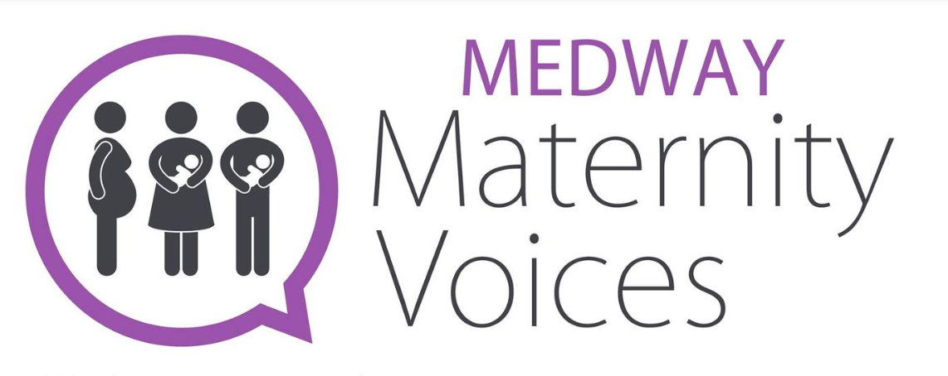









Charities’ and Service Users’ Maternity Continuity of Carer
Network
Notes:
We’re here representing 14 charities, networks or community interest companies, active in the UK, plus a number of individuals who are active on their local maternity voices partnership.
Mary convened the group as an independent – but well connected – volunteer (and member of the Maternity Transformation Programme Stakeholder Council) when is seemed that the programme for implementation of national policy to roll-out maternity continuity of carer was moving forward slowly/under threat.
Jo, and AIMS, The Assoc for Improvement in Maternity Services, have prioritised campaigning for continuity of maternity care. Jo is active on Twitter.

Slide 2

Organising public voices in support of maternity continuity of carer
…When research evidence, maternity policy, implementation tools and planning is not enough
Mary Newburn, Convenor of Charities’ and Service Users’ Maternity Continuity of Carer Network, and Patient and Public Involvement and Engagement Lead for ARC South London/KCL
Jo Dagustun, PhD, AIMS volunteer and campaigner
Mary Newburn, King’s College London, is supported by the National Institute for Health and Care Research (NIHR) Applied Research Collaboration South London (NIHR ARC South London) at King’s College Hospital NHS Foundation Trust. The views expressed are those of the authors and not necessarily those of the NIHR or the Department of Health and Social Care.

Slide 3


October 2021
“Midwifery Continuity of Carer (MCoC) has been proven to deliver safer and more personalised maternity care.
Building on the recommendations of Better Births and the commitments of the NHS Long Term Plan, the ambition for the NHS in England is for MCoC to be the default model of care for maternity services, and available to all pregnant women in England – with rollout prioritised to those most likely to experience poorer outcomes.
Timeframe
Where safe staffing allows and building blocks are in place, this should be achieved by March 2023.”
Revised to March 2024.
‘Default model of care’ target date removed in letter to NHS, 21 Sept 2022, ‘in the light of the continued workforce challenges that maternity services face’.
Source: Delivering Midwifery Continuity of Carer at full scale: Guidance on planning, implementation and monitoring 2021/22 NHS England
Notes:
A quick introduction to the implementation context.

Slide 4
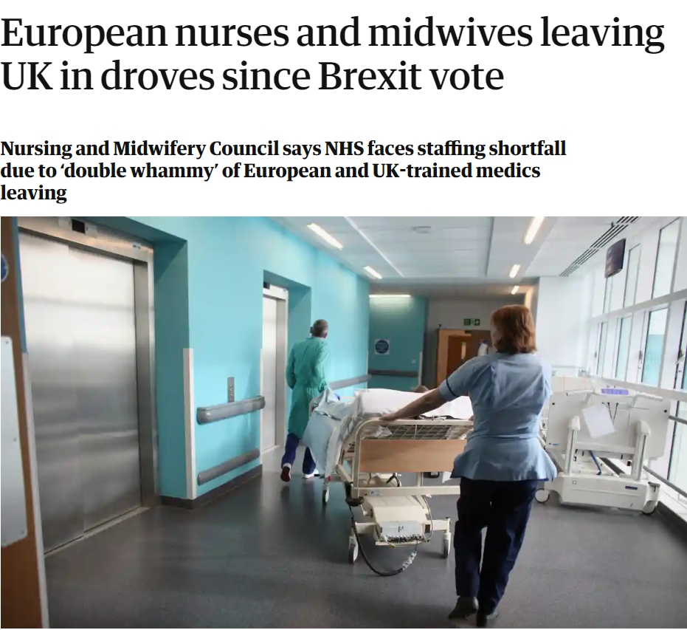
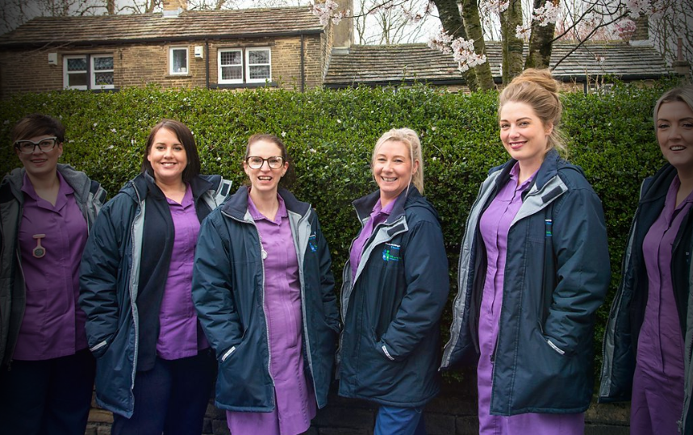




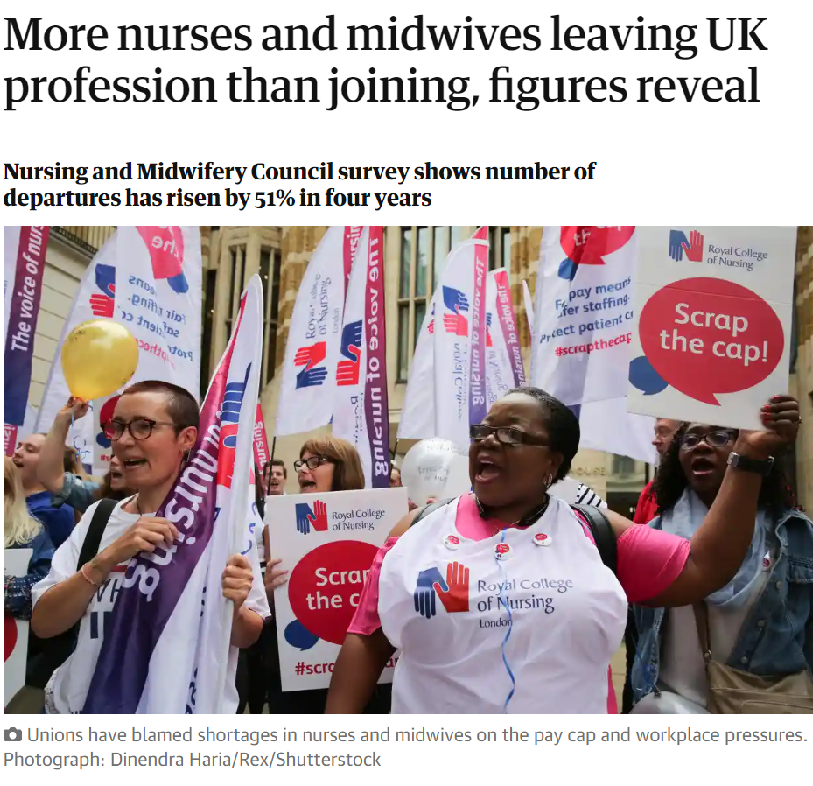

Context
2022
Failings in maternity care - 80 maternity services in England are rated as “inadequate” or “requires improvement” by the Care Quality Commission.
Soundbite headlines … deflect attention from the real cause of this crisis: years of cuts and a failure to prioritise maternal health.
Sarah Davies, Midwife
Salford
2017
2017
2022
Royal Berkshire delivery suite down two-thirds of [midwives] needed to provide safe care, while the midwife-led unit had only one third. Guardian 7.6. 2017
Notes:
But, there have been a lot of sticking points and setbacks.
Political and socio-economic context of the last 6 years has not been easy. Challenged by a staffing crisis, pay freeze, Brexit & Covid pandemic. Ockenden report & now fuel crisis & inflation)
Further contextual information –
RCM says (Aug 2022) England is over 2000 midwives short of the numbers needed, and worsening.
RCM analysis of Government figures shows that England’s maternity services were down a further 600 midwives between 2020 and 2021.
An RCM survey last year showed over half of midwives (57%) saying they were considering leaving the NHS, with fears about the quality of care they were able to give as the main driver.
Another survey of NHS staff in June showed that pay was a major factor pushing many away from the NHS. (Over four out of five NHS health workers surveyed (80%) - including midwives - said they might quit the NHS over concerns about pay. )

Slide 5


The wise woman plants a tree sapling knowing she will never sit under its shade
Chaya
“As an MVP Chair, I've been listening to all the challenges our maternity systems are under and have been a bit reluctant about 'pushing' CoCr as the response has been 'we don't have the staff’.”
“But now I'm feeling we need to change this and start pushing for what women have wanted. I imagine other Chairs are feeling the same.”
Rachael
Agnes
Zenab
Notes:
Individual supporters. We have a good range of members and supporters.

Slide 6
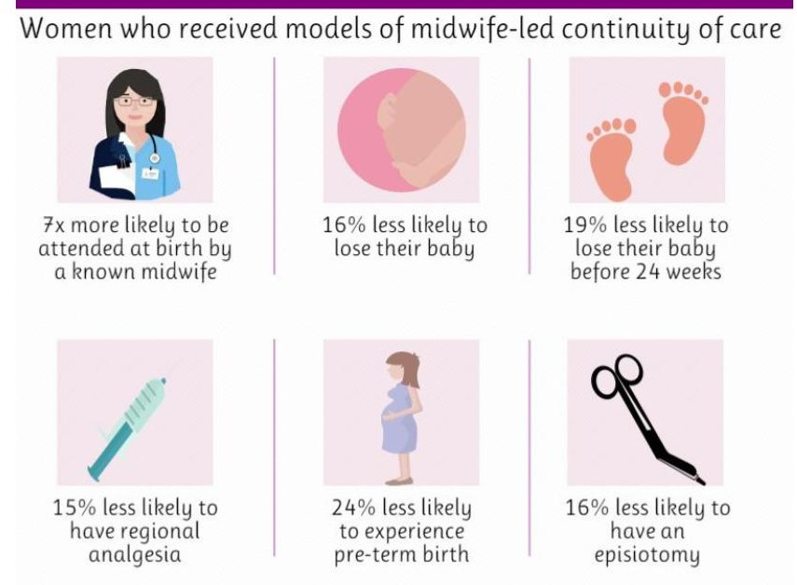
Why do we care?
Research evidence
Cochrane review (Sandall et al , 2016)
GP evidence (Pereira Gray , 2018, 2022)
Women’s experiences (Hunter, 2005; Davison et al 2015)
Women w PMH, fewer PTBs (Cummins et al, 2022)
‘Women who received midwife-led continuity models of care were less likely to experience intervention and more likely to be satisfied with their care with at least comparable adverse outcomes for women or their infants than women who received other models of care.’ (Sandall, et al.)
Notes:
Further background – not for sharing in September due to time constraints:
“There is clearly scope for further research into women's perspectives on their relationships with midwives, as the current evidence is limited and lacks generalisability. It is especially important to ensure that the views and experiences of all women using the maternity services are accessed, particularly women from hard to reach and vulnerable groups.” Billie Hunter, 2005. UK research.
Continuity, relationship, shared philosophy. Davidson, et al 2015. Australia. Women using a private, or independent, miidwife

Slide 7
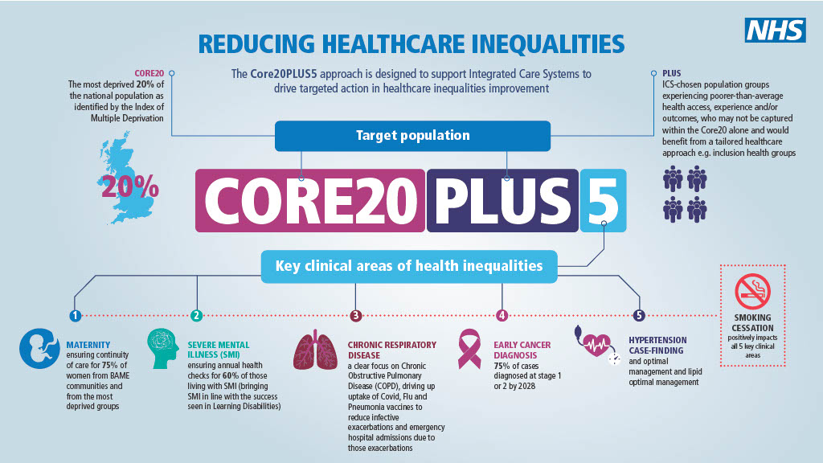
Why is our input needed?
Is our input needed?
National maternity policy for England + NHS England implementation team
Extensive consultation
15 regional drop-ins for service users across England;
38 visits to maternity services;
5192 responses to an online consultation,
two national BirthTank events (N=300)
Improving equity and equality in maternity and neonatal care
Better Births (2016) - Safety and personalisation
Quote for intro
Notes:
Proportionate universalism (Marmot).
MCoC was one of many (estimate 28) recommendations (Saving Babies Lives, Personalisation, joint training, digitalisation, cross-boundary working, etc.) designed to improve experiences and outcomes for babies and for women; part of a comprehensive, integrated plan. Designed to address need for systemic change to make a difference to risks, life chances and experiences. LMSs set up in 144 co-terminus geographic ‘footprints’. Now LMNSs. Other major midwifery changes underway such as change in midwifery supervision arrangements. https://www.youtube.com/watch?v=AelzaSEUjic&ab_channel=Maternity%26MidwiferyForum
Now, Trixie McAree presents MCoC as the horse pulling the cart full of other ambitions. It can help to deliver safer more personalised care. It has not been promoted as an early priority. It has been justled for position.

Slide 8


What makes change happen?
Co-ordinated changes in structures, processes and patterns of behaviour.
NHS England Sustainable Improvement Team and the Horizons Team, NHS England. Publications Gateway Reference: 07914 NHS England, 2018
Notes:
Do we have a place? Are we needed? Instinct says ‘yes’. What about theory?
Consider social movement change - How can we create change efforts that surge with energy, that are an unstoppable force for positive change? How do we mobilise all the people who could and should contribute to our change efforts: people who use services, their families, partners in the wider community, our workforce, and the leadership community?

Slide 9
What makes change happen?
Large scale
• A shift in power and a more distributed leadership
• Comprehensive and active engagement of stakeholders
• Mutually reinforcing changes in multiple systems and processes.
Consider social movement change
How can we create change efforts that surge with energy, that are an unstoppable force for positive change?
How do we mobilise all the people who could and should contribute to our change efforts?
Deeply challenging to current mental models and ways of thinking (it feels uncomfortable and evokes some push-back from others because it is so different from the usual)
Notes:
Large-scale change is “Widely spread across geographical boundaries, multiple organisations, or multiple distinctive groupings” (for example, Obstetricians, midwives, commissioners, senior managers, trust board members)
It’s something of a mystery, a ‘wicked’ problem.

Slide 10
10 key principles of large scale change
A clear VISION – appealing to many; stimulating passion.
Identification and communication of key themes that people can relate to.
Expect complexity – Does complexity energise you?
Frame the issue to energise and mobilise – Needed: multiple leaders from across the system, and at all levels, who are drawn to the vision. They must engage and commit their will and energy to the effort of achieving the VISION.
Mutually reinforcing change – may seem chaotic and out of control.
Keep refreshing the story and attracting new, active supporters.
Emergent planning – Flexibility, adaptability & engagement of others are key.
Aim for ‘distributed leadership’ – role model shared leadership, be creative.
When LSC is done well, sustainability is the natural by-product.
Too many leaders run out of steam. How will you maintain your energy?
Notes:
So, what has been happening in England. Jo is now going to share some key milestones.
Change, in terms of the vision, only happens the first time about 15% of the time.

Slide 11
Continuity of carer implementation milestones (pre-Covid)
2016
Better Births published
Delivery target ‘by 2020’
2017
Implementation guidance
2018
Metrics &
contracts guidance
2019
Long term plan &
NHS contracts
MCoC training provided to NHS trusts
2020
NHS contracts
NHS Resolution scheme
Aim was ‘for most’ women to have midwifery continuity of carer by March 2021

Slide 12
Continuity of carer implementation milestones, Autumn 2000 onward
Autumn 2020
Trixie McAree,
National Clinical Lead, appointed
Summer 2021
Select Committee scrutiny
Autumn 2021
Updated guidance
Core20+5
Spring 2022
Ockenden Report
Regional MCoC MWs
Summer 2022
Independent evaluation tendering
Summer 2022
NHS trusts submit MCoC plans to regional teams
Aim for full-scale delivery of midwifery continuity of carer by March 2024
Notes:
(T)he Health and Social Care Committee provided clear support in its July (2021) report for the importance of MCoC, and the strength of its evidence base, it highlighted longstanding challenges in local implementation, and the need for sufficient resources and support for LMS to deliver it.
In individual submissions to the committee, several stakeholders highlighted the need to ensure that the transition to MCoC does not put undue pressure on midwives or compromise safe staffing levels across any part of the wider maternity service.
In response, a national roundtable event was held (also July 2021) to review evidence, progress to date, and to listen to the concerns of a broad range of stakeholders. Three broad themes emerged:
• provision of safe and personalised care
• engaging midwives and obstetricians
• resources.
Source: Delivering Midwifery Continuity of Carer at full scale: Guidance on planning, implementation and monitoring 2021/22 NHS England

Slide 13
‘Building blocks’ toolkit & online tools
Building block | Develop and submit a detailed plan, with a timetable for full, sustainable, implementation | Building block
1 | Safe staffing - Agree safe staffing levels and a recruitment plan (using Birth Rate Plus) | 7 | Linked obstetricians – engagement and involvement
2 | Use NHSE planning spreadsheet – to be automated for ease of use by Nov 2022 | 8 | Standard operating policy (SOP) - To pass through the maternity services governance process
3 | Communication and engagement - with MDT staff; co-production with diverse communities. | 9 | Pay - no MW should be financially disadvantaged
4 | Skill-mix - review of MWs/preceptors, MSWs & liaison with labour suite coordinator (band 7) | 10 | Estate and equipment – space, digital access
5 | Training - Each midwife to have a personal training needs analysis (TNA) | 11 | Evaluation processes - a system for local , regional & national data-capture and reporting..
6 | Team building - allocate time in the working week | 12 | Review – Formal review by trust Board, LMS, region and national teams.
Readiness to implement and sustain MCoC
Source: Delivering Midwifery Continuity of Carer at full scale: Guidance on planning, implementation and monitoring 2021/22 NHS England
Notes:
We want to acknowledge all the work done by NHSE, Jacqueline Dunkley-Bent, Trixie McAree and others in addressing operational issues raised by Health and Social Care Committee and the round table that followed.
NHS trust MCoC Plans to regional teams by Aug 2022.

Slide 14

Charities and service users
One community of interest from diverse primary interests – a powerful network
Reducing stillbirth and neonatal death
Improvement in maternity services, e.g. pregnancy outcomes and postnatal care
Improve outcomes for Black and Brown women and families / tackle racism and discrimination
Address social complexity and deprivation
Women’s rights/human rights/LGBTQ rights
Support for physiological birth
Improve perinatal mental health
Reduce birth trauma
Optimise start in life for babies

Slide 15

Our actions
Policy positions, Birthrights and AIMS
Meetings - Royal College of Midwives, Best Beginnings, White Ribbon Alliance, AIMS
Liaison & evidence - Donna Ockenden, MPs, ministers, Health & Social Care Committee, NHSE Stakeholder Council, Maternity Voices
All Party Parliamentary Groups on Baby Loss and Maternity, Sands Birthrights
Social media, AIMS, Birthrights, Sands, Mary N
Impact of staffing shortages survey on the quality & safety of maternity care, NCT
Notes:
As a network, we’re not marching in the streets, though some of us have ‘marched with midwives’ (Nov 2021). This is what we are doing.

Slide 16
Key points and conclusions
Our commitment
We support implementation of MCoC.
We both recognise the need to tackle midwifery shortages and the need for implementation of MCoC.
Network Strengths
This Network draws us together - interests, awareness, knowledge and skills.
“Build collaborations … based on what you agree on.” Gene Declercq
Critical friend
Coordinated advice to NHSE’s MCoC team.
Recommendations
Agree on a theory of change model and review progress
  Under-resourced
Aim for more distributed leadership
  We are a resource
Communicate, communicate, communicate
  Identify a website, use video…
  Evidence for all
  Progress updates, positive stories.
Notes:
We feel that the model badged NHS England has much to recommend it.

Slide 17
References and further reading
Cummins A, et al Does midwifery continuity of care make a difference to women with perinatal mental health conditions: A cohort study, from Australia Women and Birth (available online) https://www.sciencedirect.com/science/article/pii/S1871519222003055
Fernandez C POPPIE: midwifery continuity of care for women at increased risk of preterm birth in south London https://blogs.kcl.ac.uk/clahrc-south-london/2018/09/25/poppie-midwifery-continuity-of-care-for-women-at-increased-risk-of-preterm-birth-in-south-london/
Harris J, Newton M, Dawson K and Sandall J Implementation Science in Maternity Care in Squaring the Circle: Normal birth research Theory and practice in a technological age. Eds: Downe S and Byrom S. Pinter and Martin. (2019)
Harris JM, Watts K, Page L, Sandall J (2020) Reflections on an educational intervention to encourage midwives to work in a continuity of care model – exploration and potential solutions. Midwifery 88: 1027– 33.
Hunter B. The importance of reciprocity in relationships between community-based midwives and mothers. Midwifery 2006; 22(4): 308.
Morris ZS, Wooding S, Grant J The answer is 17 years, what is the question: understanding time lags in translational research. J R Soc Med. 2011 Dec;104(12):510-20. doi: 10.1258/jrsm.2011.110180. PMID: 22179294; PMCID: PMC3241518.
NHS England “Better births: improving outcomes of maternity services in England. A five year forward view for maternity care.” In: NHS England U, (ed), 2016.
Pereira Gray DJ, Sidaway-Lee K, White E, et al Continuity of care with doctors—a matter of life and death? A systematic review of continuity of care and mortality BMJ Open 2018;8:e021161. doi: 10.1136/bmjopen-2017-021161
Sandall J SH, Gates S, Shennan A, Devane D Midwife-led continuity models versus other models of care for childbearing women,. Cochrane Database of Systematic Reviews 2016; (4).
Sidebotham M, Fenwick J, Rath S, Gamble J Midwives' perceptions of their role within the context of maternity service reform: An Appreciative Inquiry. Women Birth. 2015 Jun;28(2):112-20. doi: 10.1016/j.wombi.2014.12.006. Epub 2015 Jan 9. PMID: 25582894.

