Slide 1
Being heard, not, “seldom heard”: democratising research with diverse communities during the Covid-19 pandemic: https://blogs.bmj.com/bmj/2020/06/02/being-heard-not-seldom-heard-democratising-research-with-diverse-communities-during-the-covid-19-pandemic/ Josephine Ocloo

Slide 2
Covid-19 Mortality in the UK
Stark disparities in mortality rates/health inequalities for particular groups: e.g. BAME communities, disabled people, those on lower incomes, those living in the most deprived areas, care home residents, Men and those in the poorest health etc.
People from a black ethnic background are at the greatest risk of death involving Covid-19 than all other ethnic groups. black men 3 times more likely than white men to die & black women more than twice as likely to die as white women (ONS June 2020).
Groups that already face considerable inequalities in health may now see this get much worse.
Notes:
Say briefly who you are and Why you and Savi thought it so important to organise the event at such short notice
Both longstanding advocates of D&I and PPIE
Watching the Covid pandemic play out and its impact on a diversity of vulnerable groups and the unequal impact

Slide 3
Democratising Involvement: “Being heard not seldom heard”.
Yet these groups are the least likely to be involved in the design and implementation of research. This reflects wider patterns of public sector involvement which show that those most likely to be involved are older/from white ethnic groups/higher socio-economic backgrounds.
This context exists despite long-standing calls for more equal partnership models to involve diverse groups in research/health and care delivery.

Slide 4
Impact of COVID-19 on diverse population groups in South London
Given a key focus of the ARC’s work is about addressing local health inequalities, the emerging evidence on the disproportionate impact of Covid-19 provided an important opportunity reason to organise a community zoom meeting on 27 April this year.
The aim was to gather evidence on the unequal impact of Covid-19 on people with protected characteristics’. [age, disability, gender reassignment, race, religion or belief, sex, sexual orientation, marriage and civil partnership and pregnancy and maternity], as covered under the Equality Act 2010.
Then submit this evidence into the UK Parliamentary call for evidence of the impact of coronavirus on these groups.

Slide 5
52 People attended the Community Zoom event:
Pregnant women facing fear/isolation: Doulas highlight verbal/ emotional abuse of some BAME women driven by racist attitudes*
BAME participatants with higher risks from the virus, fearful of attending outpatients/hospital appts: fearful of going to get medication/blood tests/high levels of distrust in health system
People with disabilities/learning difficulties worried about discrimination/transport/whether they would be treated fairly in hospitals with access to resources/ventilators
Digital exclusion preventing many vulnerable people accessing primary care/benefits
Loss of face-to-face services/detrimental impact on MHSU’s: e.g. /BAME/LGBT+ groups have higher rates of poor MH/worse access, closure of services have a particular impact
Notes:
We held a zoom event at very short notice for groups across the protected characteristics: [age, disability, gender reassignment, race, religion or belief, sex, sexual orientation, marriage and civil partnership and pregnancy and maternity], as covered under the Equality Act 2010. This showed that diverse groups want to be involved and the issue to address is about structural barriers to inclusions
2. Black women are currently 5 times more likely than White women to die in childbirth

Slide 6
What Did We Learn from the Zoom Event:
It’s possible to organise an event at short notice & get diverse involvement: diverse groups want to be Heard, nor “Seldom Heard”.
It is important that the objectives of community events are not just meeting the interests of dominant groups/organisations & are also action oriented
Diverse communities have important things to say about health/social care research/service delivery because of their lived experiences/expertise.
Some communities may not want to work with health & social care or research institutions because of distrust that has built up over a long period of time because of exclusionary practices. We need to rebuild Trust.

Slide 7
What Action Can We Take:
We need to make conversations about equality/diversity/exclusion central to discussions about PPIE.
Look at how EDI is addressed in the structures of our work for public members/researchers
Given the Covid-19 pandemic we need to democratise research spaces so groups most affected by Covid-19 can be involved both as research participants/PPIE
How can these structures/spaces be more inclusive? E.g what is our diversity strategy for inclusion in grants, recruitment of research participants, public involvement activities incl payment for time/travel, how people’s views are gathered, in what settings & acted upon.
How do we reach out to groups and build trust? Enable individuals who have been traditionally excluded/faced discrimination to have leadership positions.
Notes:
*Many research project disproportionately recruit white participants even in areas most affecting BAME groups

Slide 8
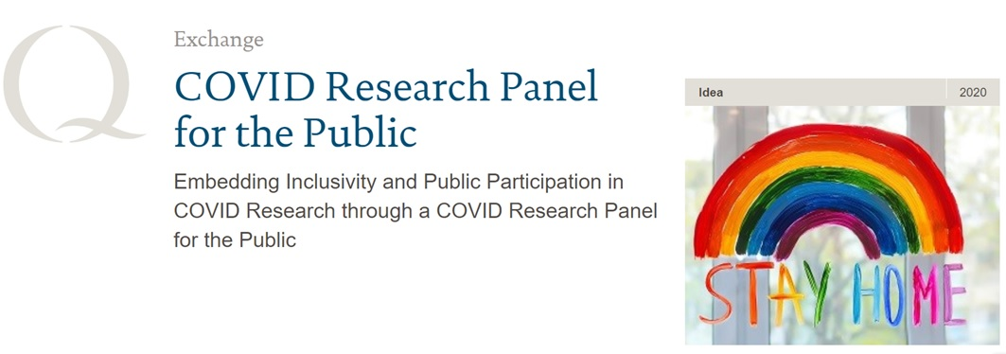
ARC Covid Research Panel for the Public

Slide 9
Setting Up A Public Involvement Covid-19 Research Panel:
Enable feedback/input from the public into all ARC Covid-19 research
Composition: members of community groups/service users/carers
Monthly meetings for panel members to give input/feedback with different ARC Covid research projects presenting to the panel
Some meetings could be longer with an open session first for members of the public wanting to attend/with the panel meeting afterwards
Test how the panel works write up findings with panel members as lived experience researchers

