Slide 1
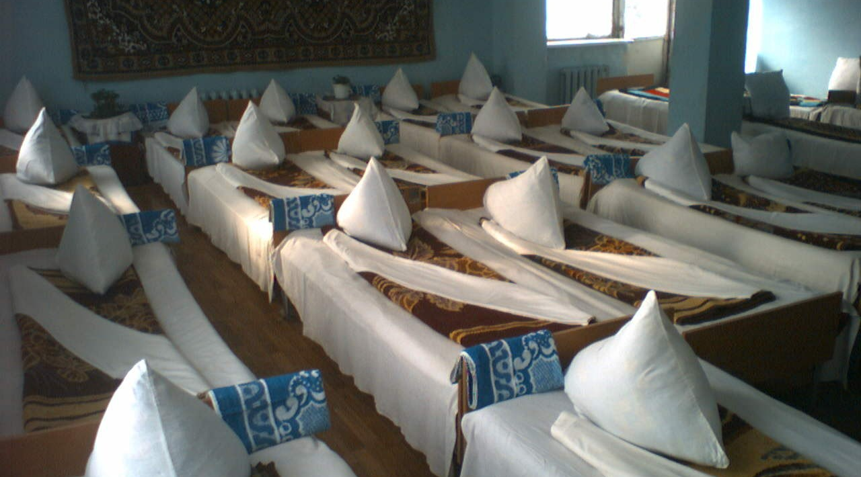
Reforming mental health care
Prof. Robert van Voren

Slide 2
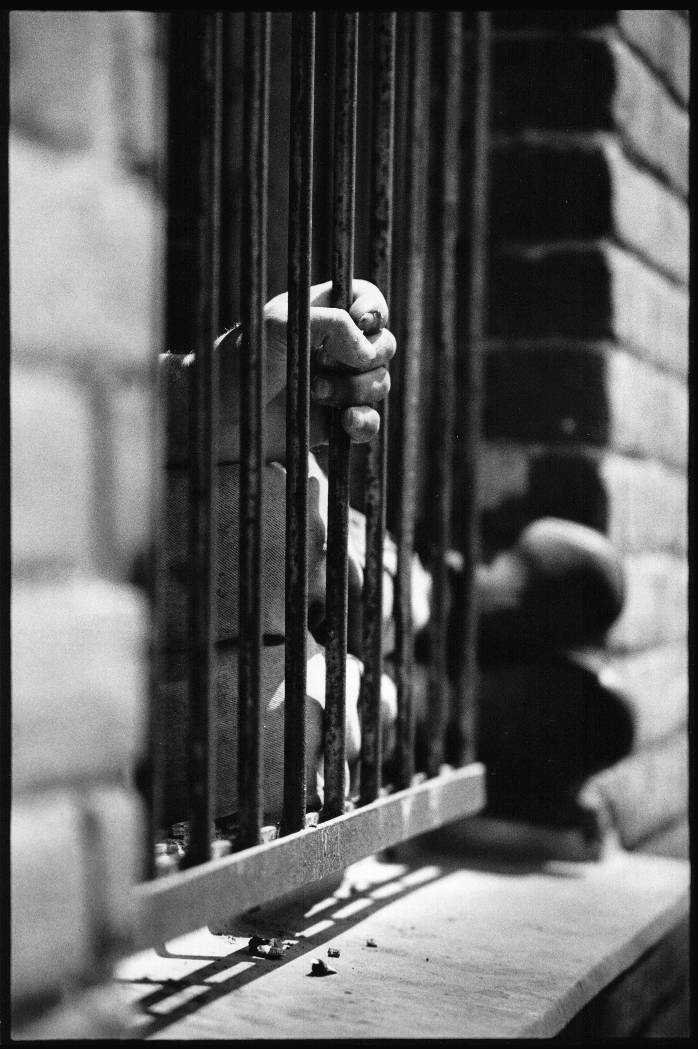
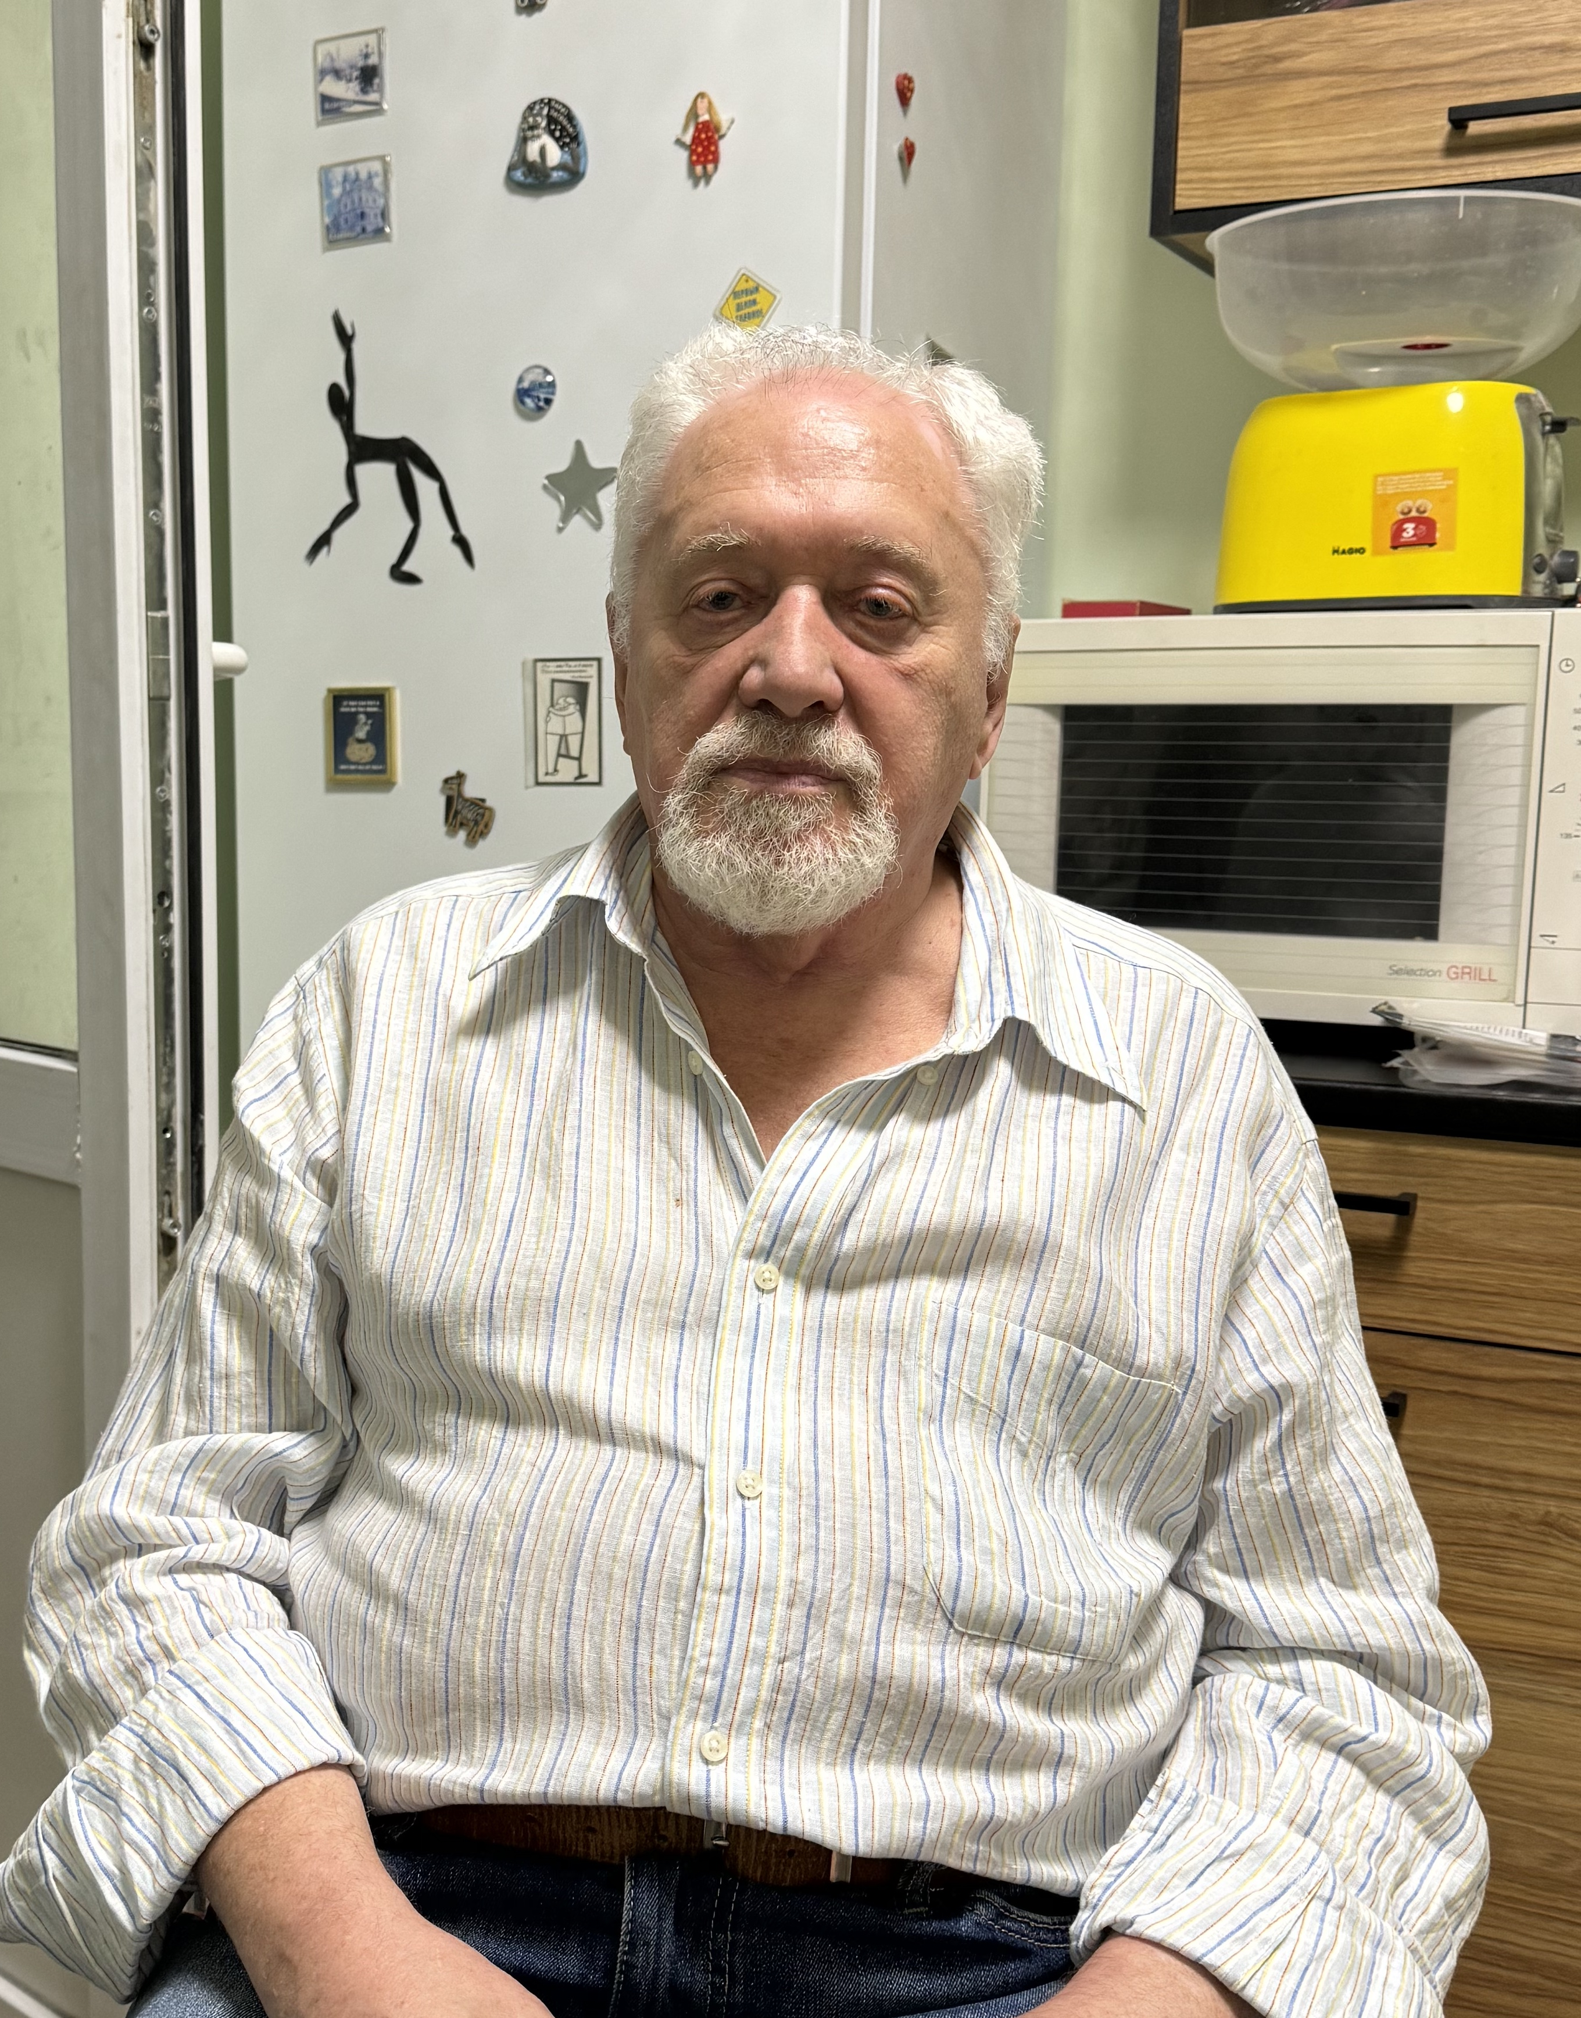
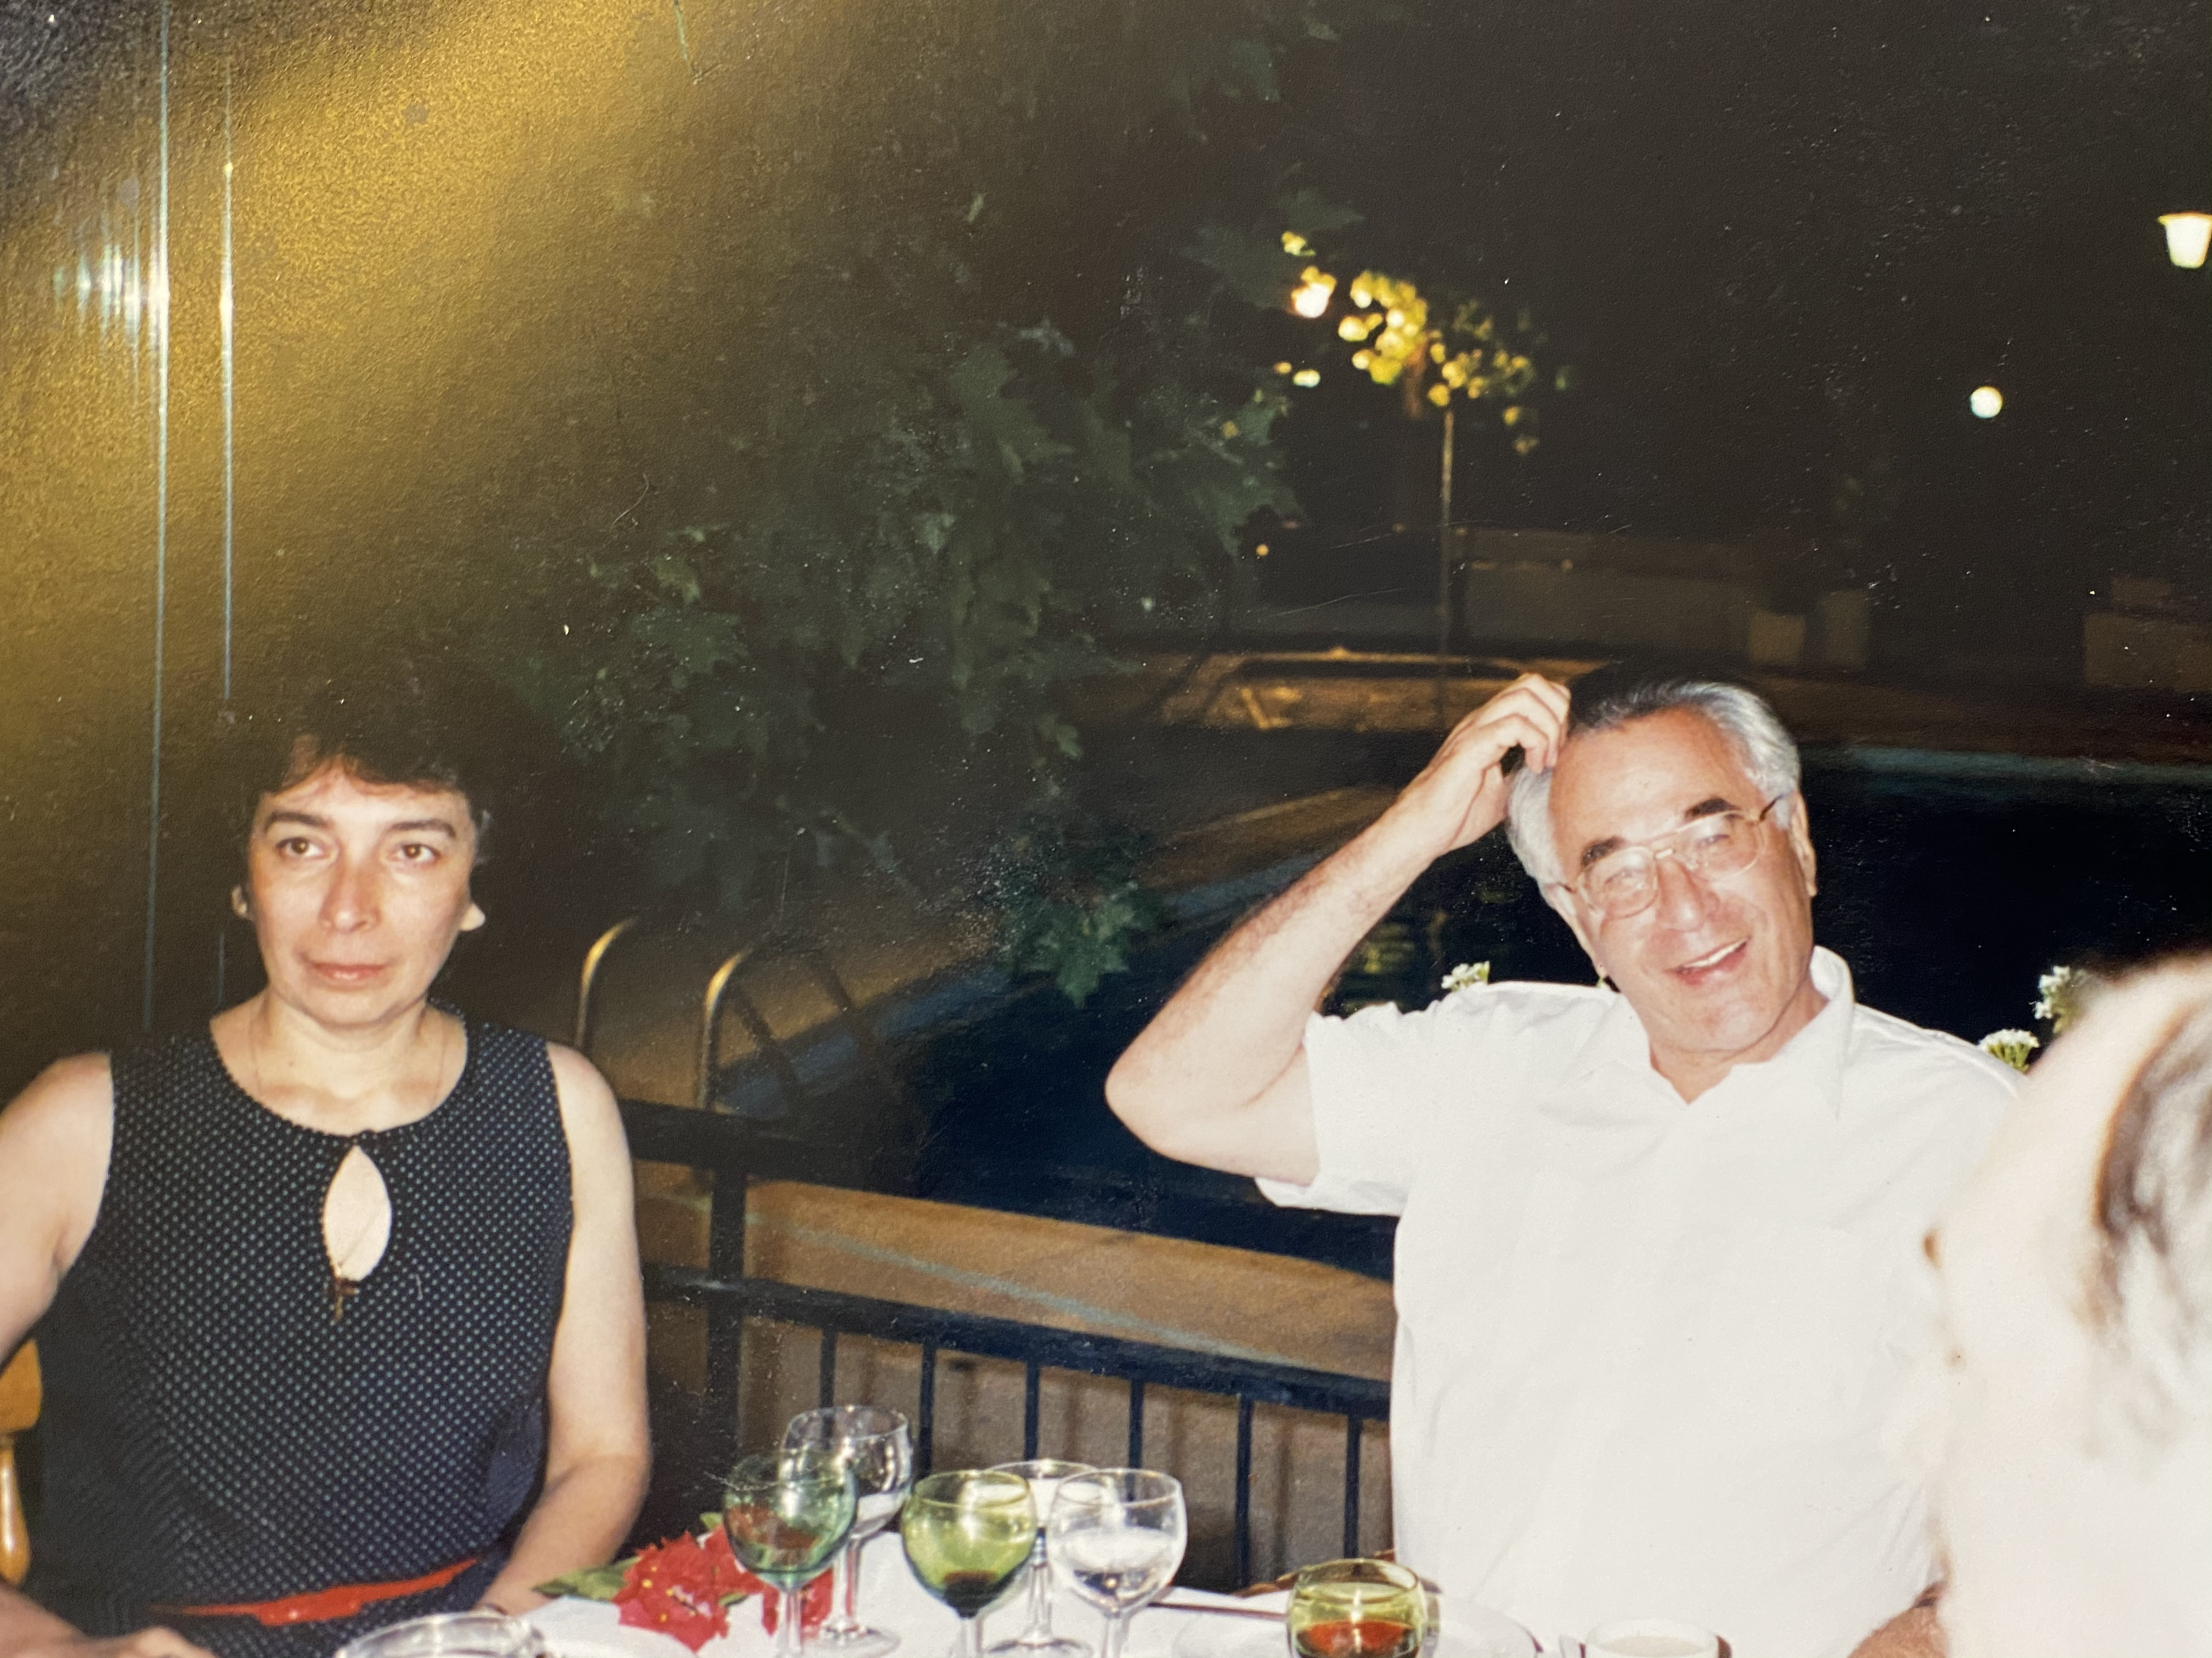
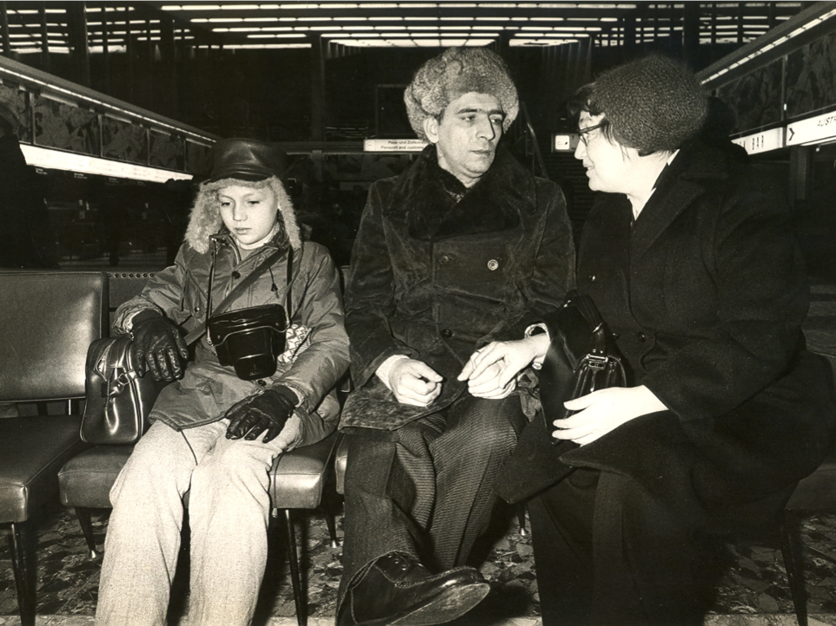
Starting from scratch
Entry point: dissidents incarcerated in psychiatric institutions for political reasons
1989-1991: discussions in the kitchen of Semyon Gluzman with Yuri Nuller (St. Petersburg), Svetlana Polubinskya (Moscow) and Gluzman himself (Kyiv)
1991-1993: humanitarian aid

Slide 3
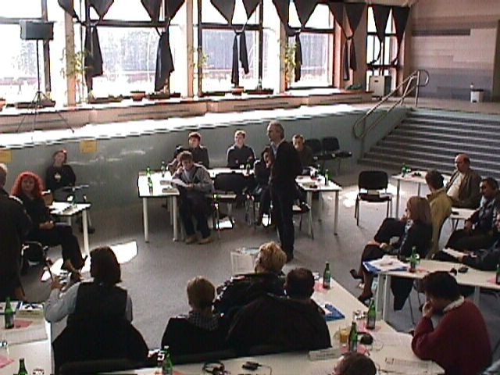
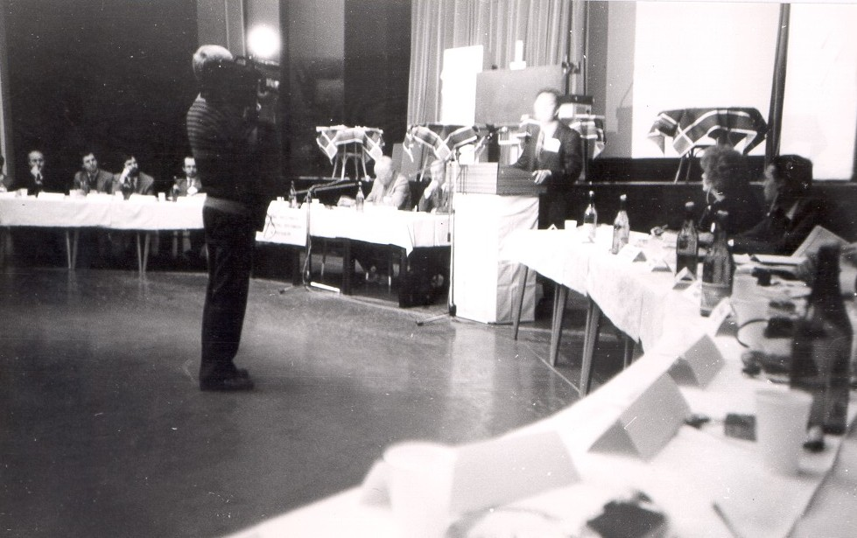
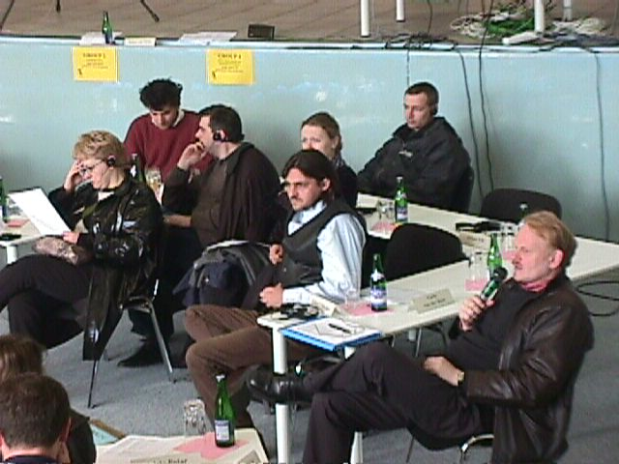
1993: first Meeting of the Network of Reformers in Psychiatry in Bratislava
1994: start of sub-Networks: substance abuse, psychiatric nursing, psychogeriatrics, user & relative involvement, NGO-building, forensic psychiatry & prison mental health
Meeting Points at WPA Congresses and other international gatherings
Bratislava 1993

Slide 4
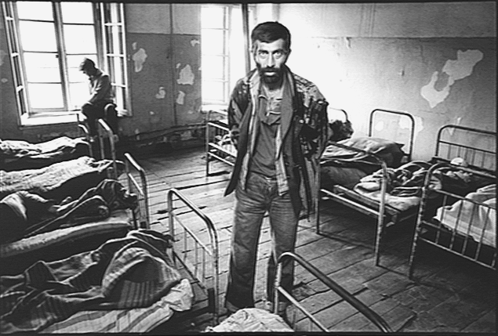
Soviet psychiatric system
Highly institutional
Biologically oriented with mian treatment with neuroleptics (aminazin, haloperidol, majeptil) plus insuline shock therapy and sulphozine
Focused on ostracizing persons with chronic mental illness from society: psychoneurological internats
Massive human rights violations
“Do not hang outside your dirty linnen!”

Slide 5
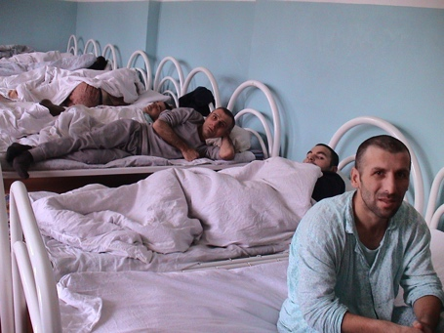
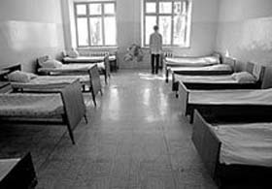
“In many of the hospitals, patients have only 2-2.5 square meters at their disposal, although the norm is 7 square meters. […] Cases in which patients are sleeping in pairs in one bed and even on the floor are not rare. In several hospitals, double bunk beds have been made.”
“As a result of overcrowding of hospitals, sanitary-hygienic norms are being violated, unacceptable conditions are created for living, diagnosing and treatment of mentally ill persons as well as for the work of the personnel. Often patients are discharged prematurely.”
Report to the Central Committee of the CPSU, February 18, 1972

Slide 6
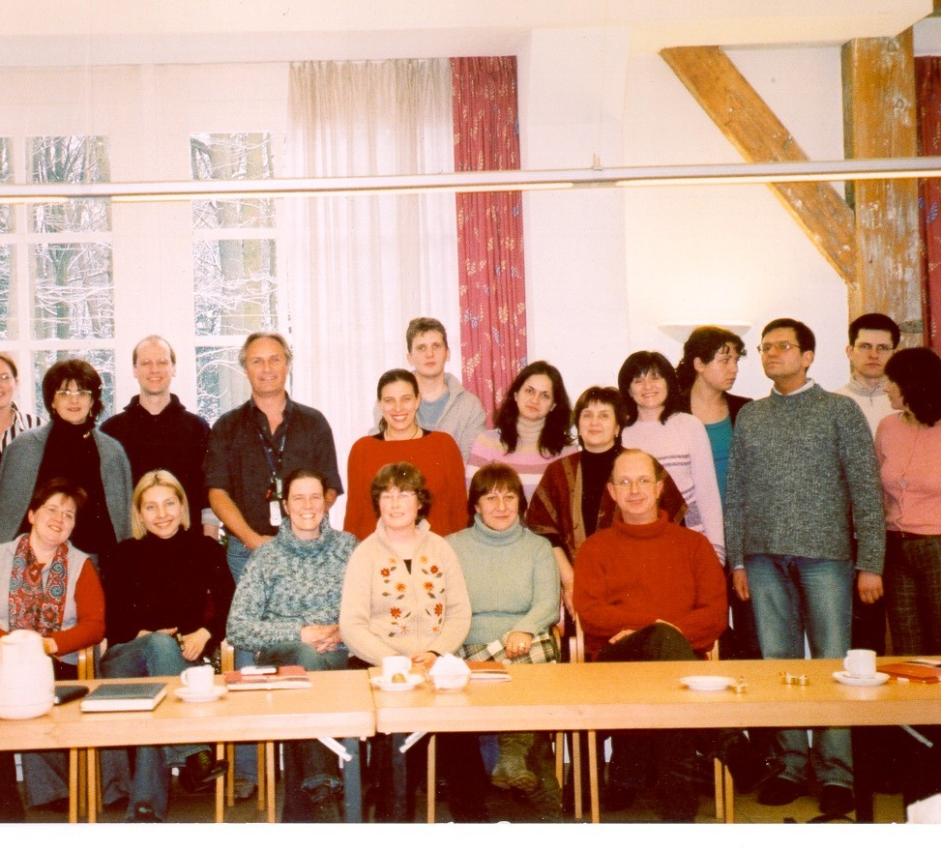
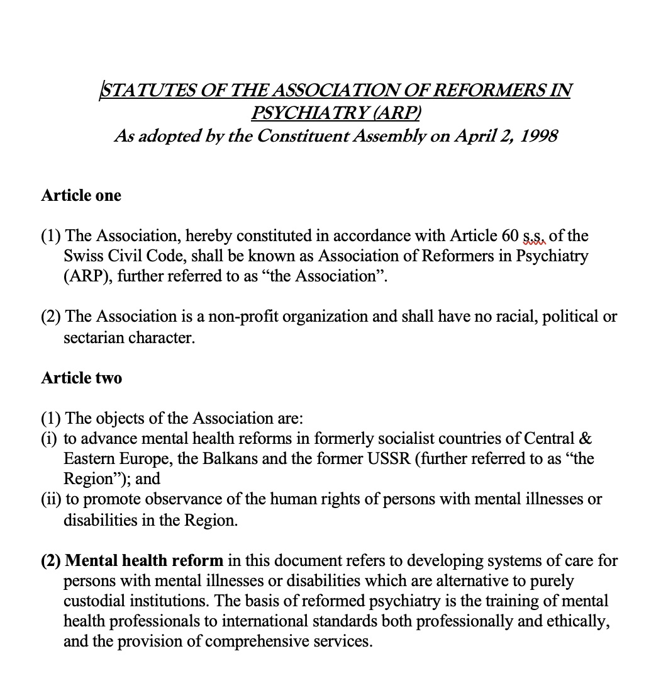
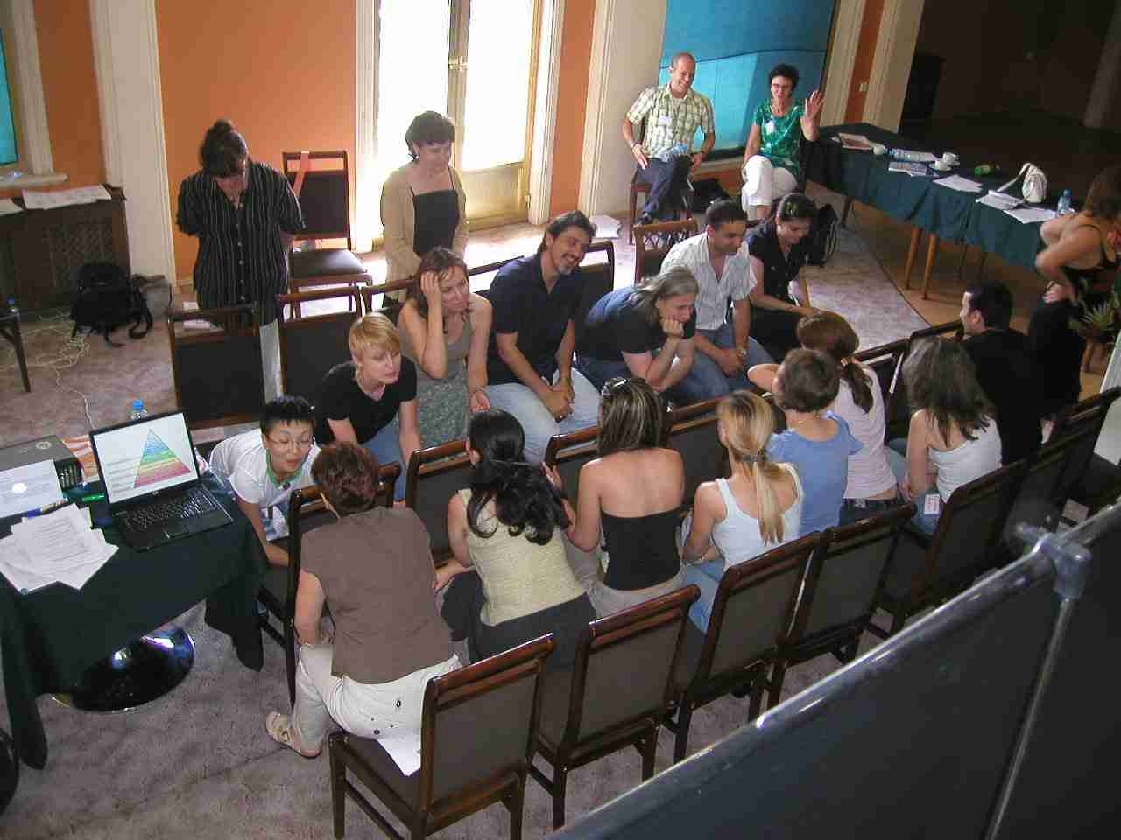
Where to start?
Pilot projects to initiate new approaches
Training programs – both extracurricular and at universities
Reconstruction, refurbishment, upgrading of services
Development of NGO’s, involvement of users and relatives
Policy development
Advocacy and human rights monitoring
Anti-stigma campaigns
Literally hundreds of projects, Dutch Foreign Ministry alone financed 33 projects with total value of 10 million euro

Slide 7
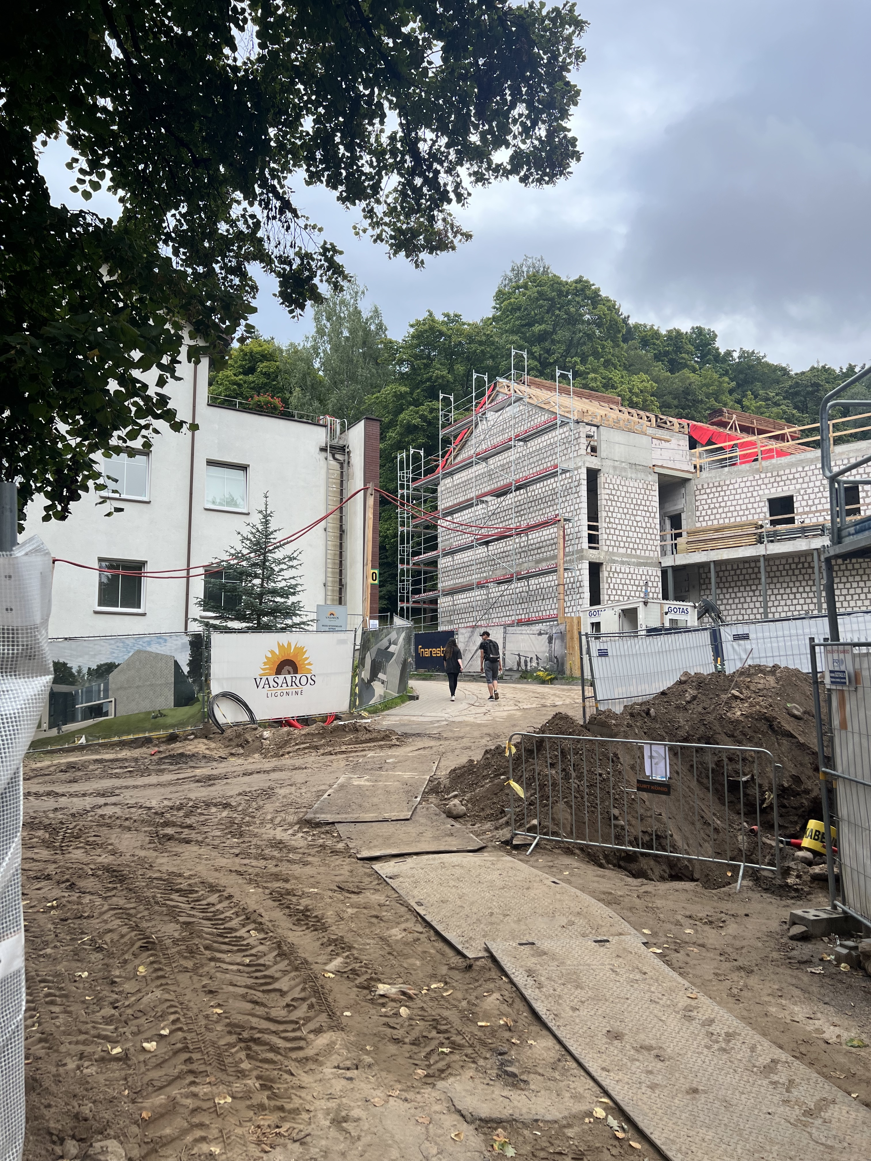
Gradually development of a systemic deinstitutionalization process
Development of Psycho-Social rehabilitation programs (BG, GEO, LT, SK, SRB, UA etc.)
Supported employment and protected living environments (LT, BG, GEO, UA)
Development of consecutive chains of care (BG, GEO, LT, SK, SRB)
Development of reintegration programs for forensic psychiatry and prison mental health (GEO, LT, RUS, UA)
later also programs in Africa, Indochina and Sri Lanka)
2004 plan implemented in 2024

Slide 8
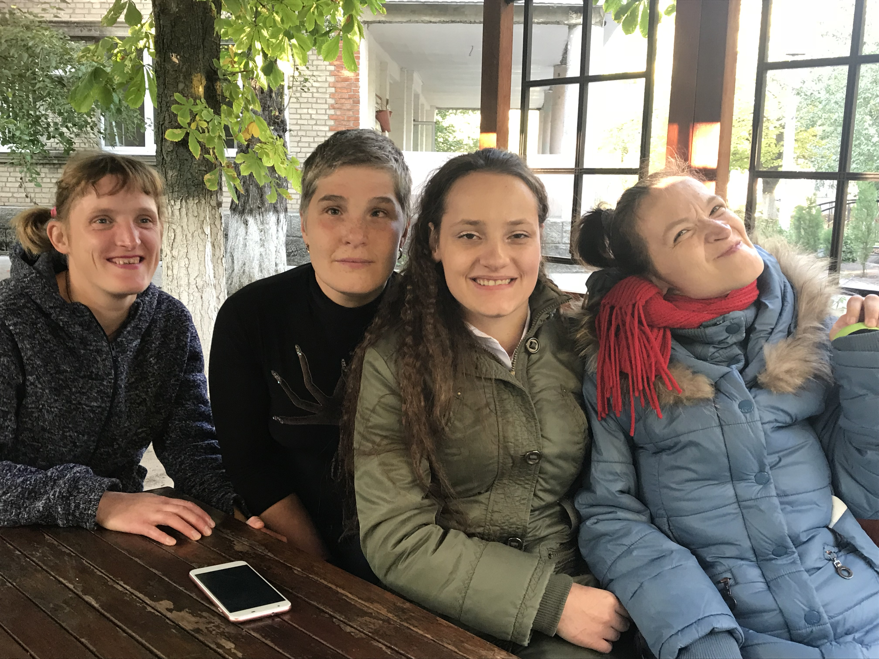
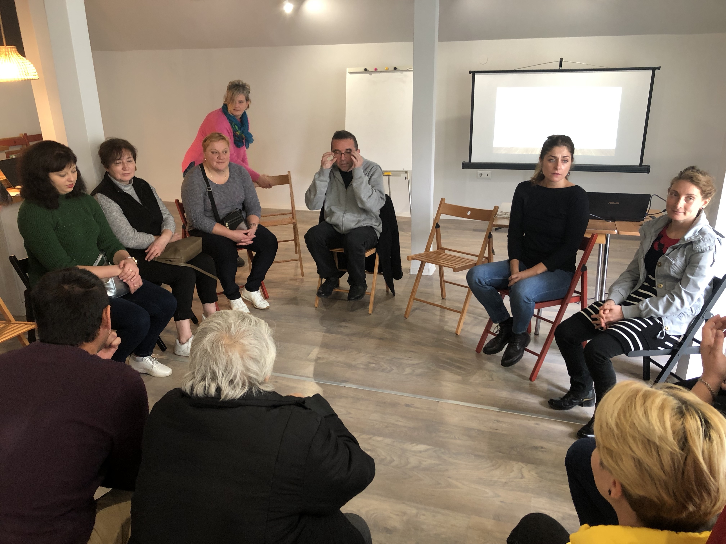
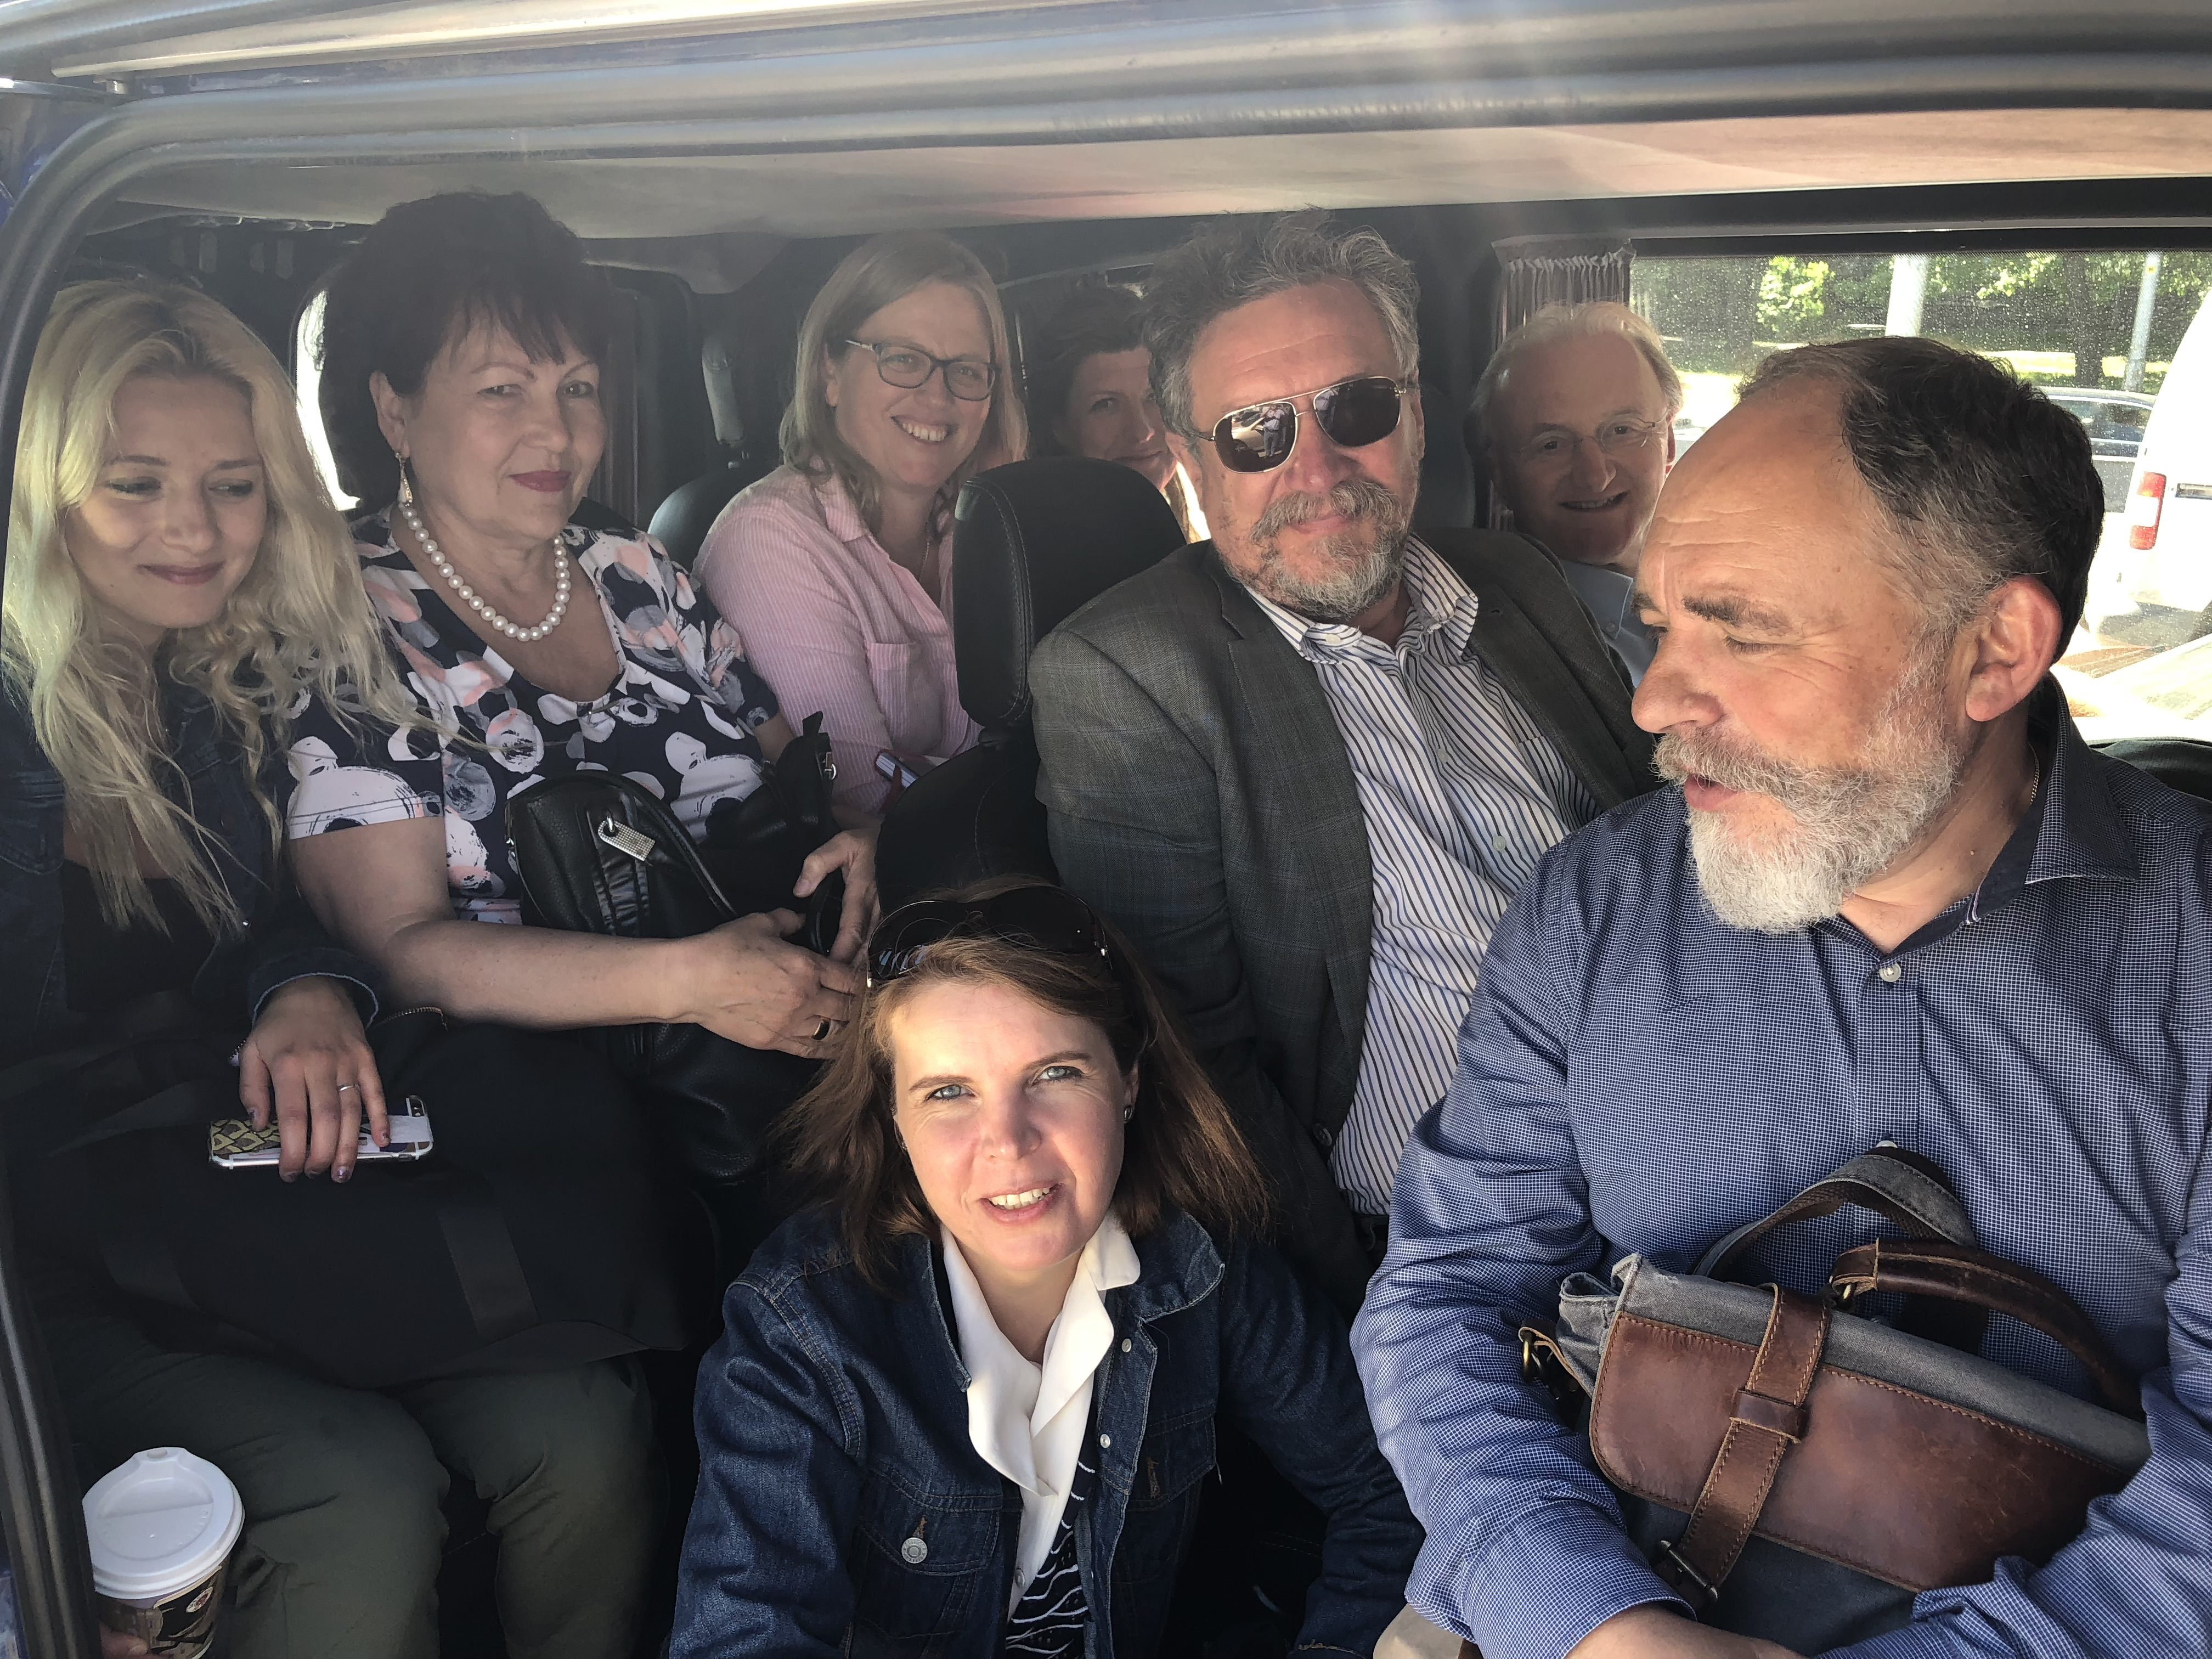
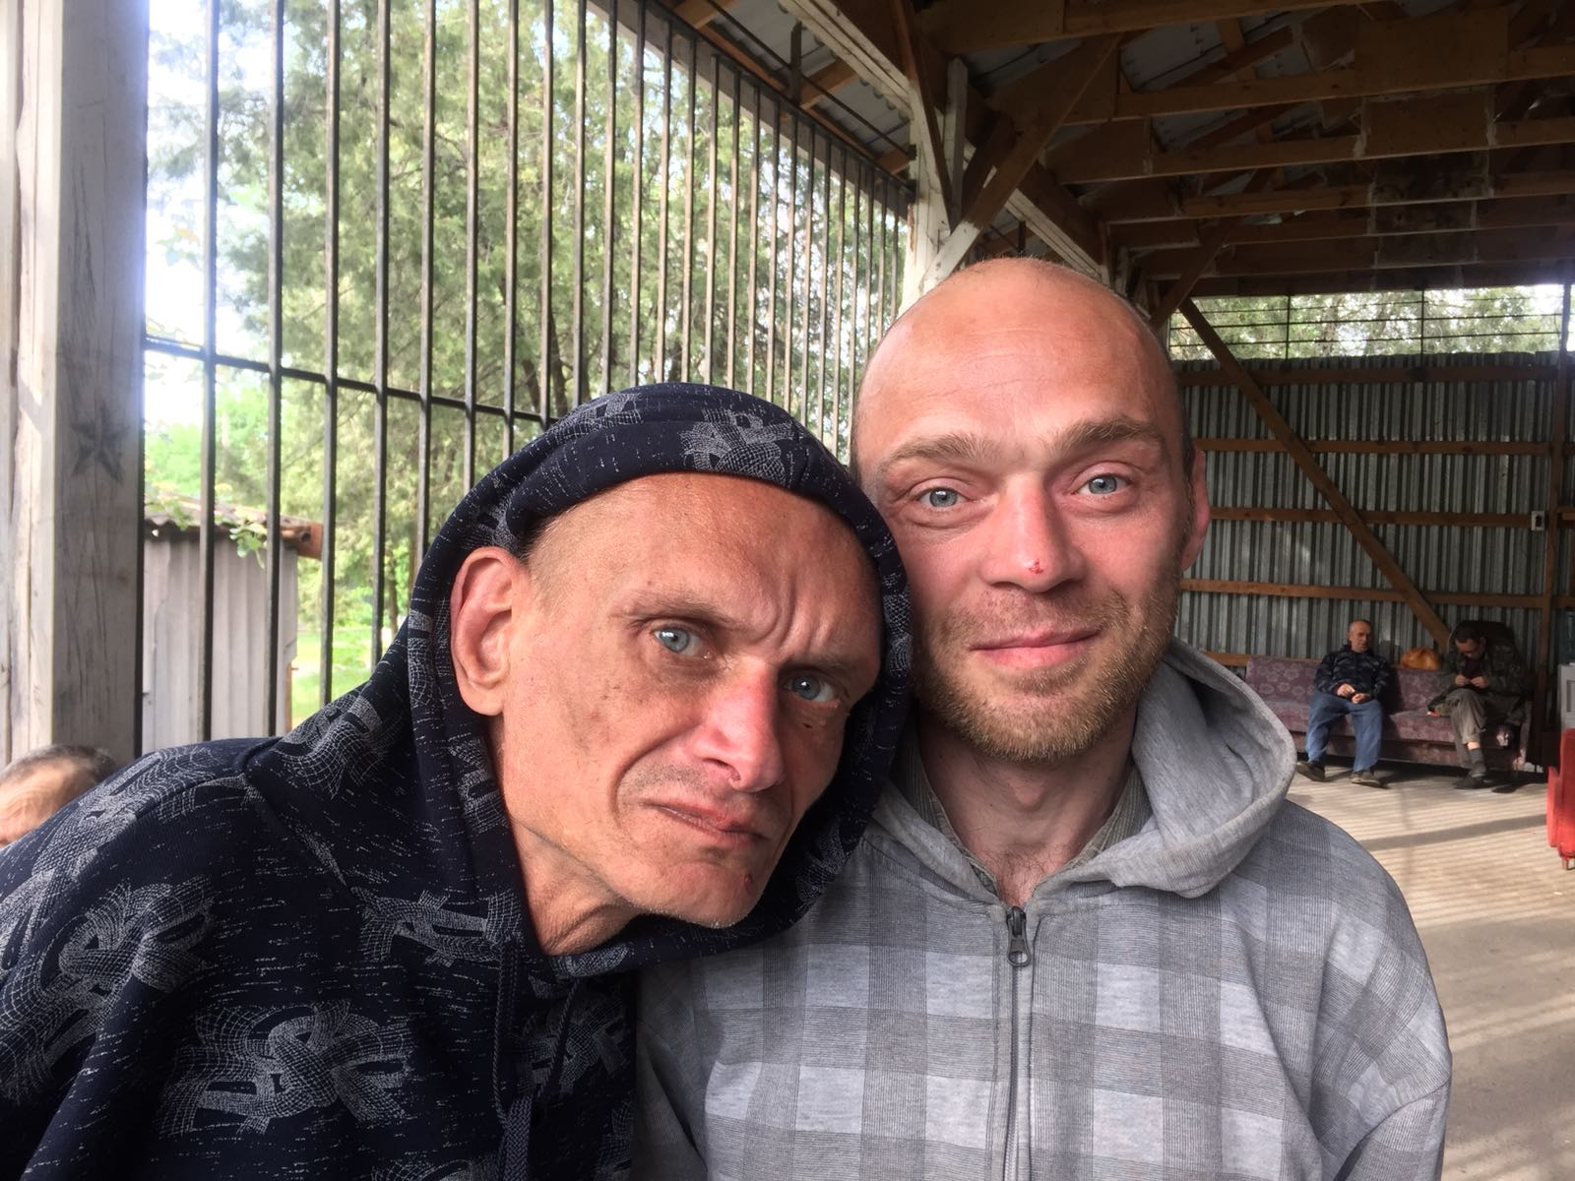
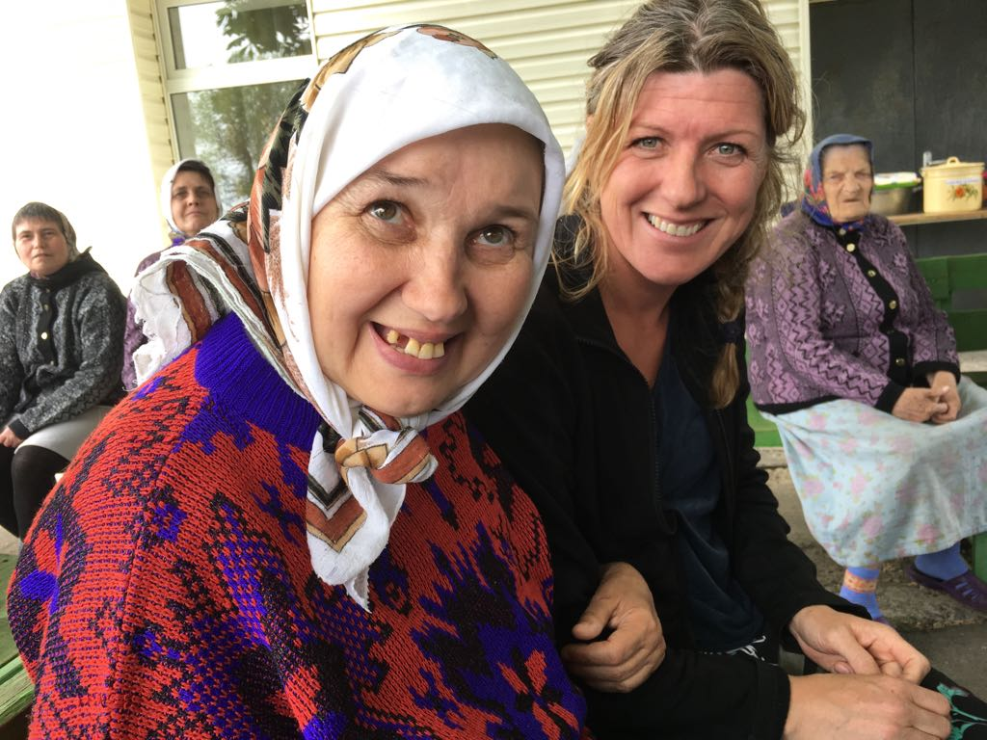

Slide 9
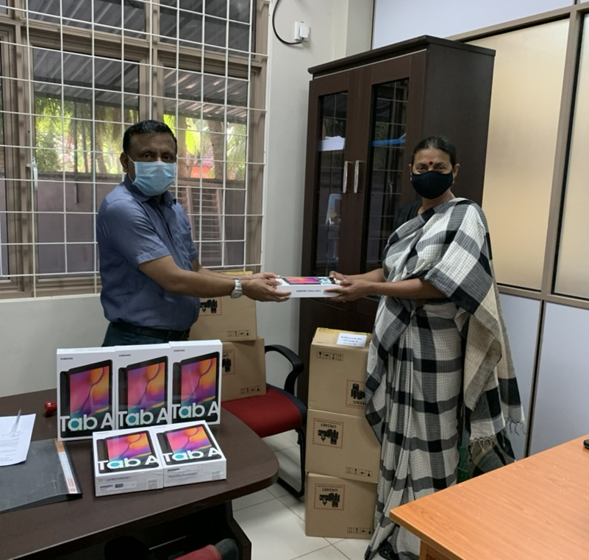
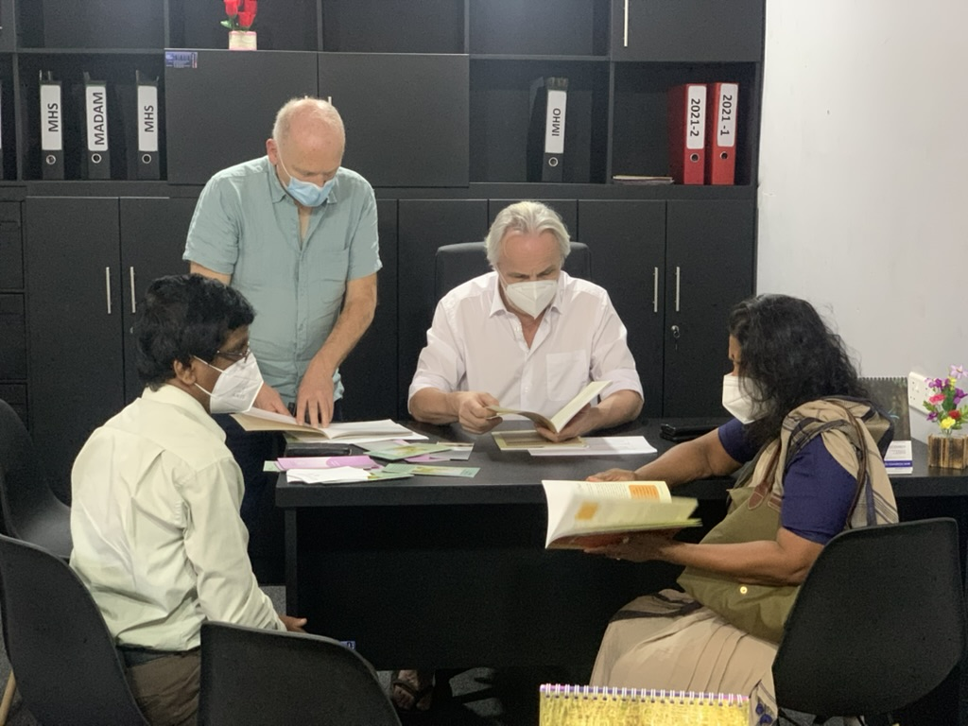
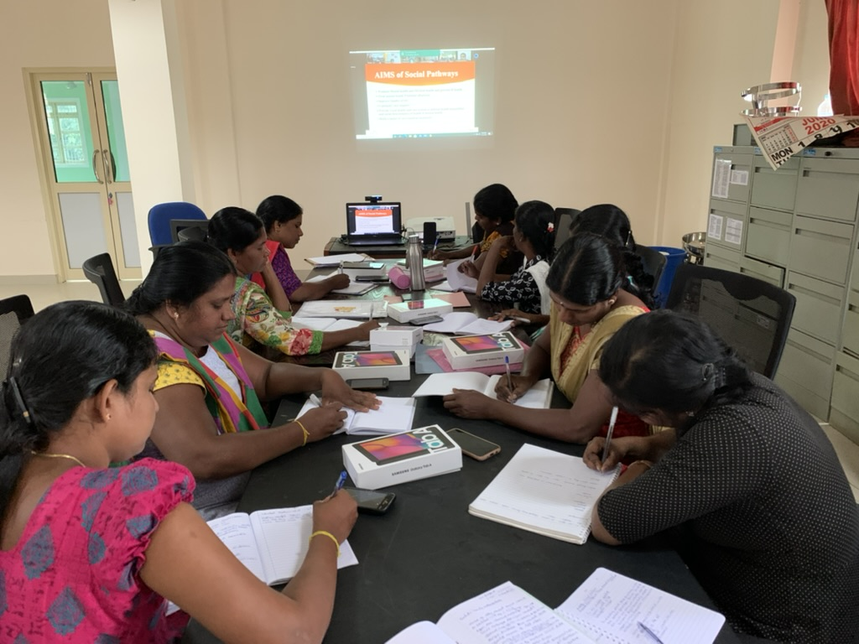
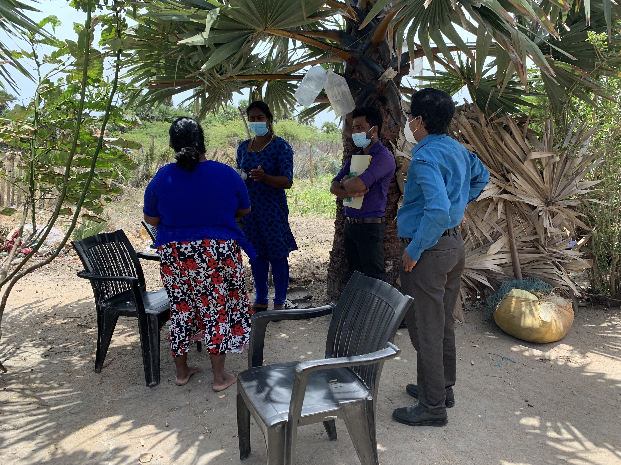

Slide 10
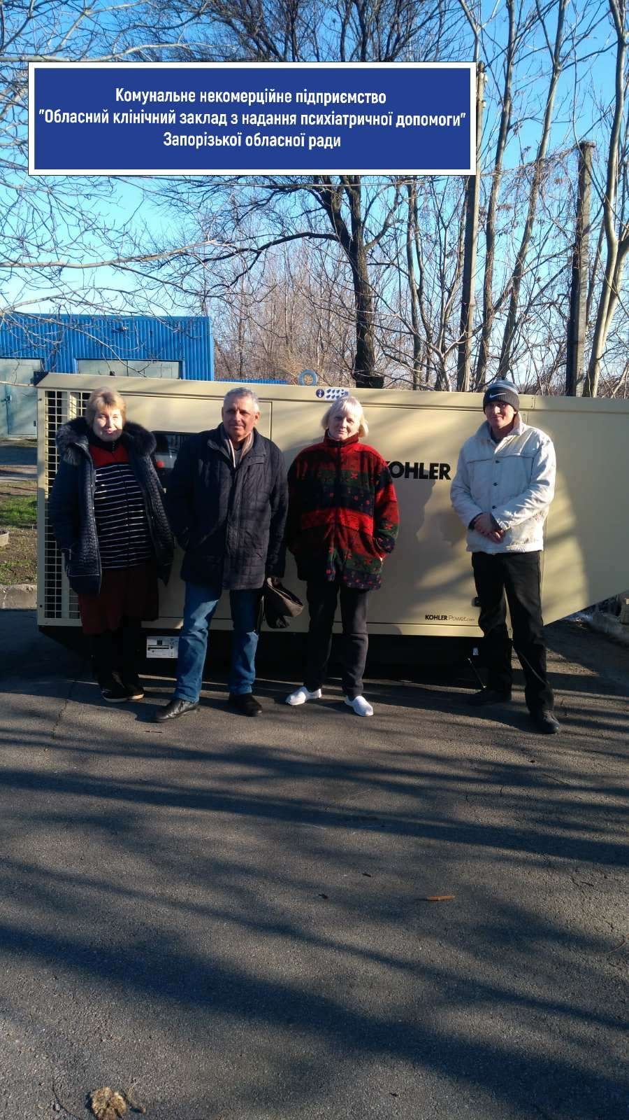
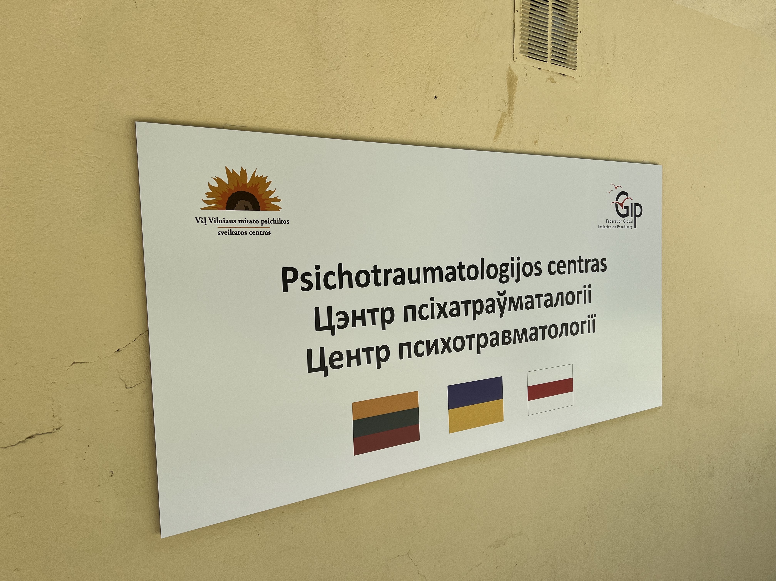
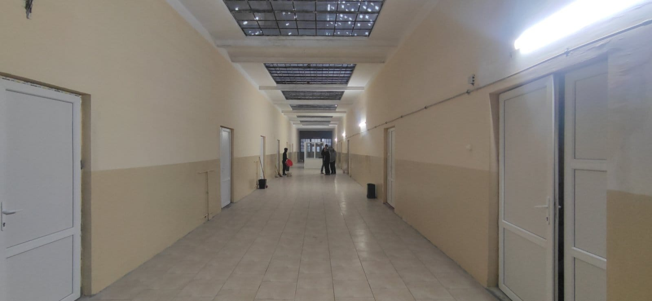
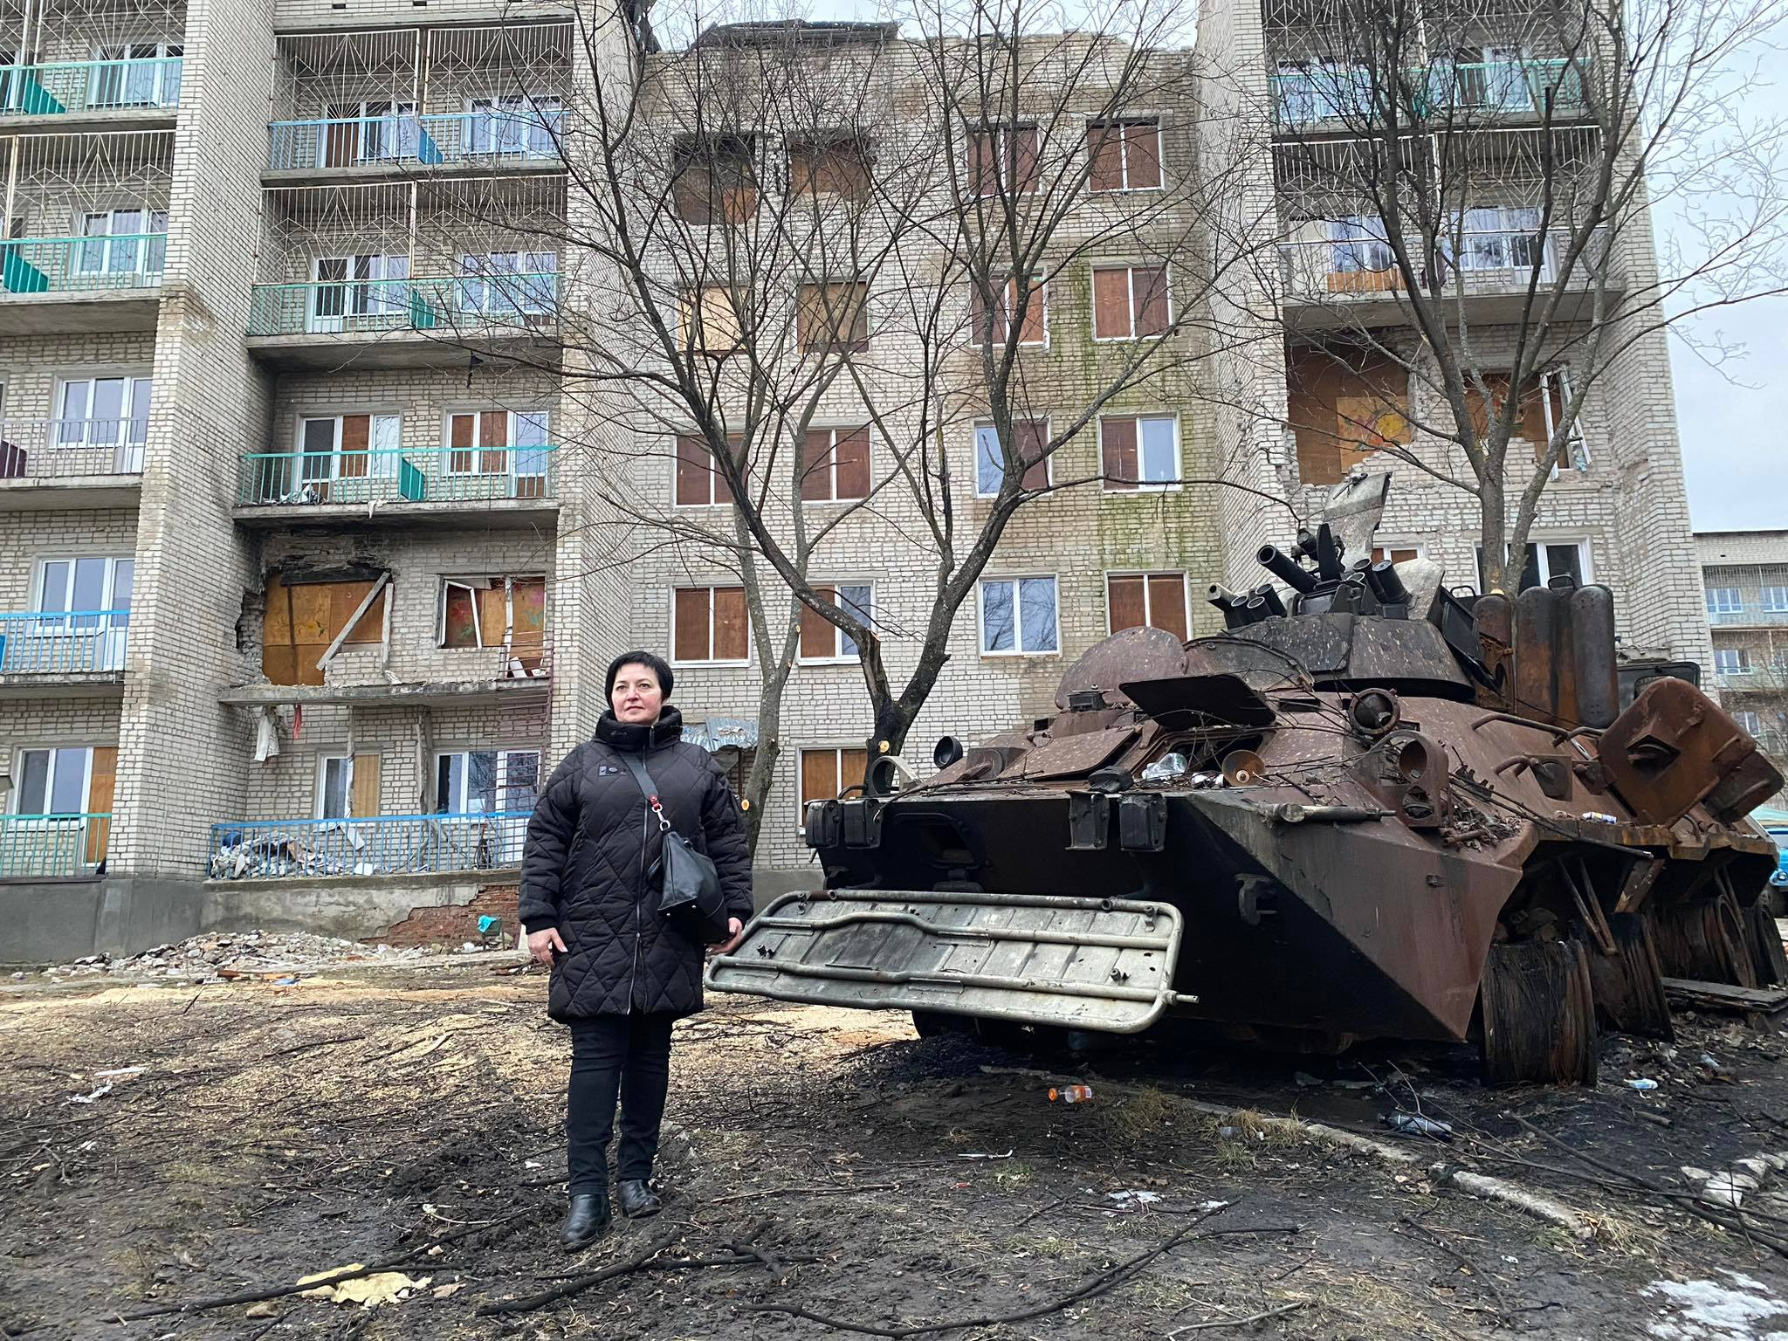
2022-2024: focus Ukraine
Psychological aid program for Ukrainians, including free counseling for First Line Defenders: samopomich
Mental health crisis center in Vilnius (LT) for Ukrainian and Belarusian refugees
Supporting existing and surviving mental health professionals during times of war and in some cases helping to restart abandoned or damaged institutions
Training mental health professionals in various trauma-related aspects in Lithuania and Ukraine itself
Developing programs for veterans and preparing for the future wave of crisis situations, among others with the Ukrainian penitentiary service

Slide 11
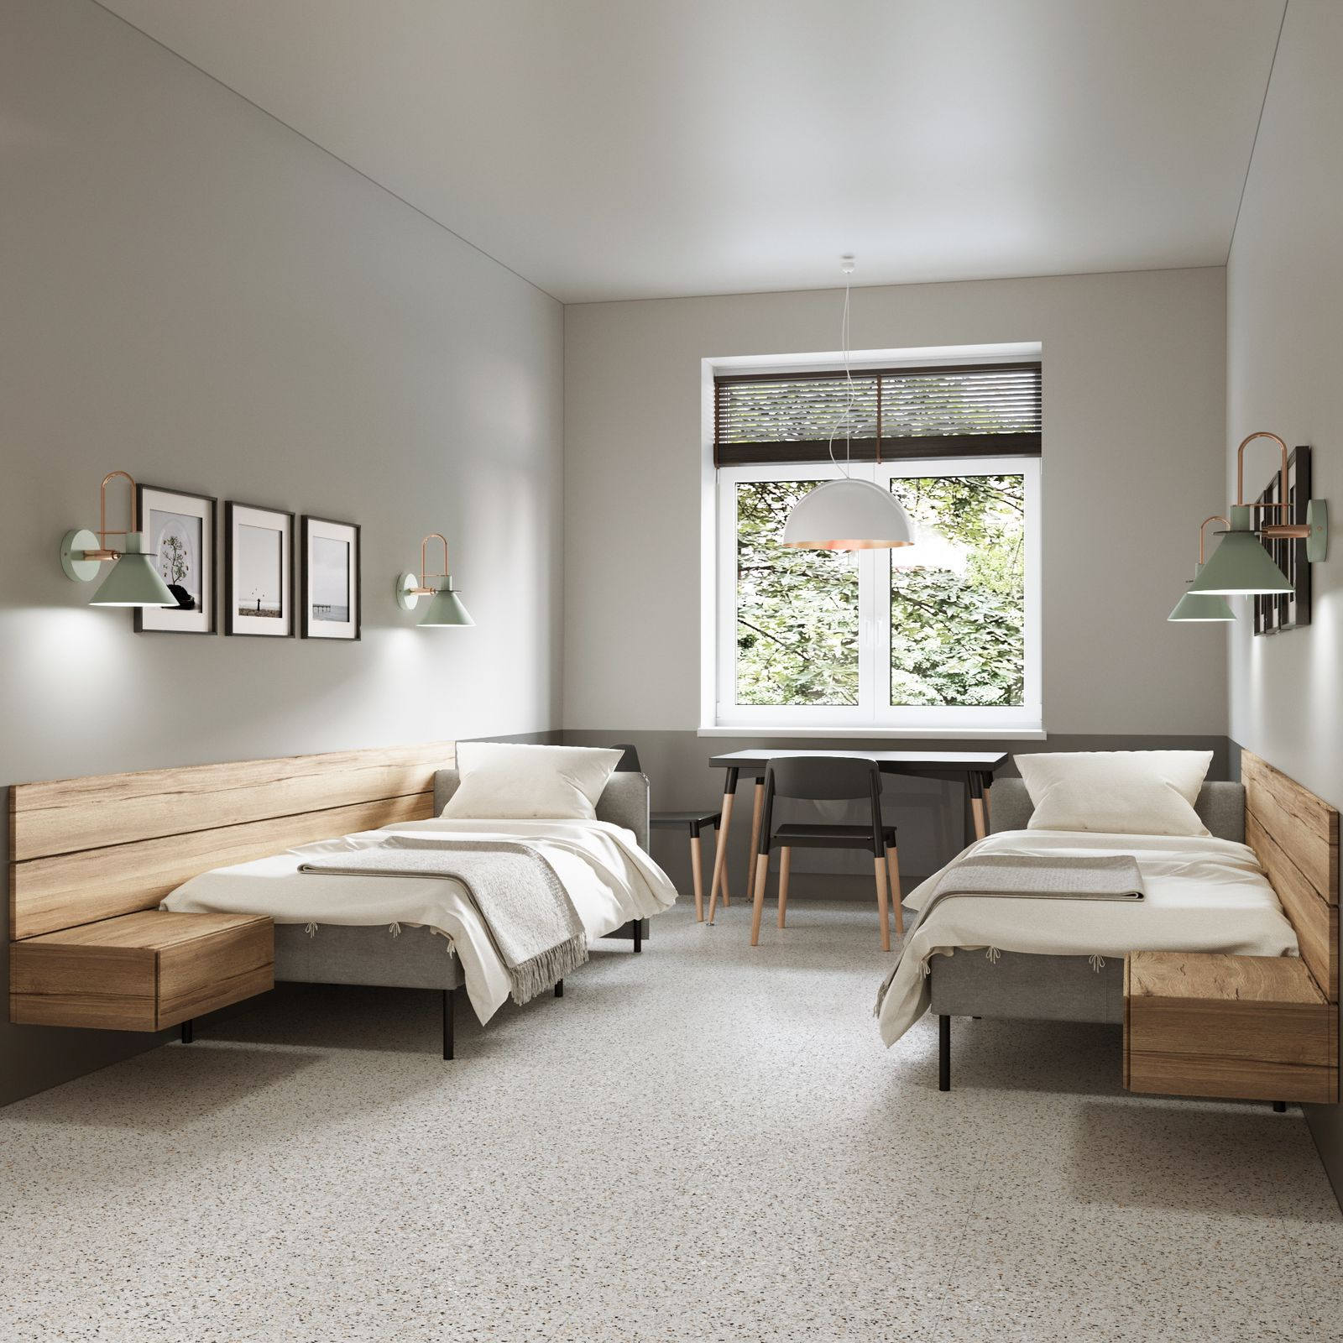
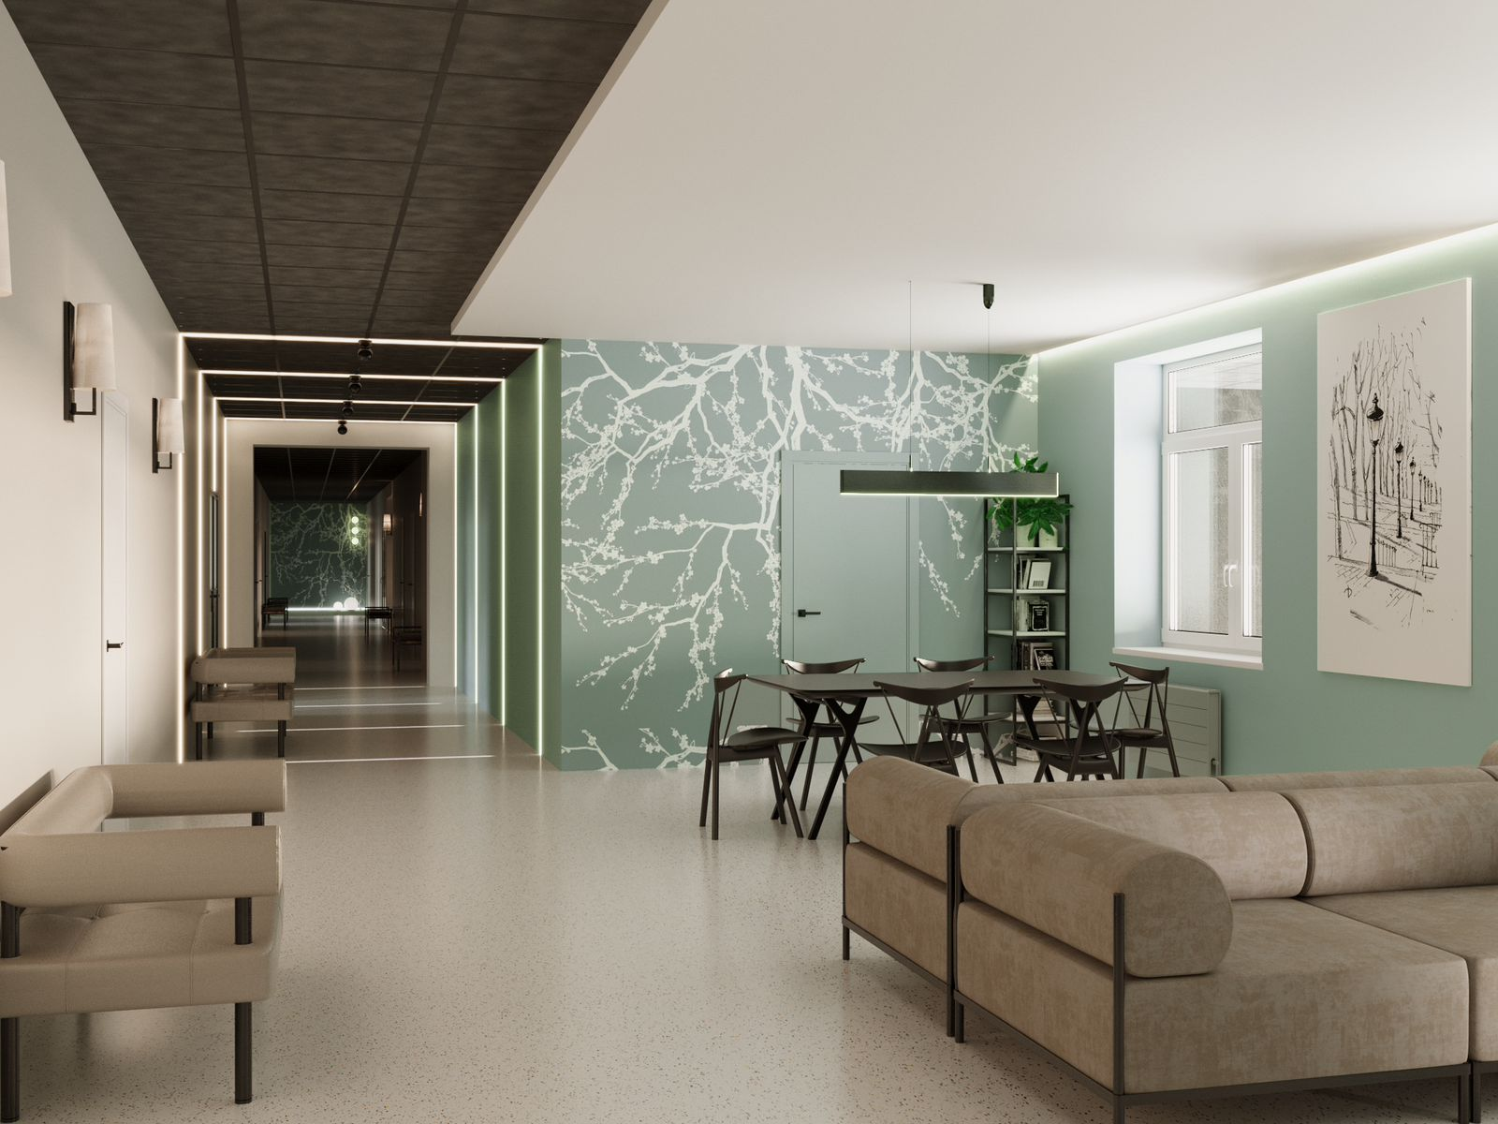
Our goal
Develop the Veteran Mental Health Center of Excellence at Shevchenko University in Kyiv, together with the Centre for Military Health Research at King’s College in London with three main focal points:
research,
methodology and
training
Develop a joint veteran mental health program involving the UK, Lithuania, The Netherlands, the Czech Republic and Canada, to make sure that we don’t overlap or compete
Link up with NATO HQ and Kyiv (Human Centric Approach/Irpin Center of Excellence)
Develop several model veteran centers at local level (in towns and regional centers across the country)

