Slide 1
Interventions to reduce mental health stigma in Tunisia: Challenges and lessons learnt from the INDIGO-Partnership Research Program
Uta Ouali,
Razi Hospital, University of Tunis El Manar, Tunisia
London, 12 March 2024

Slide 2
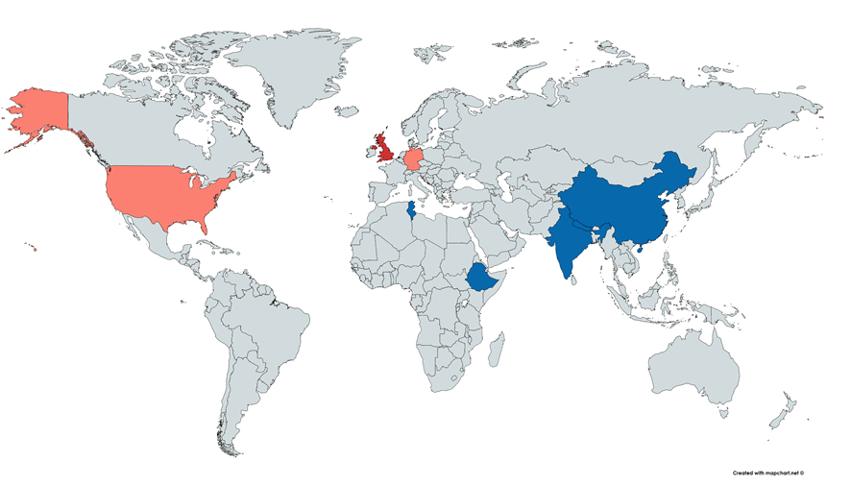
INDIGO-Partnership
Develop and implement interventions to reduce stigma in LMIC’s
Knowledge Transfer
Research capacity development
Interventions in:
Primary care (PRIMARY)
Mental health services (READ)
Community (LOCAL)
Project financed by a grant from MRC UK 2018-2024

Slide 3
INDIGO-LOCAL
Training of primary health care professionals in mental health and stigma reduction (INDIGO-PRIMARY)
Aims :
To develop an intervention toolkit for a local area public awareness program designed to increase referrals of people with mental illness for assessment and treatment.
Pilot Indigo Local in a small proof of principle platform activity
Local stakeholder group workshop
Workshop for members of the local community
Local area public awareness program in MH:
Events within the community
Local media campaign

Slide 4
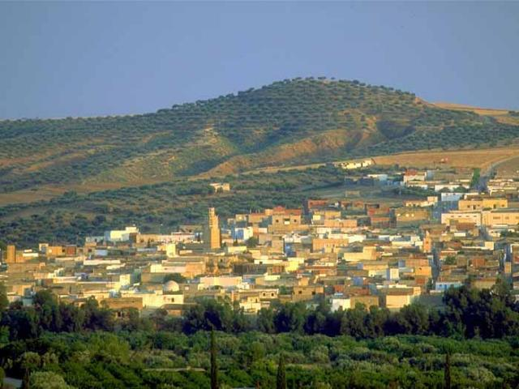
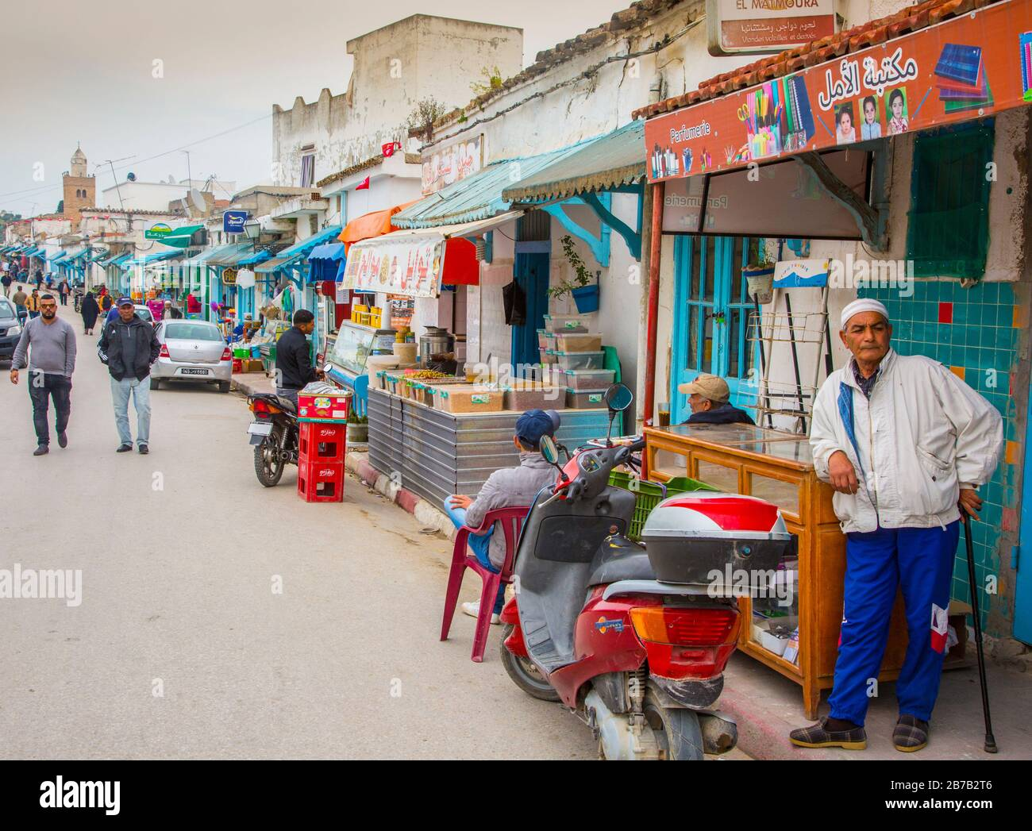
INDIGO-Primary and Local Site Testour
Notes:
77 km south west of Tunis; 10.000 inhabitants, one of Tunisia’s oldest towns

Slide 5
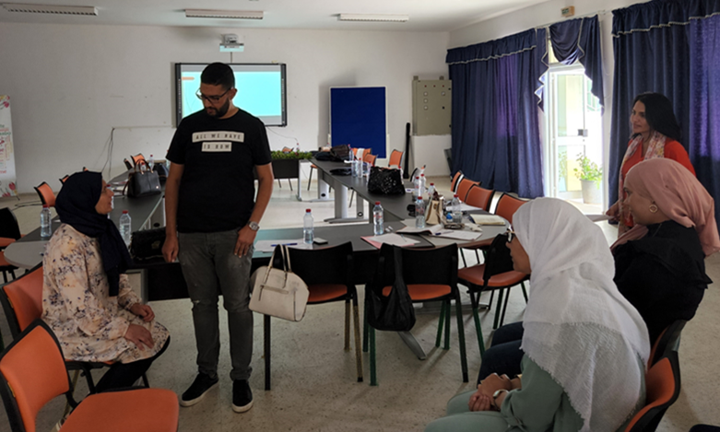
INDIGO-Primary
17 PHC professionals
3-day training
Modified mh-GAP
Role plays
Clinical cases
Recovery story by expert by experience,
Inspirational figure
Notes:
Dépression et suicidalité, psychose, addictions, communication et gestion de l’agitation

Slide 6
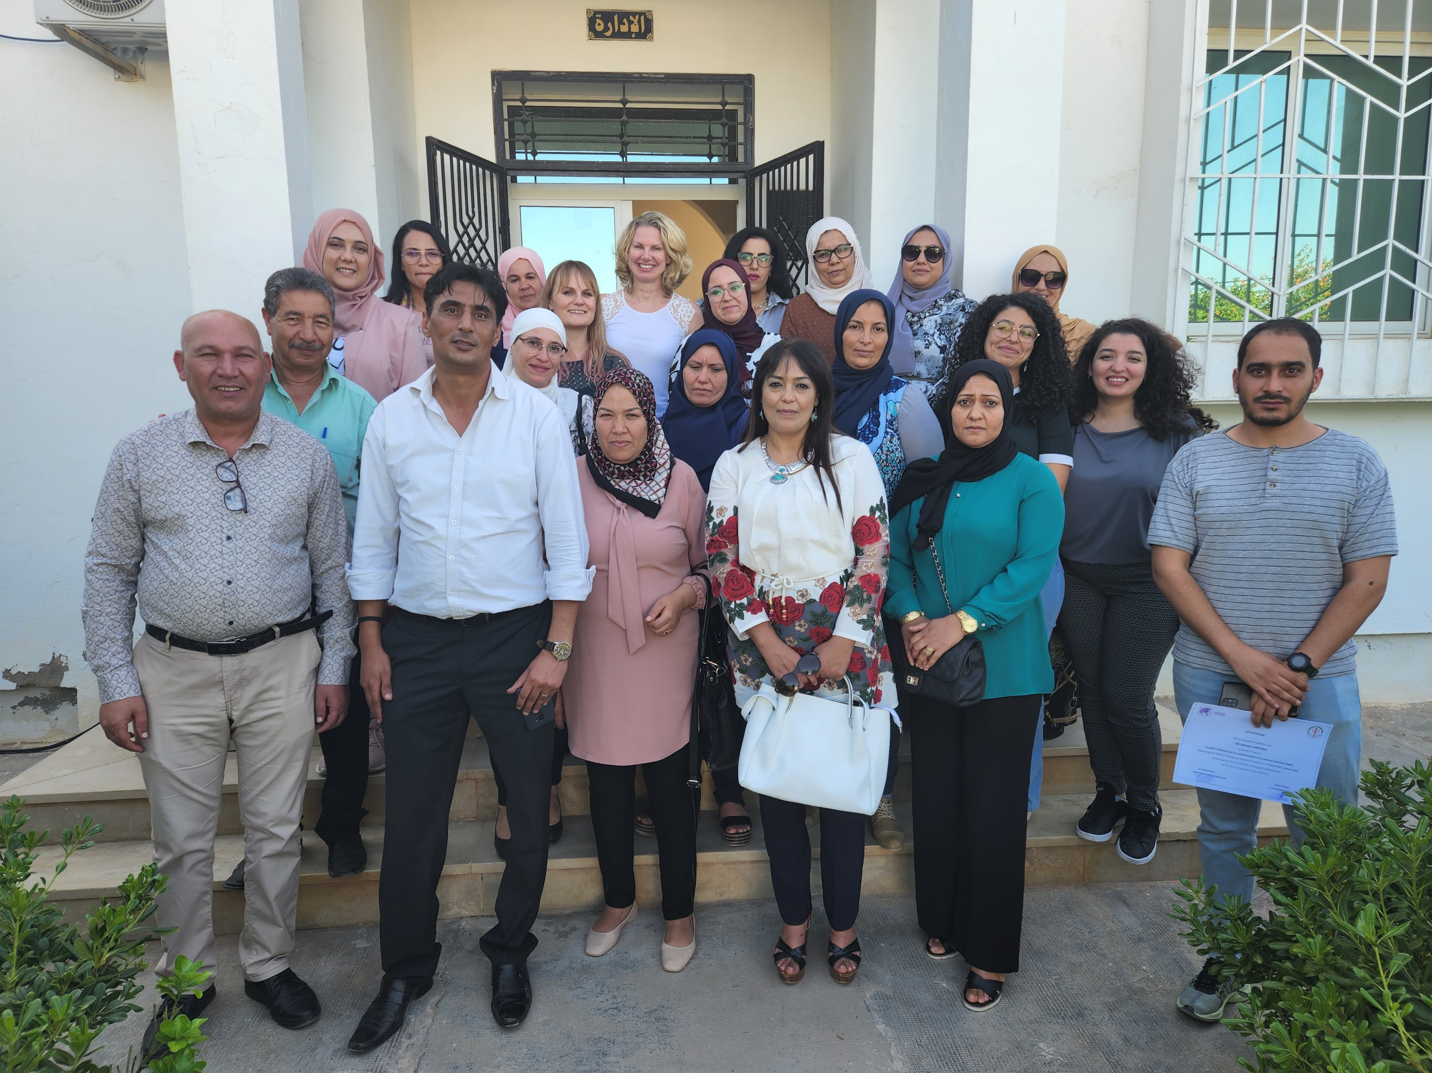
We specifically appreciated the videos on mental health and the story of the expert by experience.
It was great to have seen the difference in our approach before and after the training by doing the same roleplays.
I did not know that listen to the patient could be a form of treatment in itself.
I truly believed that advising somebody to look at the blue sky and the sun would improve his depression.
I am glad to have learned how to approach a patient with suicidal ideas.

Slide 7
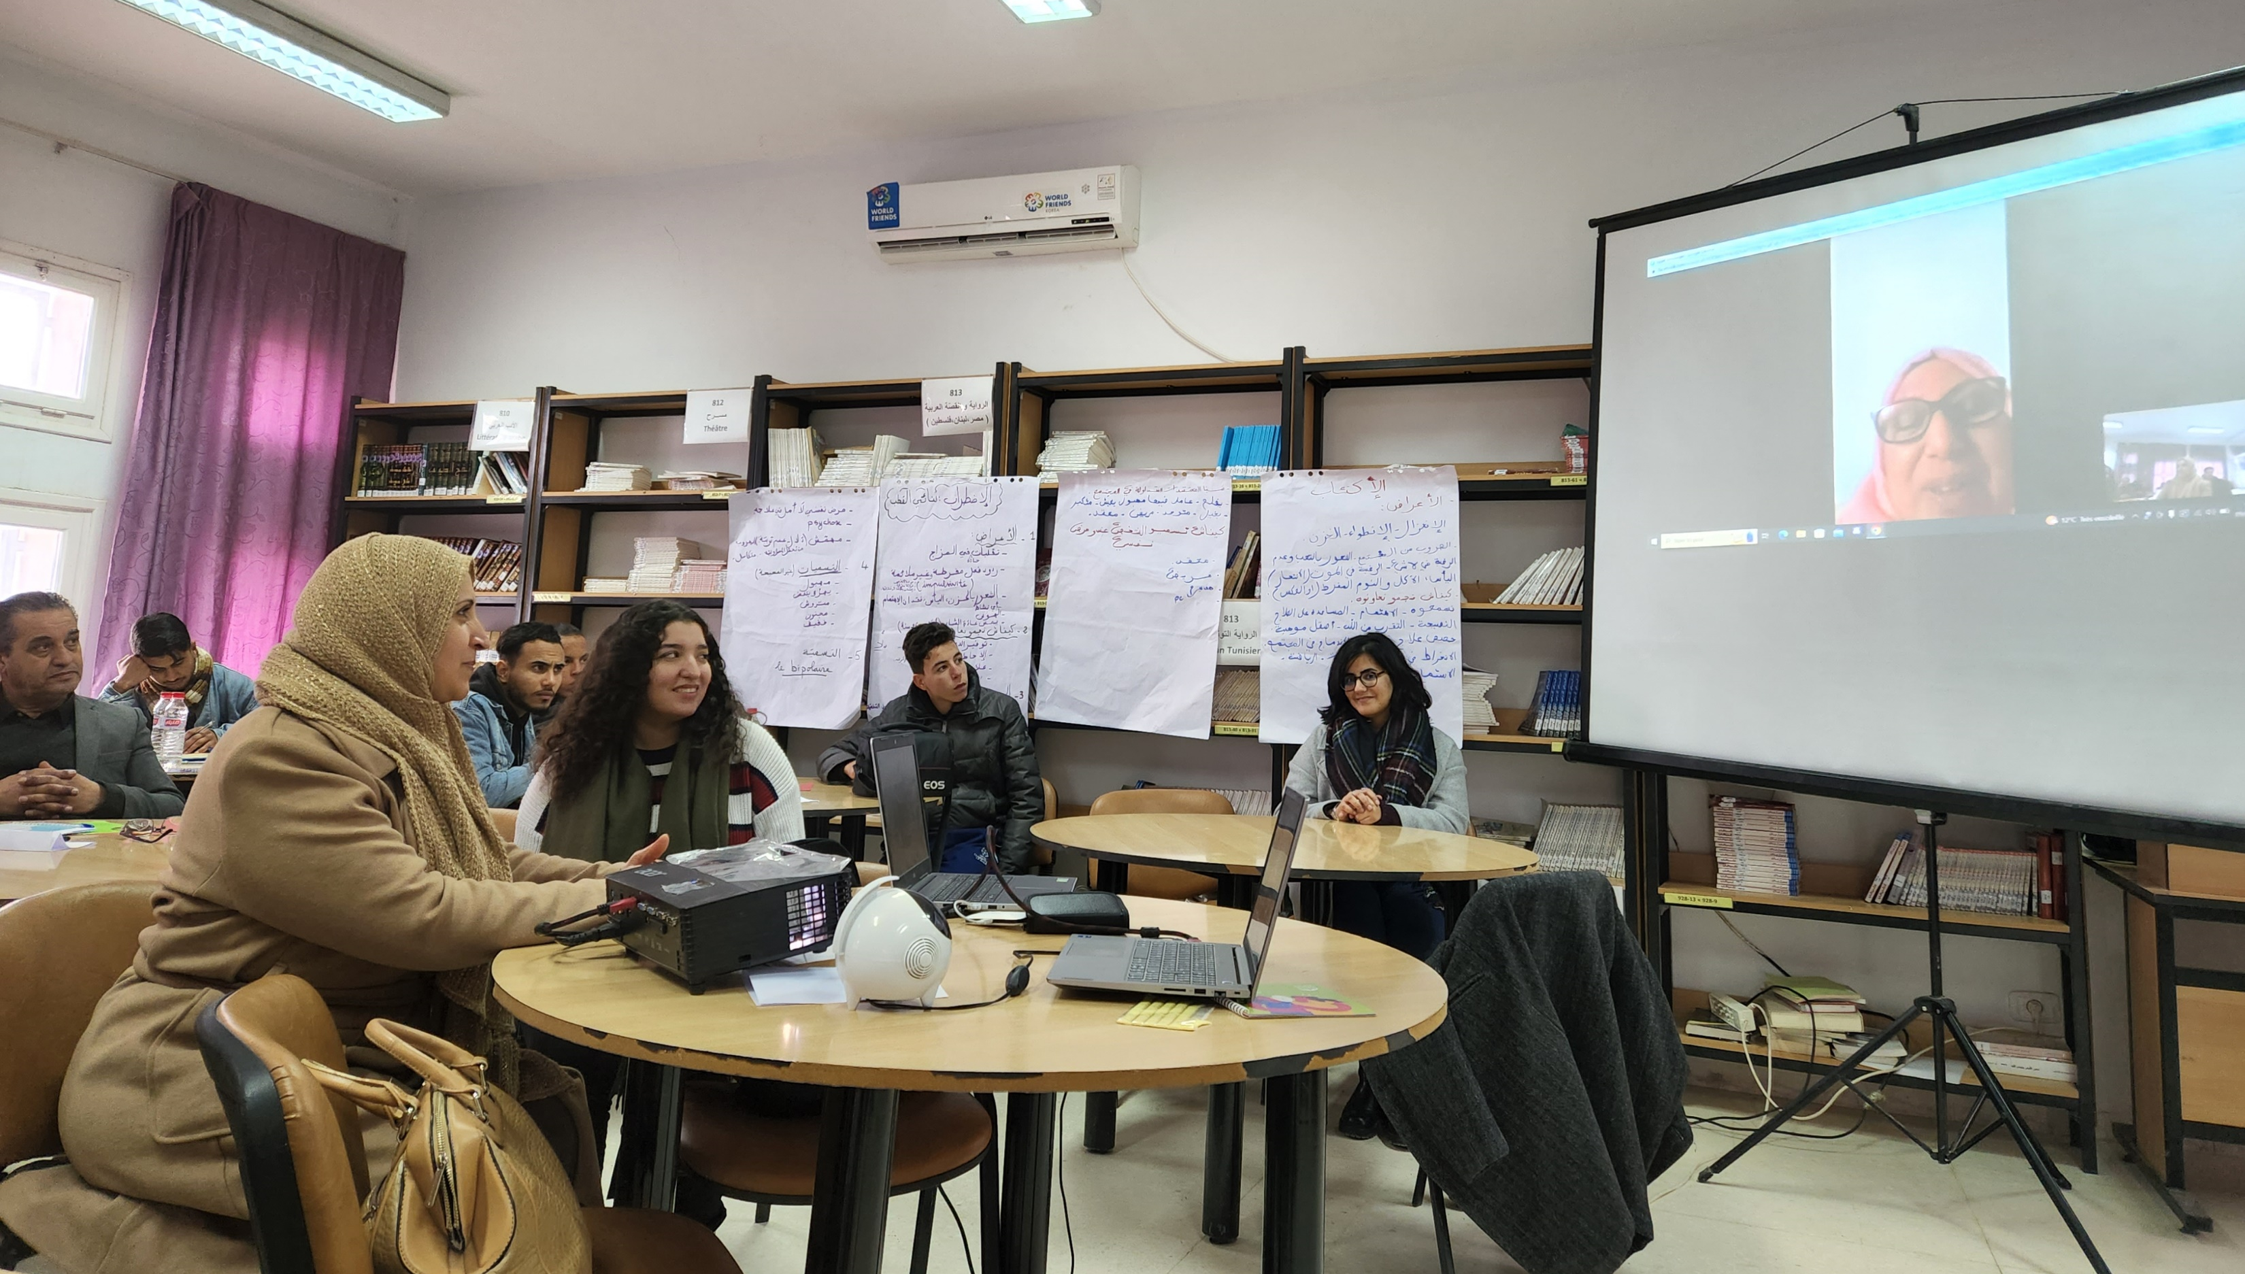
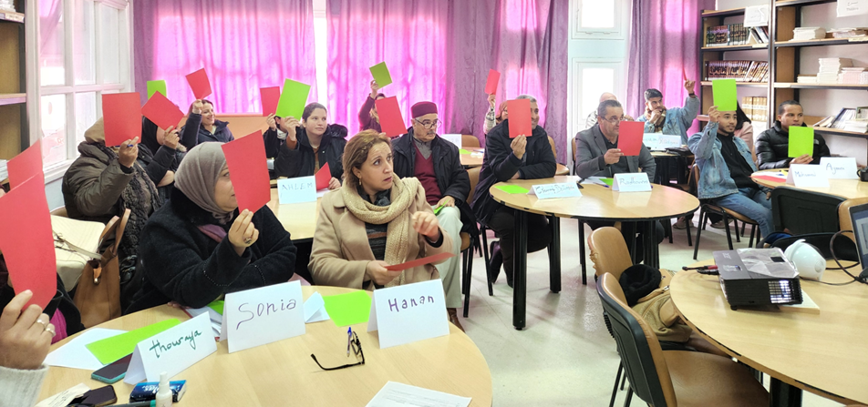
INDIGO-Local: Community workshop
19 members of the community of Testour
3 days of training in Feb 2023
Mental Health and mental illness
Mental Health stigma
Actions to reduce stigma in the community

Slide 8
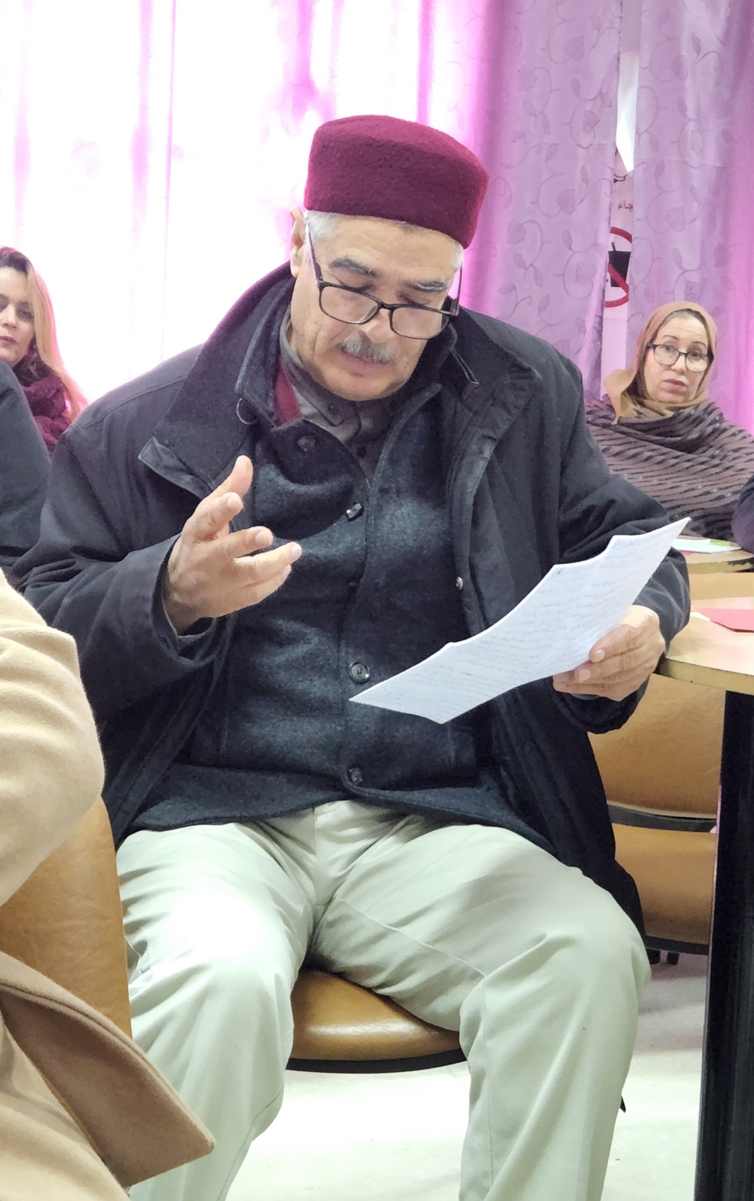
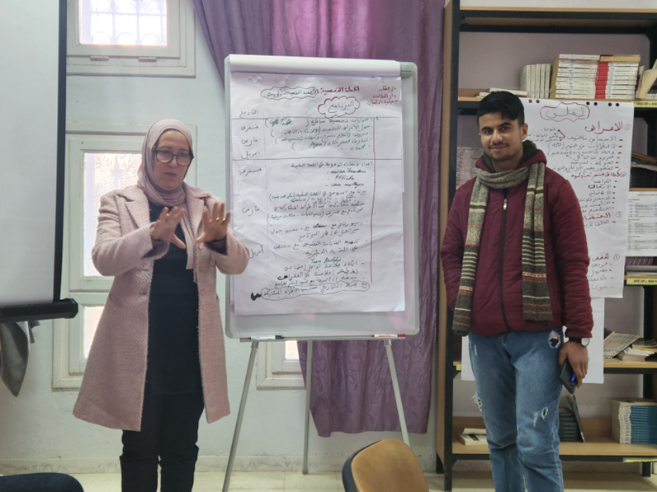
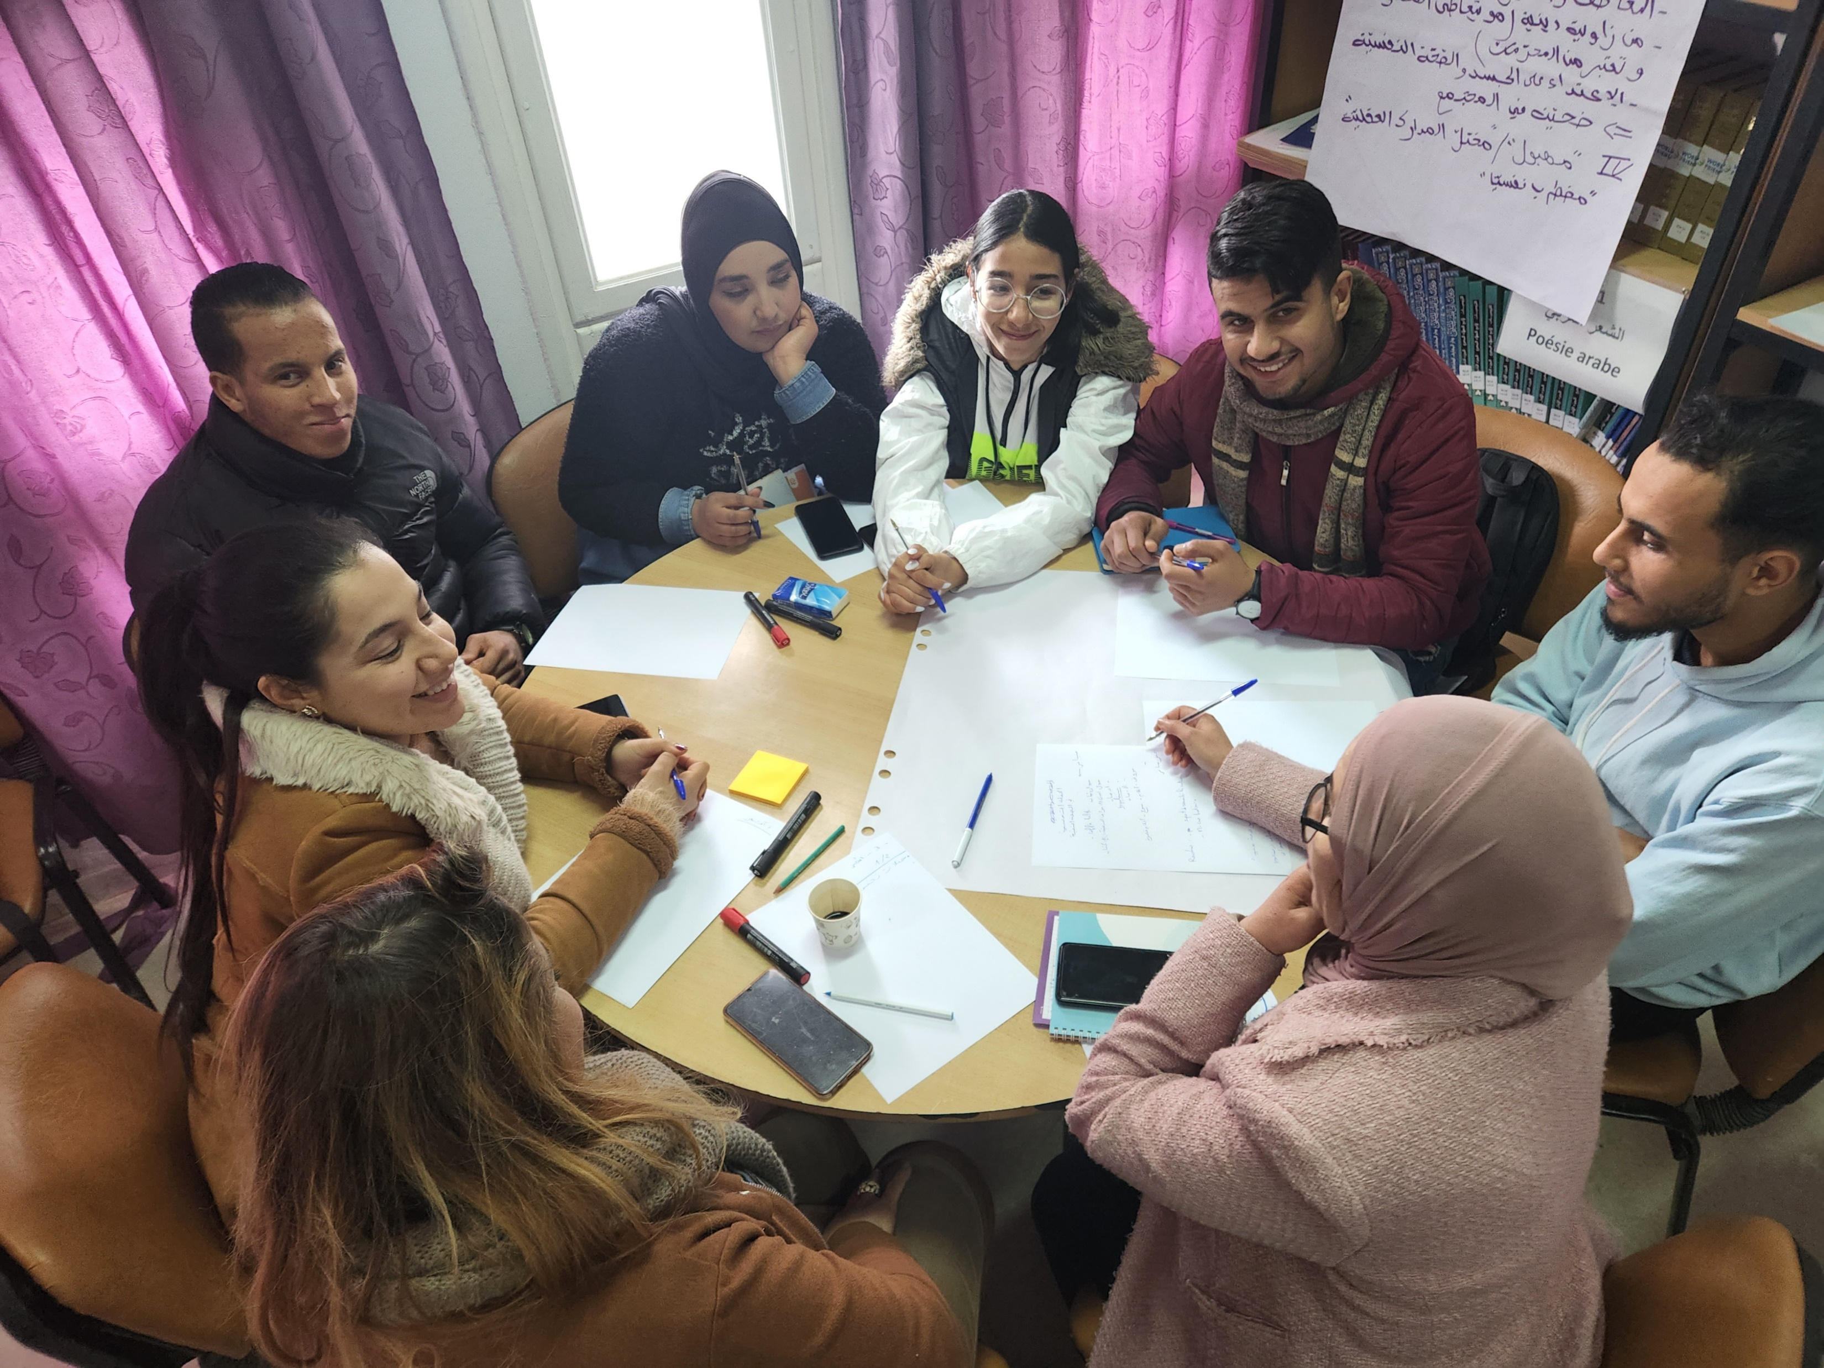
Proposing and planning community members actions to reduce stigma

Slide 9
I wouldn’t have thought medication could treat mental illness.
The workshop helped us to better understand the nature of mental illness.
We can stigmatise people with mental illness without realising.

Slide 10
Media Campaign
Facebook, radio, booklets, leaflets, posters
Duration: April – June 2023
Donne de l’importance à ta santé mentale

Slide 11
Local radio
Weekly sessions with mental health professionals covering:
Anxiety and stress
Psychosis
Addictions…

Slide 12
Posters
Primary care centers
Local hospital
Townhall
Schools
Community culture centres
Youth clubs
Post office
Explanation of pathway to care

Slide 13
Preliminary results: service uptake
year / month | Pre/post campaign | Number of new patients | Total number of patients
2022 | pre | 72 | 289
2023 / Jan – Nov | Campaign March – June | 140 | 370

Slide 14
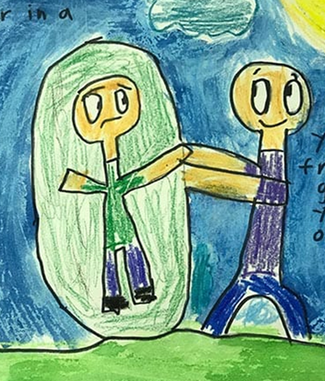
Challenges and lessons learnt
Challenges:
Engage experts by experience
Little cooperation between stakeholders
Lessons learnt :
Importance of cultural adaptation of interventions
Importance to “touch participants emotionally” to make an impact
Expert by experience should be able to interact with participants
Necessity to involve different stakeholders, including past participants, to ensure sustainability

Slide 15
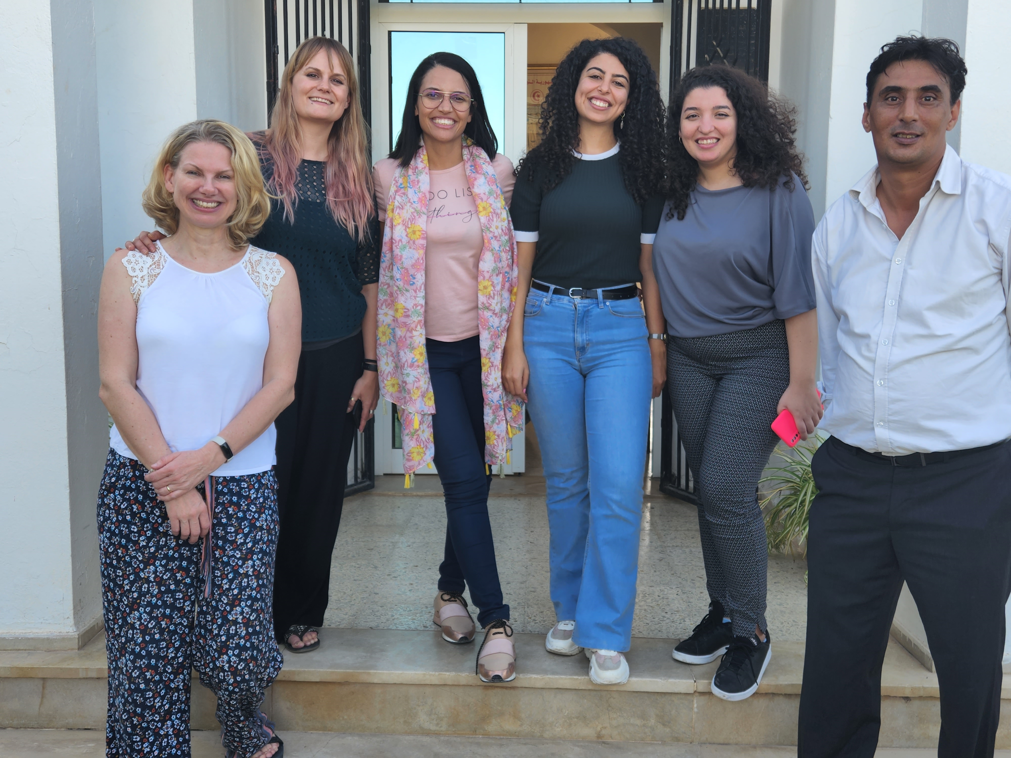
Uta Ouali,
Medical School of Tunis,
University of Tunis El Manar
Department Psychiatrie A
Razi Hospital La Manouba,
Tunisia
uta.ouali@gmail.com

