Slide 1




Mental Health among Young People in Barbados: Stigma and Help-Seeking
Beth Gallimore MPhil
PhD Student
Institute of Psychiatry, Psychology & Neuroscience; King's College London, UK
Email: jay-bethenny.gallimore@kcl.ac.uk
@BethGallimore

Slide 2
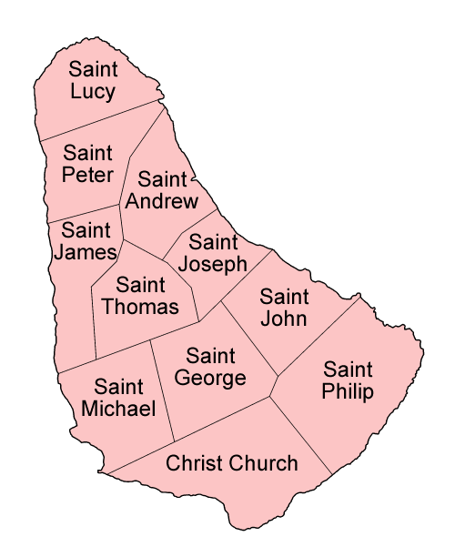

Barbados
Island in the Eastern Caribbean
Divided into 11 parishes
Population = 282,000
Size = 21 miles long, 14 miles wide
92.4% African descendants

Slide 3

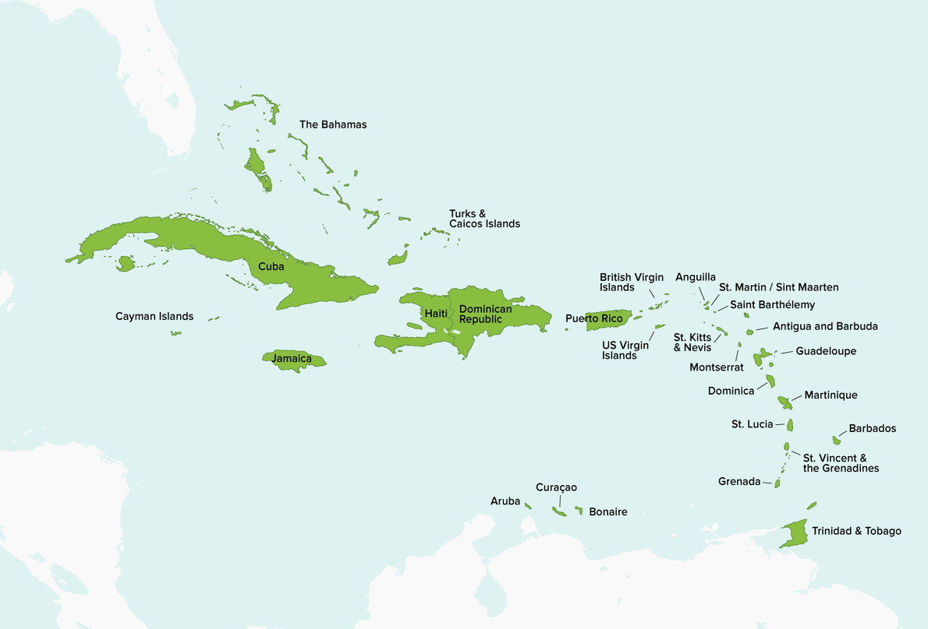

Background - Project
Mental health in the Caribbean is a neglected area
Increasing rate of mental health challenges and stigma
Stigma is a barrier to help-seeking
Barbados is focused on addressing mental health stigma among youth
WHO. (2019). Barbados – meeting the health needs of its adolescents. https://apps.who.int/iris/bitstream/handle/10665/326383/WHO-MCA-19.04-eng.pdf

Slide 4
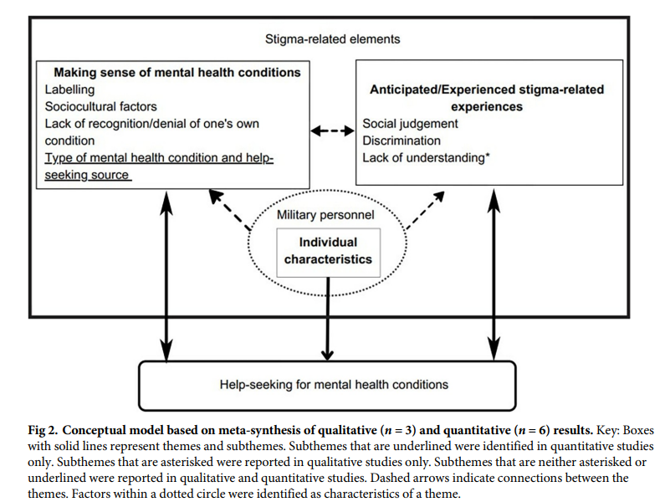
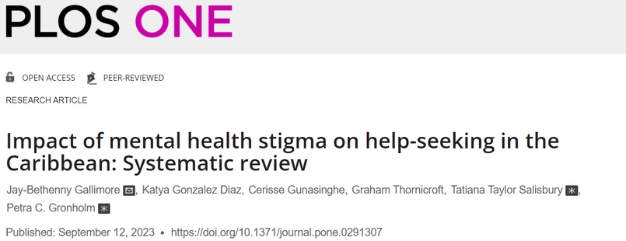


Slide 5
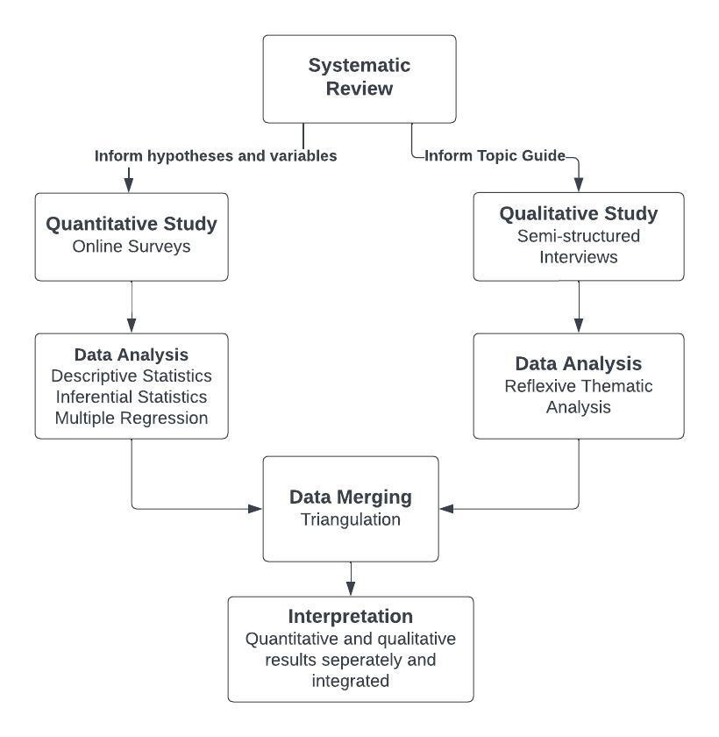
Flow diagram for mixed methods PhD project

Slide 6

Qualitative Interviews - Semi-structured
Topic Guide - Reviewed for cultural appropriateness and relevance
Lived Experience of Mental Health Stigma and Help-Seeking
Methods of Recruitment - Community mental health services, Educational Institutions, Social Media, Snowballing
Inclusion Criteria
  18-24 years
  Live in Barbados
  Diagnosis of a mental health condition or self-identifying as having experienced mental health difficulties
20-30 young people
In-person/Online

Slide 7

Pilot work
Like how we were able to follow my responses rather than a strict set of questions
Felt that the questions were not too intrusive
Interview Feedback
I find it helpful to be able to just talk about it
Feeling nervous beforehand, but I had fun
Your research would be really helpful to a lot of psychology students
Preliminary findings
Culture, religion, privacy and confidentiality, gender stereotypes

Slide 8

Parent-child relationship
“Things got better because I spoke with my mom…she's there for me and she'll support me in whatever way and she'll help me overcome it.”
“The years of my mom mistreating me, I was going through a lot. I didn't know how to handle it…and I couldn't go to her.”

Slide 9
Reflections
Strengths and Challenges
Cultural relevance
Community engagement
Recruitment

Slide 10


Slide 11
Thank you!!!
Thank you to my supervisors:
Dr Tatiana Salisbury
Dr Petra Gronholm
A special thank you to:
My advisor and mentor:
Professor Sir Graham Thornicroft
Email: jay-bethenny.gallimore@kcl.ac.uk
@BethGallimore

