Slide 1
Applied Health Research ^
Dr Kritika Samsi
Senior Research Fellow, NIHR Policy Research Unit in Health & Social Care Workforce
Theme lead, social care, ARC South London

Slide 2
Applied Health Research ^
& CARE
Dr Kritika Samsi
Senior Research Fellow, NIHR Policy Research Unit in Health & Social Care Workforce
Theme lead, social care, ARC South London

Slide 3
Recognising the contribution of the social care workforce and how to support them
Dr Kritika Samsi
Senior Research Fellow, NIHR Policy Research Unit in Health & Social Care Workforce
Theme lead, social care, ARC South London

Slide 4
Social care workforce overview
Statistics of the adult social care workforce in the UK:
82% of the workforce are female.
The average age of the workforce is 44 years.
27% of workers are aged 55 and above.
84% of the workforce were British.
7% (113,000 jobs) had an EU nationality.

Slide 5
Day centres
In south London, our work has focused on recognising the valuable support day centres provide older people & supporting their sustainability
During Covid, we sought to support day centres by collating information that could enable day centres to unlock following pandemic lockdowns: https://www.kcl.ac.uk/research/helping-day-centres-to-unlock-lockdown
Through prioritisation activities, community engagement, an online forum and a stakeholder survey, we identified elements that would boost support to the sector; have created a Day Centres Resources Hub.
Currently in development, the website will be launched in
April 2024.

Slide 6
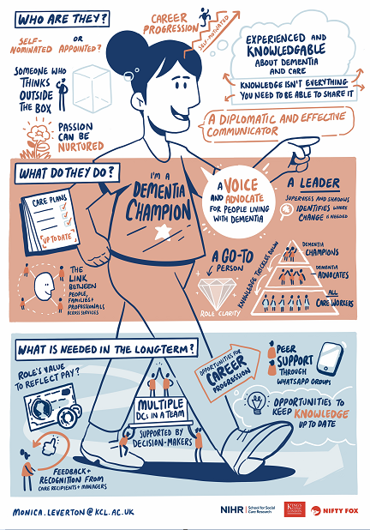
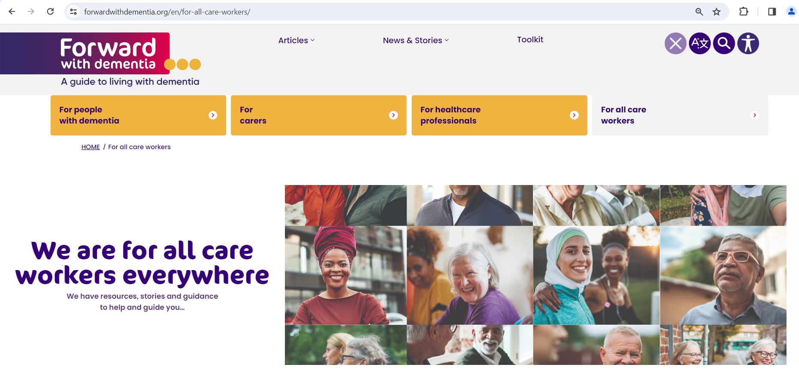
In home care
Work to support the homecare workforce, a typically fairly isolated workforce that provides support in people’s own homes
International recruitment and Health & Care Visa study:
topical & sensitive
Capturing views of staff recruited from abroad, experiences of settling in & sustainability of workforce
& Care providers about the challenges experienced
Dementia Champion study
to develop a dementia specialism leadership model that can be used in home care settings to support people with dementia and carers
Forward with Dementia:
developed additional content on online hub of resources to support all care workers, especially the homecare workforce: https://www.forwardwithdementia.org/en/for-all-care-workers/
Notes:
Forward with Dementia:
developed additional content on online hub of resources to support different groups affected by dementia (people with dementia, carers, health care professionals). We contributed to resources for all care workers, especially the homecare workforce: https://www.forwardwithdementia.org/en/for-all-care-workers/

Slide 7
hidden workforces
Ancillary workers in care homes – “domestic services”, housekeepers, laundry staff, chef
Contributions during Covid
“I started working as a hairdresser and doing residents’ hair during lockdown. Well, someone had to do it, because we stopped any external visitors or outside staff from coming into the home. We wanted less staff overall. And I had qualifications for beauty therapy – it was on my C.V., so I was happy to do it. I did haircuts, hair wash, manicure, pedicure, I enjoyed it! And I think the residents enjoyed it too!”
Relationships with residents
“About my mum, it was in fact the senior cook who said “I'm very worried. Your Mum seems not to be eating as much. I think she's struggling to eat. Do you think we can get somebody to see her so that maybe we can soften her food?” That was the cook. Not a carer, not the manager. So I had Mum reviewed and she then was put onto a soft diet and her intake has improved. She eats very well now with pureed food. It was the senior cook who actually picked up that her tray wasn't being emptied and that she wasn't eating everything.”
Notes:
Relationships with residents
“About my mum, it was in fact the senior cook who said “I'm very worried. Your Mum seems not to be eating as much. I think she's struggling to eat. Do you think we can get somebody to see her so that maybe we can soften her food?” That was the cook. Not a carer, not the manager. So I had Mum reviewed and she then was put onto a soft diet and her intake has improved. She eats very well now with pureed food. It was the senior cook who actually picked up that her tray wasn't being emptied and that she wasn't eating everything.”

Slide 8
hidden workforces
Ancillary workers in care homes – “domestic services”, housekeepers, laundry staff, chef
Good practice model
“But it's just so heart breaking that when they have employee of the month, we never get recognised, it's always the carers (care workers). You know, we do a good job. If it wasn't for us cleaning, you know, they could have had this virus in the home. But we kept on top of all the cleaning. And we don't get recognised, which is very unfair.”
Notes:
Relationships with residents
“About my mum, it was in fact the senior cook who said “I'm very worried. Your Mum seems not to be eating as much. I think she's struggling to eat. Do you think we can get somebody to see her so that maybe we can soften her food?” That was the cook. Not a carer, not the manager. So I had Mum reviewed and she then was put onto a soft diet and her intake has improved. She eats very well now with pureed food. It was the senior cook who actually picked up that her tray wasn't being emptied and that she wasn't eating everything.”

Slide 9
Future work going forward…?
Supervision in home care
Dementia and racial abuse of staff
Capturing the value of social care and the workforce – “small acts of care” – in preventing deterioration of health status and quality of life

Slide 10
Thank YOU!
Dr Kritika Samsi, King’s College London
kritika.1.samsi@kcl.ac.uk

