Slide 1
Stigma: measuring a multifaceted problem
Graham’s festschrift, 12th March 2024
Claire Henderson

Slide 2
Stigma measurement
Measured from the source
Pescosolido and Martin, 2015 Annual Review of Sociology. 4187–116. (Experiential vs action oriented view)
Individual
Knowledge that prevents agreement with stereotypes
Attitudes- stereotype endorsement
Behaviour- reported and intended: avoidance, unfair treatment, helpseeking for self/others and disclosure of a mental health problem
Structural measures
Discriminatory policies, disparities with physical health care or policies such as insurance coverage

Slide 3
Measured from the target
Perceived stigma- perception of public stigma/’most people’
Experienced discrimination
Anticipated discrimination
Behaviour resulting from anticipated discrimination- withdrawal from opportunity
Stigma stress- and coping
Self-stigma/Internalised stigma
Economic costs of discrimination
Stigma related barriers to care

Slide 5
Viewpoint survey of mental health service users: Top 10 discrimination life areas 2008 and 2014
2008 | 2014
1 Being shunned (57.9%) | 1 Being shunned (47.2%) (-10.7%) Signif
2= Friends (53.3%) | 2 Family (43.3%) (-9.8%) Signif
2= Family (53.1%) | 3 Friends (39.7%) (-13.6%) Signif
4 Social life (43.2%) | 4 Mental health staff (31.6%) (-2.7%)
5 Mental health staff (34.3%) | 5 Social life (29.6%) (-13.6%) Signif
6 Dating (30.9%) | 6 Physical health staff (28.0%) (-1.6%)
7 Physical health staff (29.6%) | 7 Benefits (23.4%) (+4.4%)
8 Neighbours (25.3%) | 8 Neighbours (20.0%) (-5.1%) Signif
9 Finding a job (24.2%) | 9 Safety (18.2%) (-1.4%)
10 Privacy (21.6%) | 10 Keeping a job (15.6%) (-1.3%)

Slide 6
Viewpoint survey – percentage of relevant life areas, last 12 months
Median amount of reported discrimination (percentage) over 2008-2014
Notes:
Overall experienced negative discrimination scores (DISC score) are calculated using a binary score for each item, where zero indicates no discrimination, and one indicates at least a little discrimination. The overall experienced discrimination score is the percentage of items answered in which discrimination was reported

Slide 7
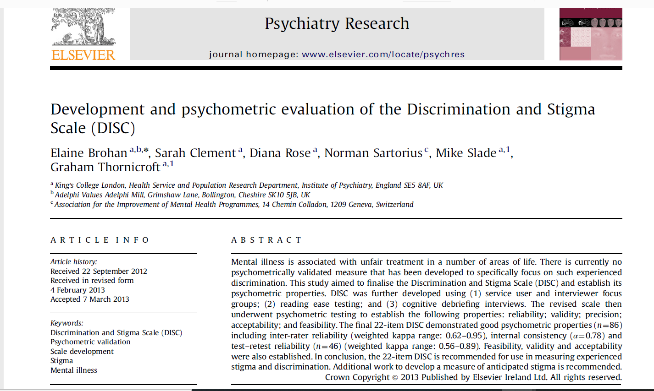

Slide 9
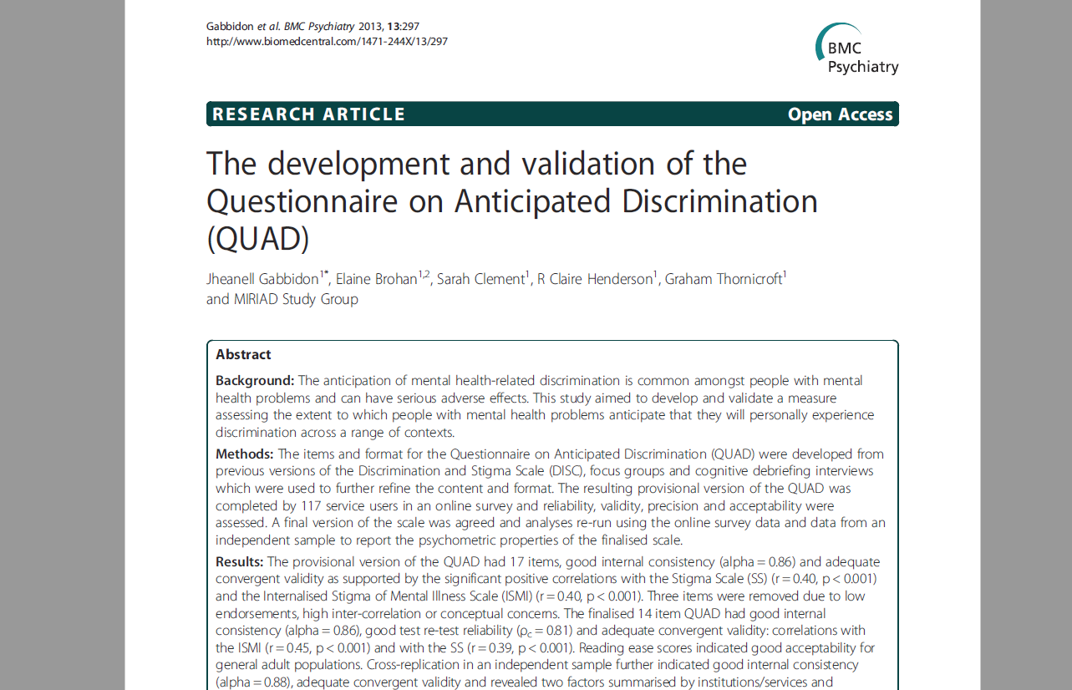

Slide 10
Anticipated discrimination
92.6% of a service user sample anticipate discrimination in at least 1 area of life
More common than the experience
Farrelly S, Clement S, Gabbidon J, Jeffrey D, Dockery L, Lassman F, Brohan E, Henderson RC, Williams P, Howard LM and Thornicroft G. Anticipated and experienced discrimination amongst people with schizophrenia, bipolar disorder and major depressive disorder: a cross sectional study. BMC Psychiatry 29 May 2014, 14:157.
Responses to anticipated discrimination
Around 70% feel the need to conceal- no change 2008-14
Reductions in stopping self from seeking work and education/training seen by 2013 and 2014
Corker E, Hamilton S, Robinson E, Cotney J, Pinfold V, Rose D, Thornicroft G & Henderson C. Viewpoint survey of mental health service users’ experiences of discrimination in England 2008-14 Acta Psychiatrica Scandinavica, 134 (Suppl. 446): 14-22, 2016.

Slide 11
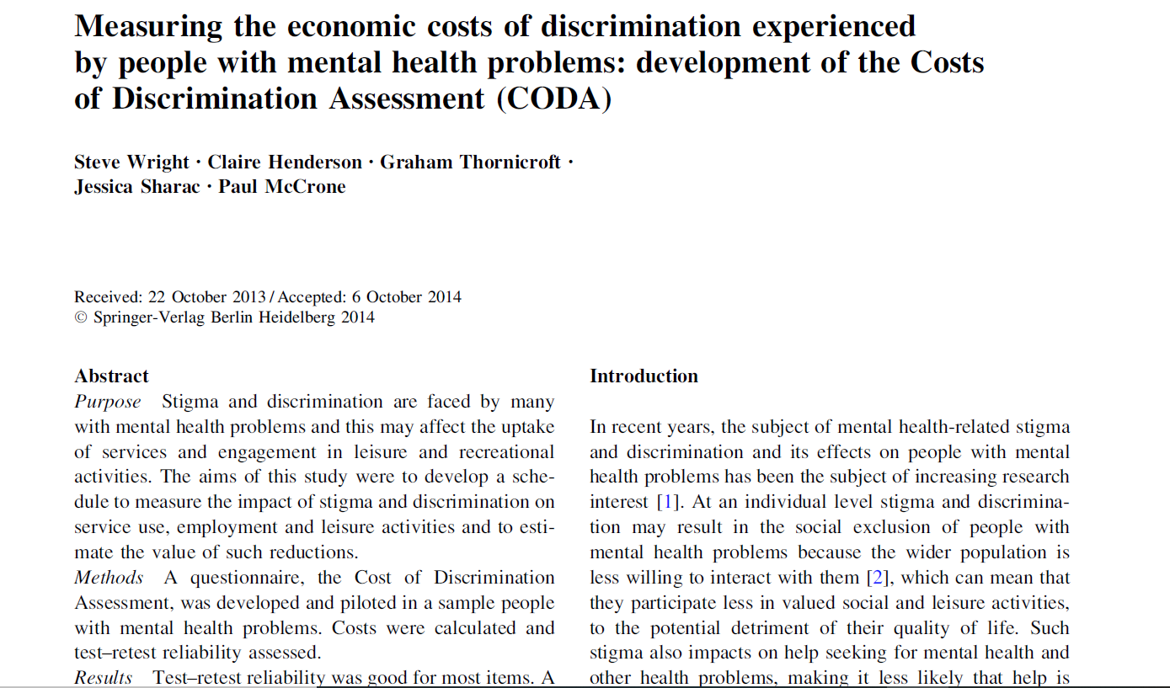

Slide 12
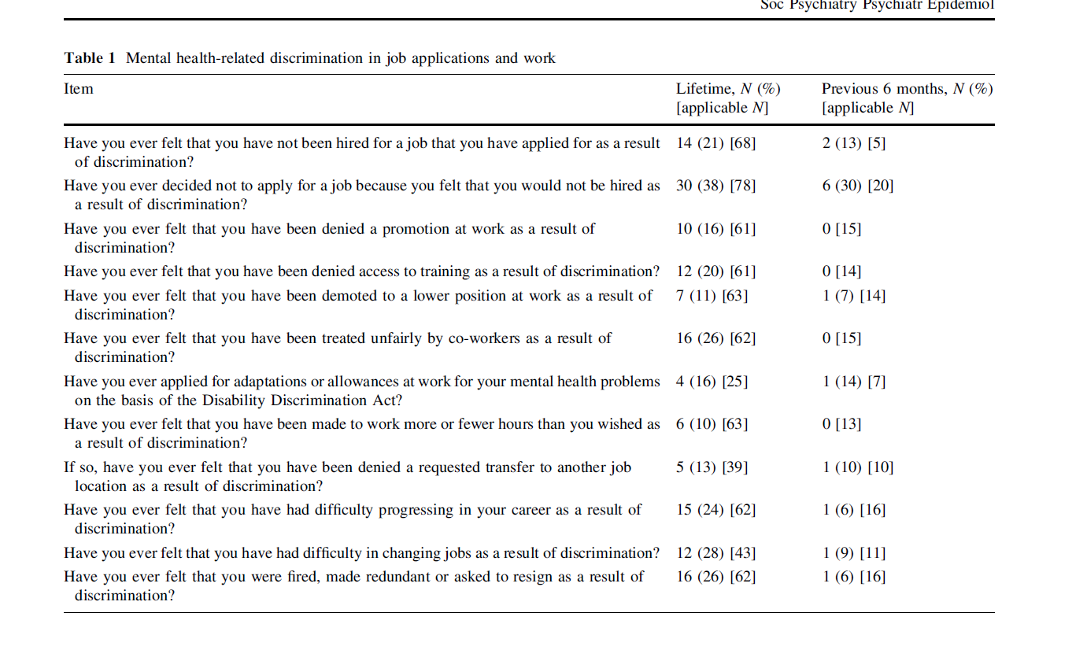

Slide 14
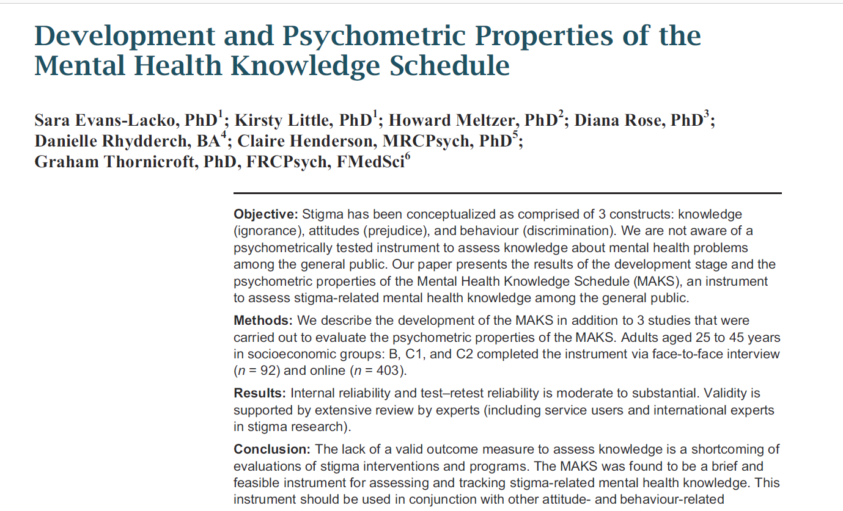

Slide 15
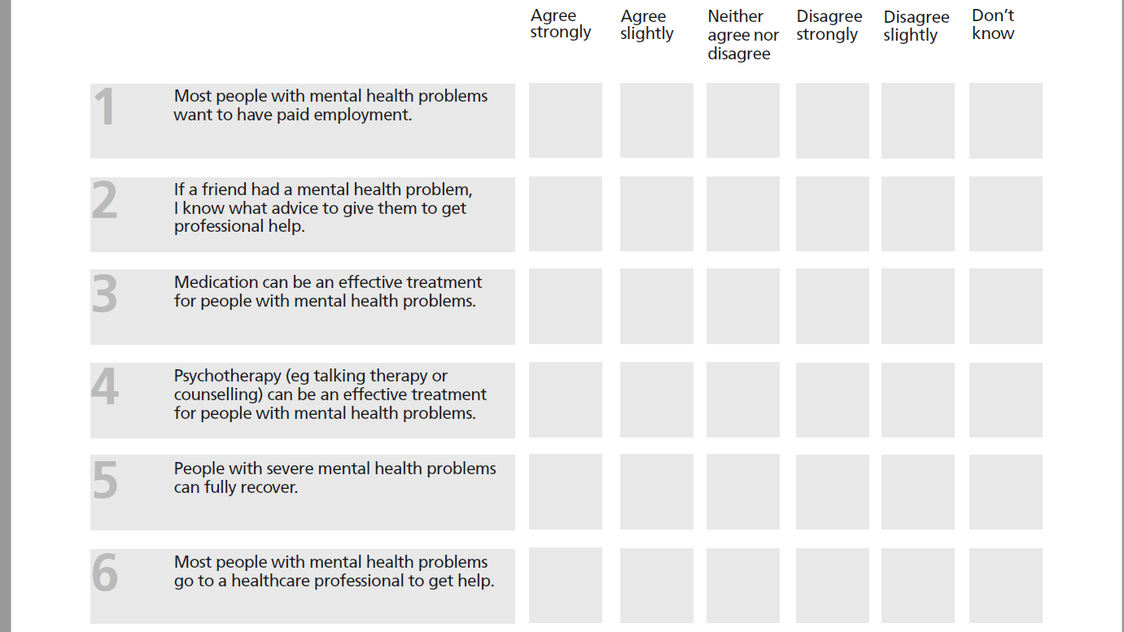

Slide 16
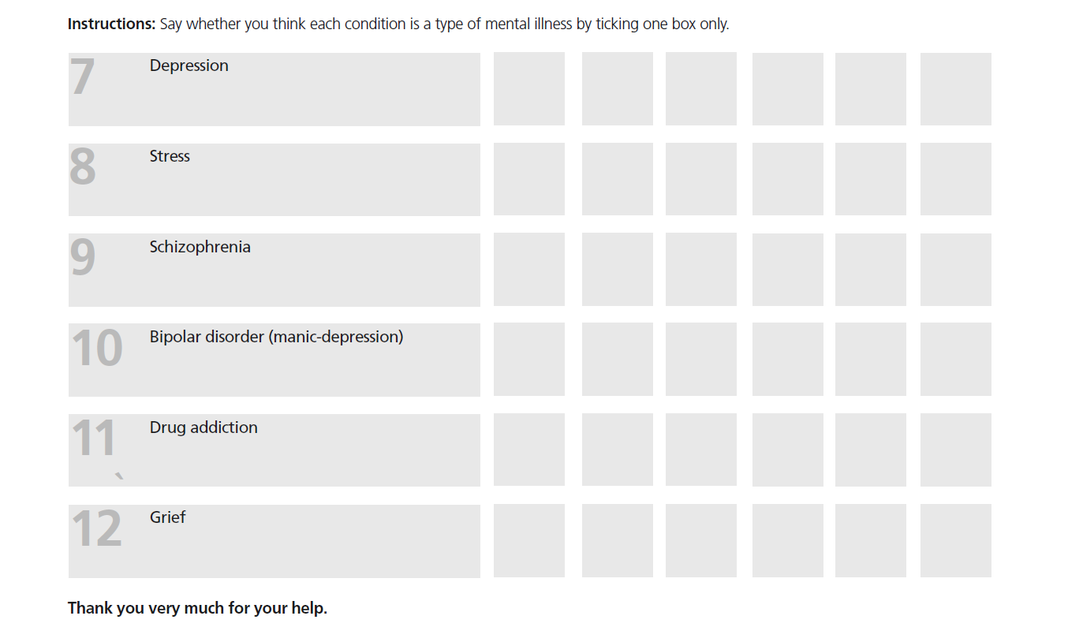

Slide 18
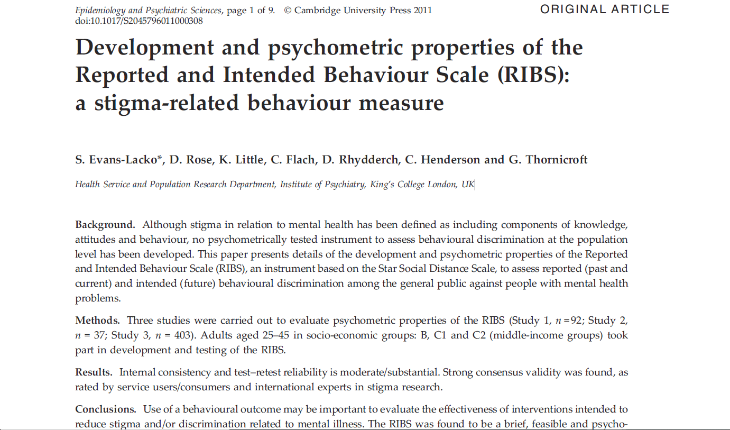

Slide 19
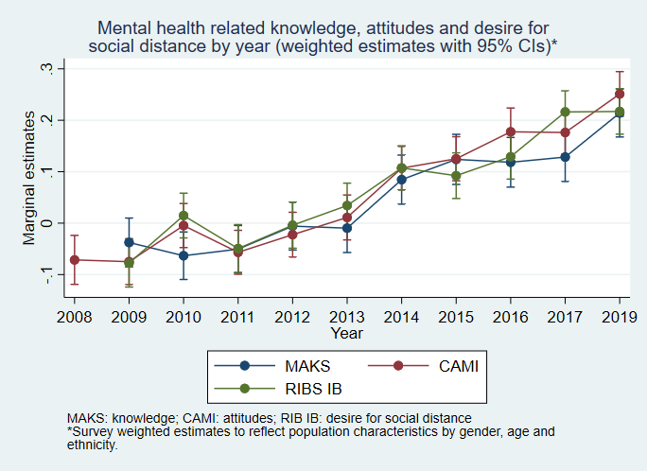
Marginal estimates of stigma related knowledge (MAKS), attitudes (CAMI) and desire for social distance (RIBS intended behaviour) by year (95% CIs)

Slide 20
Cultural adaptation and psychometric evaluation: INDIGO partnership implementing sites MAKS, MICA, RIBS, DISCUS, BACE and more

Slide 21
