Slide 1
Roxanne Keynejad NIHR Clinical Lecturer in General Adult Psychiatry King’s College London
Setting up new networks with Seed Funding

Slide 2
Outline
Seed funding
Activities
Example calls
Example 1: iVAMHN
Example 2: Decolonial GH for ECRs
Lessons learned
Reflections

Slide 3
Seed funding
‘Small’ grants “to seed new initiatives” or “expand existing collaborations”
Often ~£5,000
[KCL] need to be spent by 31st July

Slide 4
Activities
Workshops to develop new research/education projects/ programmes
Research projects to collect pilot data/prepare large grant applications
Designing collaborative modules and online joint teachings
New initiatives with potential to develop long-term partnership collaboration
Esp beyond PI-to-PI collaborations + with wider benefits for King’s internationalisation strategy
Costs of staff/equipment/travel to carry out joint education/research projects

Slide 5
Examples
King’s Global Engagement Partnership Fund
King’s Circle U. Seed Fund: similar activities in collaboration with Aarhus University (Denmark), Humboldt University (Germany), UCLouvain (Belgium), University of Oslo (Norway), University of Belgrade (Serbia), Université Paris Cité (France), University of Pisa (Italy), University of Vienna (Austria) ~£5,000
Circle U. Seed Funding Scheme: €5,000 to €10,000
[Previously] King’s ODA Seed Fund Grants £5,000
Departmental calls
LSHTM?

Slide 6
Example 1: iVAMHN
King’s ODA Seed Fund grant
King’s Global Engagement Partnership Fund (recouped)
Matched funding from Psychology & System Sciences division

Slide 7
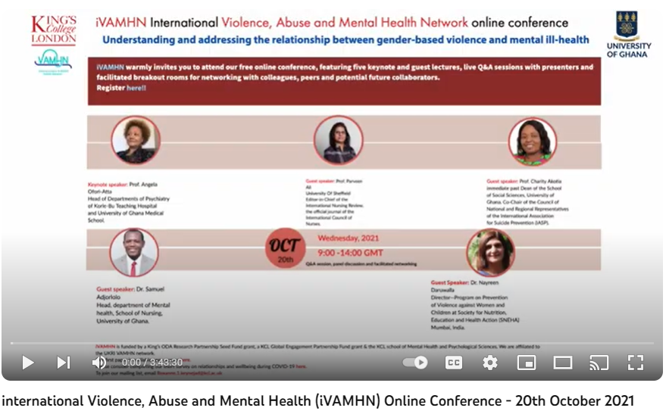
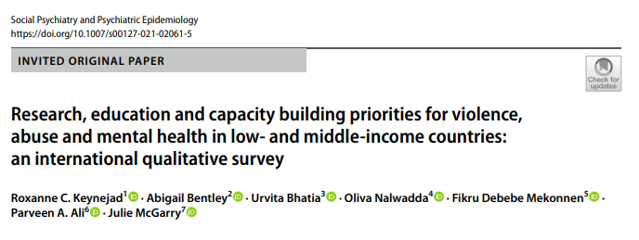
iVAMHN
Oct 2019: In-person conference following iVAMHN meeting, Nottingham (delegates from Uganda, Somaliland, India plus online)
Podcast episode
2020: collaborative online survey
Mar 2021: Paper on research, education, capacity building priorities
Oct 2021: online conference
Nov 2021: video symposium at Shameless! Women of the World Festival

Slide 8
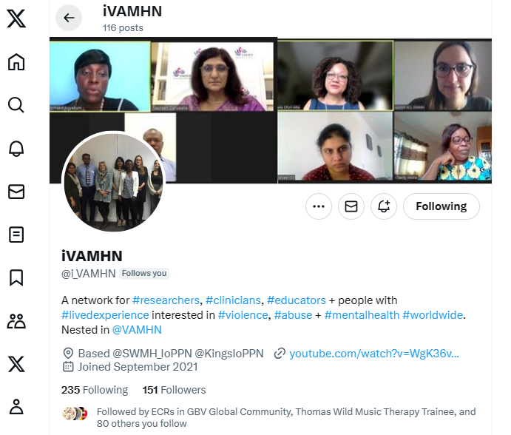
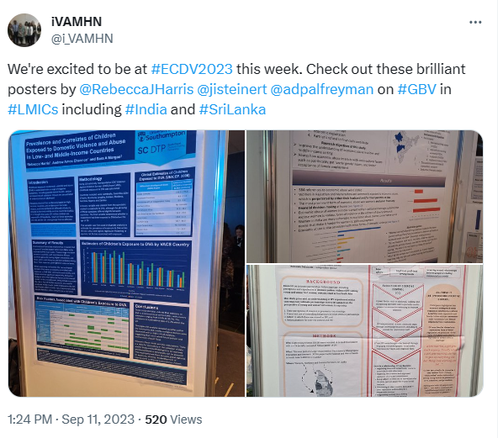
iVAMHN
Sept 2022: symposia at Marcé international conference (speaker from Nepal)
Nov 2022: symposia at international association of Women’s Mental Health conference (speaker from Kenya, Gambia (online))
Mar 2023: online conference
Sept 2023: symposium at European Conference on Domestic Violence (studies from SA, Sri Lanka, Ethiopia)
Newsletters
Twitter…

Slide 9
Lessons from iVAMHN
Small budgets
Value of the entity
Time scales
Barriers to in-person global meetings
Terms of reference
Time commitment
Leadership
Bridging funds

Slide 10
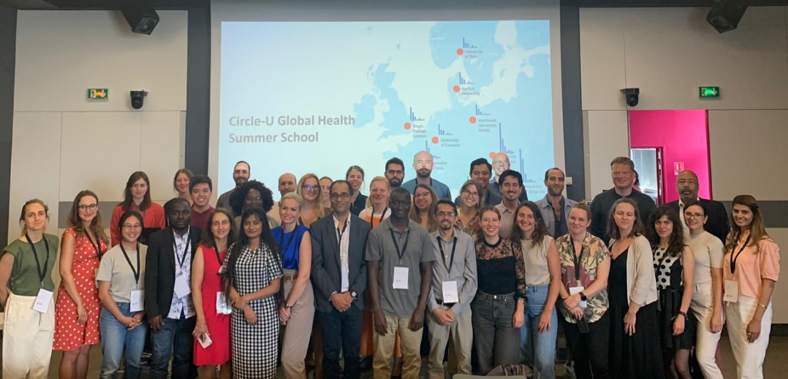
Example 2: Decolonising GH
Rethinking Global Health Summer School 2022
Decolonising global health day
WhatsApp group
Circle U. Seed Fund grant - unsuccessful
King’s Circle U. Seed Fund grant

Slide 11
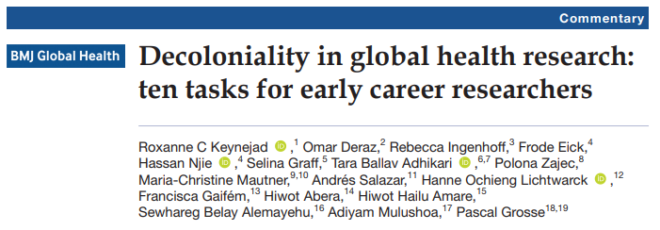
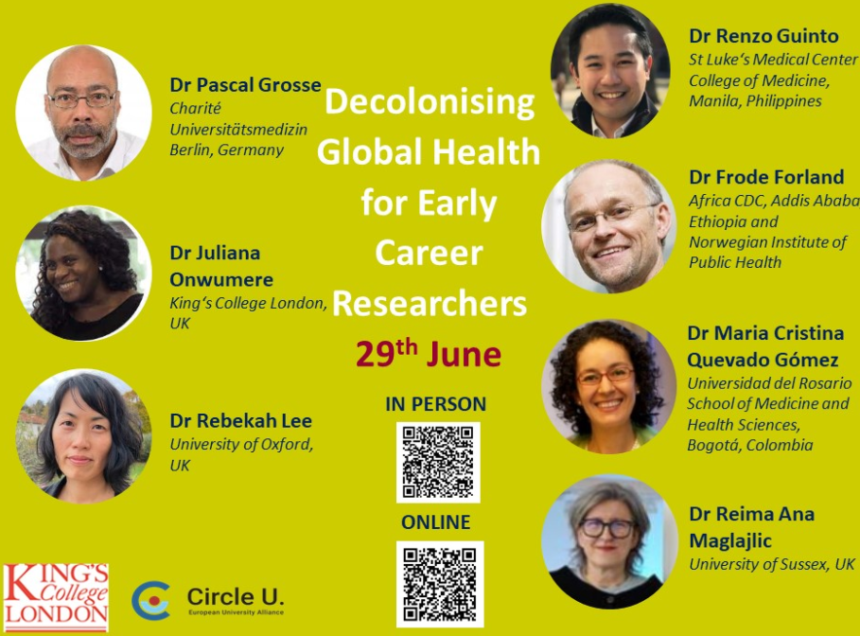
ECRs decolonial MH network
June 2023: Online conference
(delegates from Gambia, Nepal + online)
New members from Ethiopia and ‘23
Summer School
2022-3: Collaborative paper (BMJ GH)
Oct 23: Applied for Circle U Seed Fund
grant to host meeting in Gambia – unsuccessful
Nov 23: podcast episode

Slide 12
Lessons from Decolonial Network
Benefits of in-person meeting
Barriers to global attendance
Shared leadership
Safe space to pursue interest outside primary research focus
Building on international meetings
Grant management
Article processing charges
Leadership transition

Slide 13
Reflections
Transferable skills
Meet authors
Develop network
Collaborate outside city/country/region/continent
Framework for meetings
Support and platform ECRs
Time…

Slide 14
Thank you
Roxanne.1.Keynejad@kcl.ac.uk
@RoxanneKeynejad

