Slide 1
Equitable partnerships for global mental health: Putting your money (and time and energy) where your mouth is
Professor Charlotte Hanlon

Slide 2
Targets speak of global partnerships for sustainable development that are:
‘mutually agreed’, ‘equitable’, ‘multi-sectoral’, ‘civil society’, ‘north-south’, ‘south-south’, ‘triangular’, ‘sharing’,

Slide 3
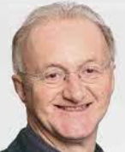
‘Shifting the balance of power’
HICs → LMICs
Narrow biomedical → community, broader psychosocial

Slide 4
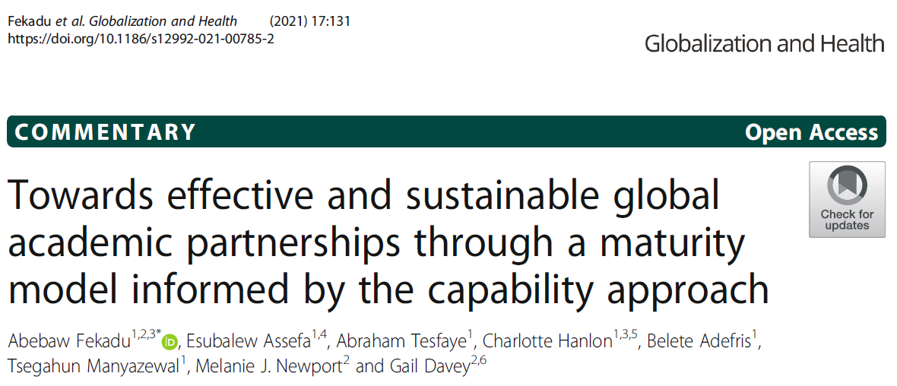
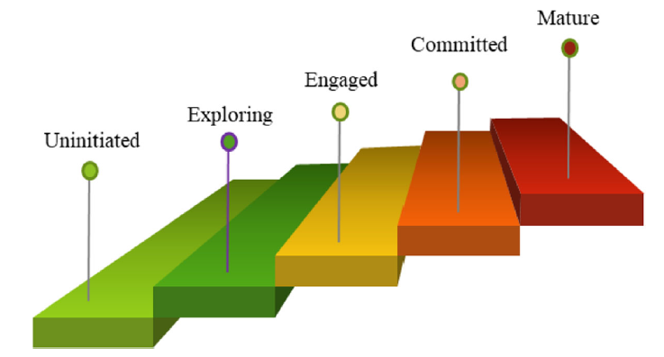
Increasing levels of freedom, equity, diversity, and agency afforded to partners
Anchored in mutual learning, empowerment, and autonomy

Slide 5
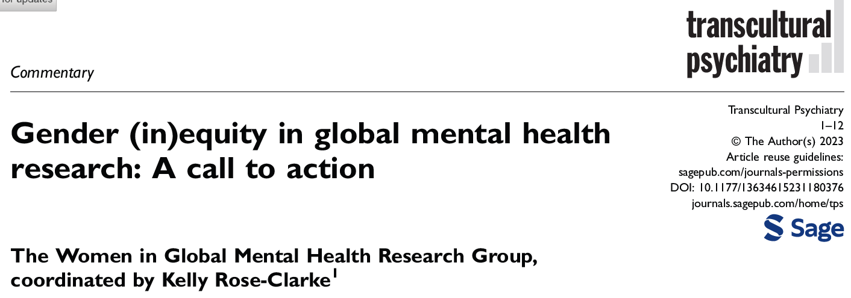
Ensuring mutual, fairly distributed benefits
Between HIC and LMIC partners
Chibanda et al.
And within LMIC partners

Slide 6
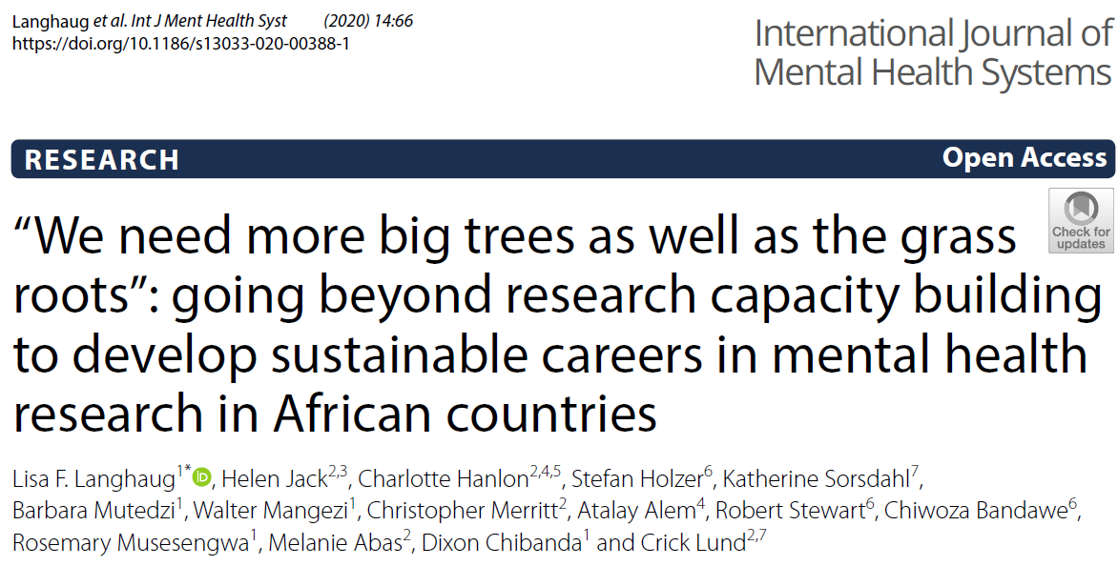
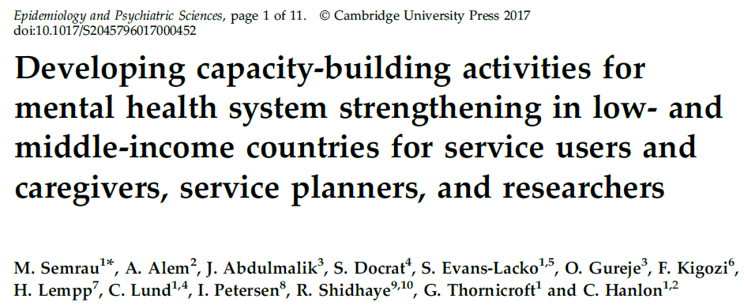
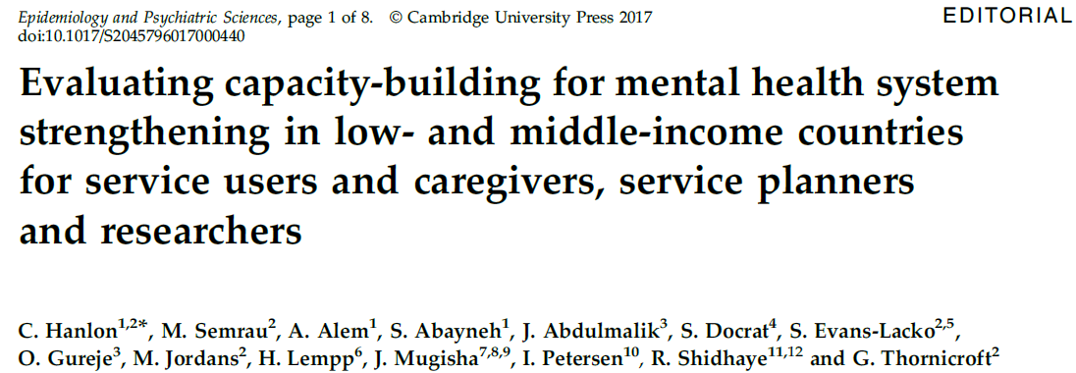
Developing capacity where it is needed
Responsive to needs
2-way
Long-term
Sustainable
Accountable

Slide 7
King’s College London-Addis Ababa University partnership
22 years on…

Slide 8
Addis Ababa University PhD programme Mental Health Epidemiology
Started in 2011; 17 graduates (4 women)
50 enrolled; 15 withdrawals (1 woman)
35 completed or on programme (17 women)

Slide 9
Addis Ababa University PhD programme in Mental Health Epidemiology
Of 34 completed/on programme:
21 nested in KCL projects
24 supervised by KCL academics
Programme established by KCL academic
KCL support for short courses co-run with Ethiopian colleagues

Slide 10
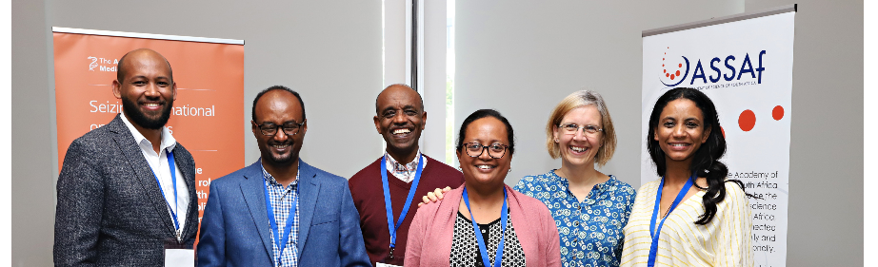
Career pipelines & sustainability
6 post-doctoral fellows – all linked to KCL projects
2 PhD graduates now faculty at AAU, 1 in WHO office
1 NIHR GH group co-led with senior Ethiopian academic
PhD programme co-led by Ethiopian academic
Creative commons licence for training materials

Slide 11
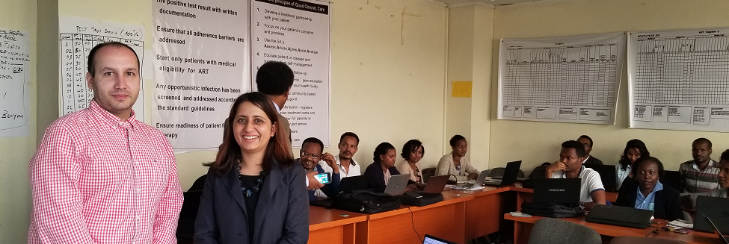
2-way benefits
Graduates published 54 papers linked directly to PhD
Contribute to KCL MSc
Link to KCL PhD students
Vibrant experience for KCL students in Ethiopia
Expands networks and grant opportunities for both
Better science, more productive collaborations

Slide 12
Equitable partnerships involving people with lived experience
Research subject
Participatory research & intervention development
Research co-I
Peer researchers
Leading research projects
Lived experience advisory group
Empowerment, engagement and ecosystem

Slide 13
Intentional structures and processes
Co-leads for work packages
Sharing the chairing
Supporting ECRs to publish, get grants
Women in leadership positions

Slide 14
What is needed next
Long-term, reliable commitment
Recognition of 2-way benefits
Making capacity-building integral to work
Shifting role of HIC universities
Building excellence in Africa-based training
Notes:
Africa-based PhD programmes should not be seen as a threat to HICs – benefit to everyone. Need for external supervisors.

Slide 15
Thank you

