Slide 1
Mental health care research in 2024: Three priorities for the next decade Prof Sonia Johnson Professor of Social & Community Psychiatry, University College London Director, NIHR Policy Research Unit for England
DIVISION of Psychiatry

Slide 2
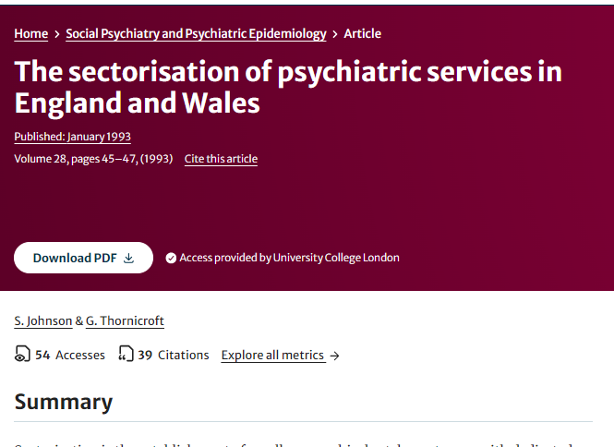
Division of psychiatry

Slide 3
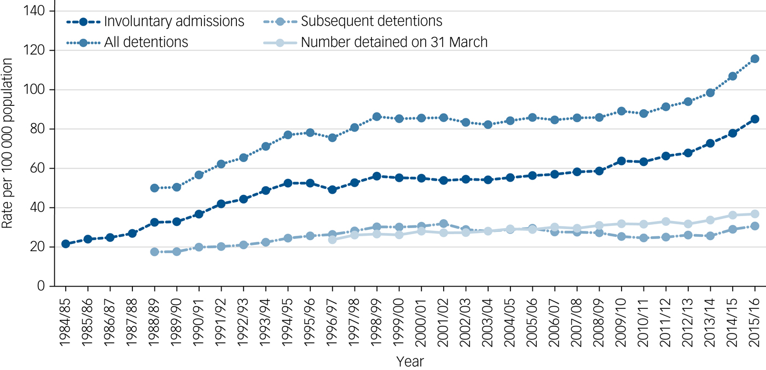
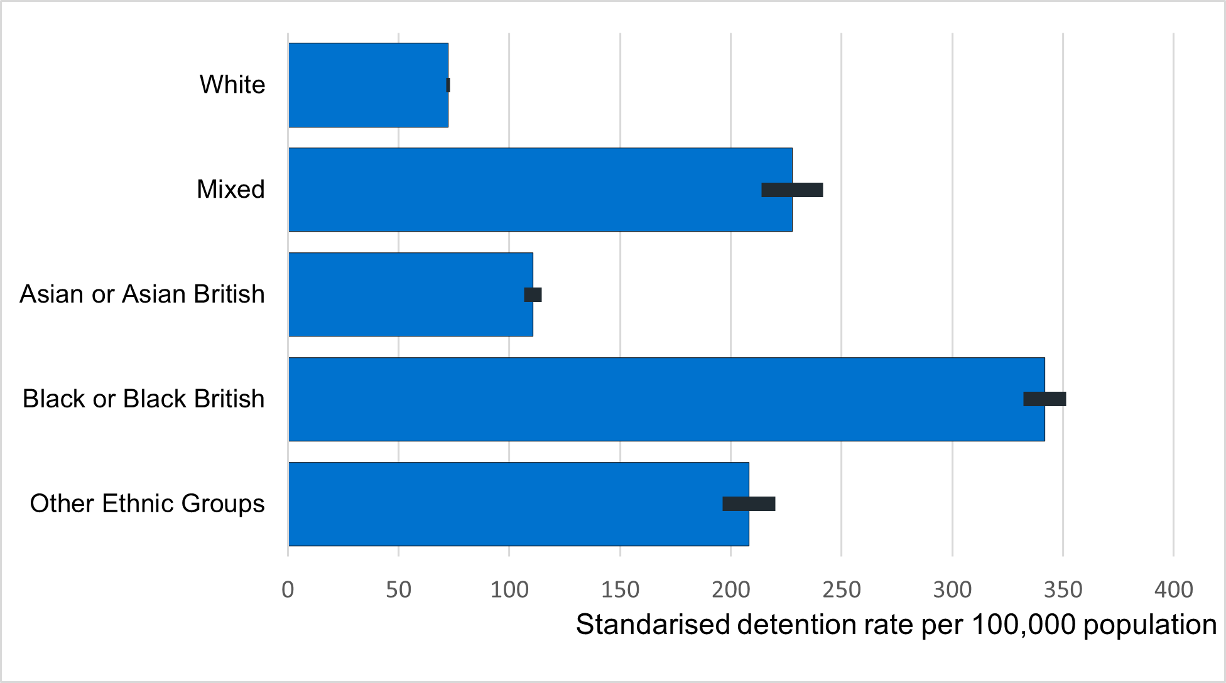
Three priorities for the next decade Priority 1: Find out how to make large reductions in compulsory admission rates and ethnic disparities
Keown et al. 2018
NHS Digital

Slide 4
Division of psychiatry
- Considerable work on admission alternatives over last century….
- But usually only voluntary admission
- Compulsory admission: at odds with accepted principles of collaboration &consent
- Ethnic inequalities suggest severe injustice
BUT
- Very few intervention studies (19 with compulsory admission as outcome in 2018)
- Absence of testing of strategies tailored to frequently detained minorities
Thus an ethical imperative for research
-

Slide 5
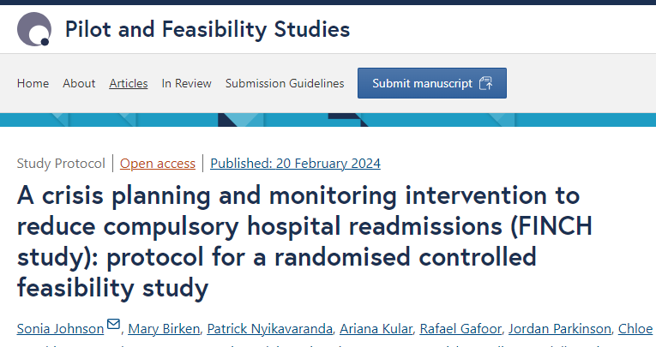
Division of Psychiatry
Crisis planning to prevent compulsory admission
Interventions involving crisis planning/strengthened self-management best so far – but evidence not strong or consistent
Service users and carers report little attention to crisis planning/preventive interventions after discharge
FINCH study: co-production and feasibility trial of a crisis planning and monitoring intervention to reduce repeat detention

Slide 6
Priority 2: Implement and test the “social cure”
- A century’s knowledge about social influences on mental health….
- But very few NICE recommendations for social interventions (employment in psychosis; peer support and social prescribing in depression)
- Tensions:
- activism and attending to structural determinants vs. individual approaches
- letting organic community approaches flourish vs. evidence gathering
BUT evidence brings resources, service users favour social interventions

Slide 7
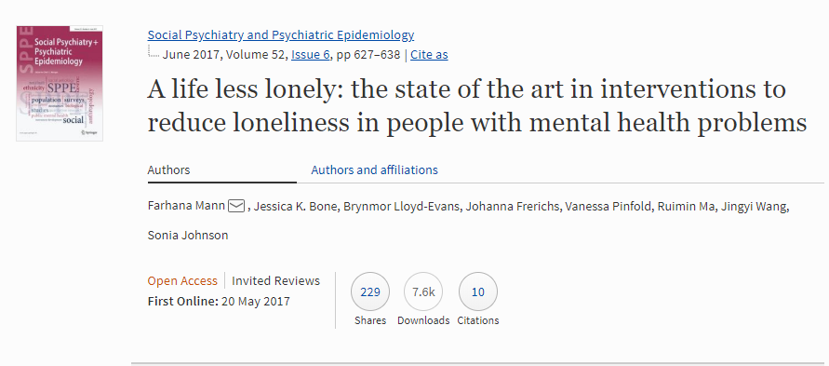
Loneliness as a target for mental health interventions
- Subjectively distressing lack of connection to others (emotional or social)
- Associated with most mental health conditions (especially depression, perinatal conditions, “personality disorder”)
- Drivers in mental health include: mental health symptoms, stigma, social deprivation, withdrawing to protect self and others
- Psychological, social and community approaches to intervention

Slide 8
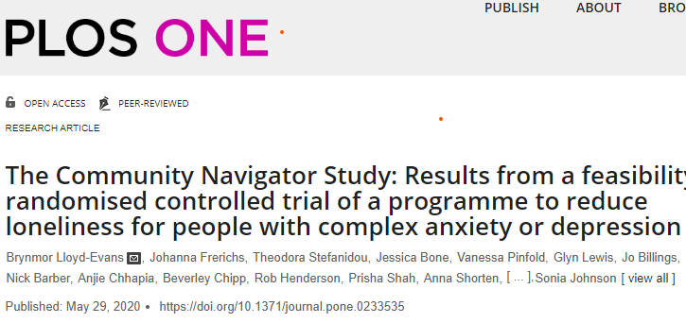
Community navigator study
Community navigator intervention over 8 months for people with treatment-resistant depression
Reinforcing positive social identities, developing valued connections
Promising feasibility randomised controlled trial
Currently: full multicentre randomised trial (NIHR HTA)

Slide 9
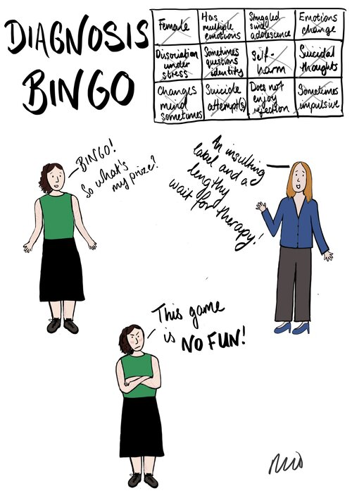
Priority 3: Justice for people with a “personality disorder” diagnosis
Currently:
- Unparallelled stigma from professionals outside specialised services
- Highly disjointed pathways with frequent ejections from services, denial of treatment and support
- Research mainly confined to hard to access psychotherapies focused on reducing self-harm
©Rachel Rowan Olive

Slide 10
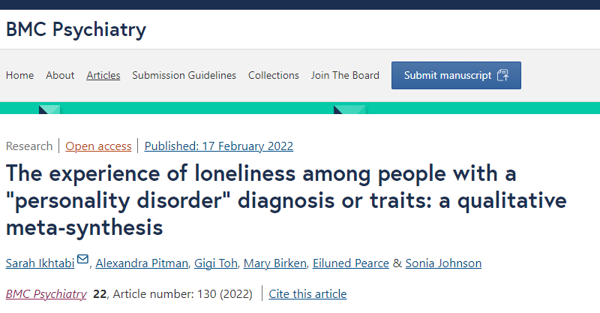
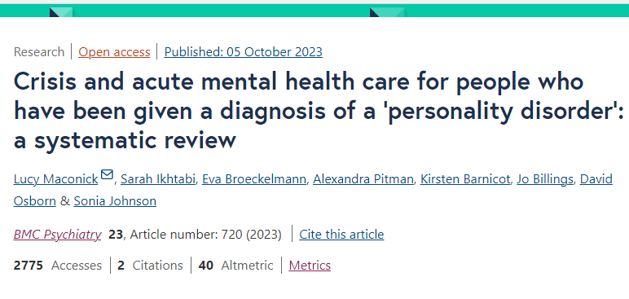
Some key research gaps
- What terminology is acceptable and useful, potentially replacing “personality disorder”?
- How can the quality of acute and crisis care be radically improved?
- How can social needs of people with a “personality disorder” diagnosis be addressed?
- How can stigma be addressed, especially from professionals?
- How can people with a “personality disorder” diagnosis be supported as parents?

Slide 11
In conclusion…
- Travelling back towards locally based care, integration with primary and community organisations, lack of focus on diagnosis: back to the 90s in mental health?
- Essential not to lose track of people with severe needs, who may be stigmatised and excluded by communities.
- Mental health care still too often distressingly poor, especially in acute settings: research needs to help address worst inequalities and injustices

