Slide 1
Health Systems Strengthening
Applied Research for Child Health
Ingrid Wolfe
March 2024

Slide 2
Child survival in high-income settings
UK compared with Sweden
potentially avoidable child mortality: 1,951 per year
5 children per day
132,874 person-years of life
Wolfe, Lancet 2013
Notes:
What’s going on in the UK?

Slide 3
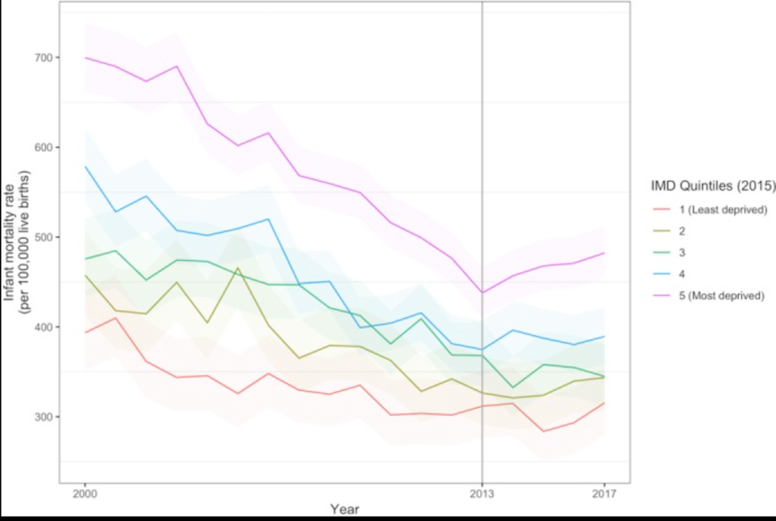
Infant mortality & deprivation
Taylor-Robinson D,et al. BMJ Open. 2019
One quarter of all deaths under the age of 1 could be avoided if all births had the same level of risk as those to women with the lowest level of deprivation.
The Marmot Review, 10 years on. Feb 2020

Slide 4
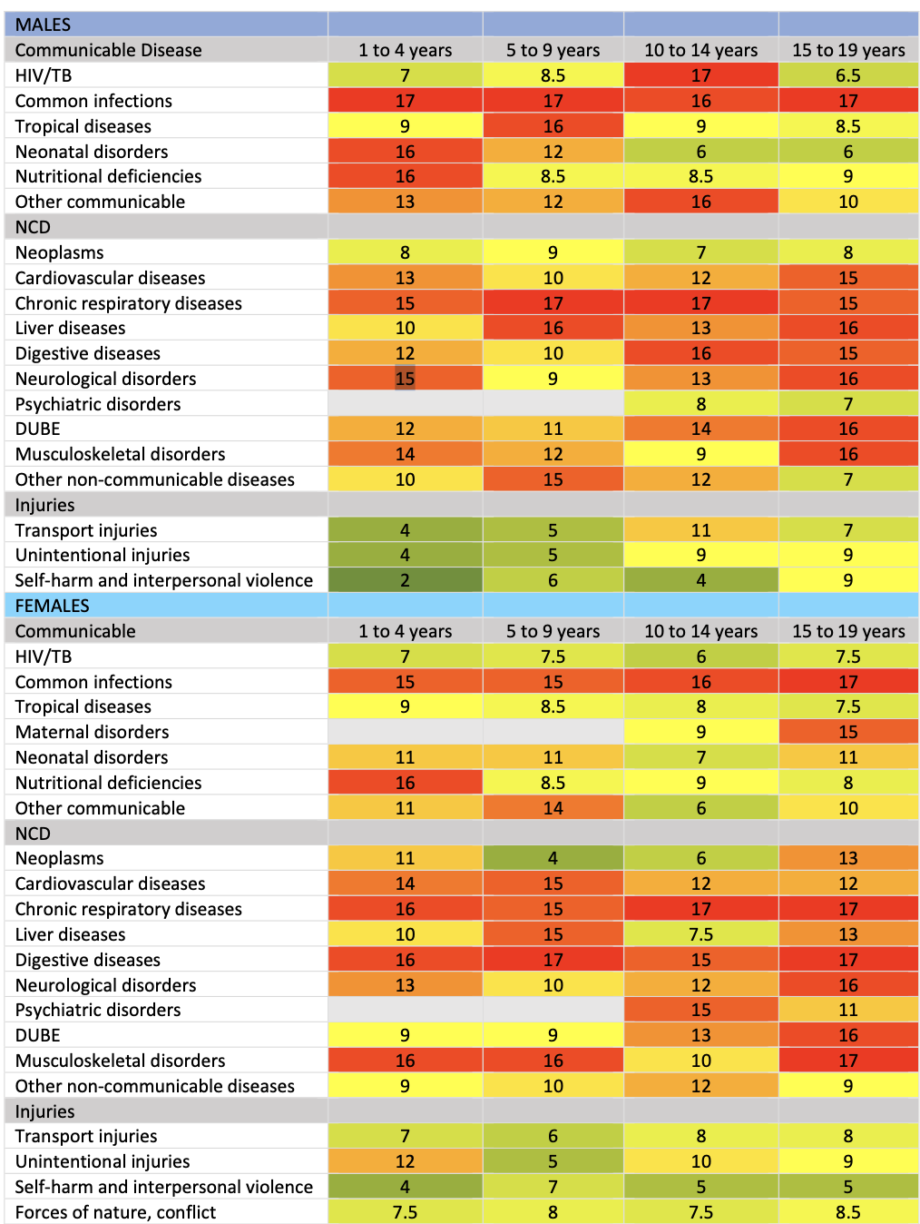
Cause-specific mortality rank UK v EU15+
The UK had significantly higher mortality for
Common infections
Chronic respiratory conditions
Liver diseases
Neurological disorders
The UK had significantly lower mortality for
Transport injuries
RCPCH State of Child Health
Child health in 2030 in England: comparisons with other wealthy countries, 2012-22

Slide 5
What’s going wrong?
“Britain is failing its young children
on a grand scale”
Why?
What should we do about it?
Notes:
Applied health research

Slide 6
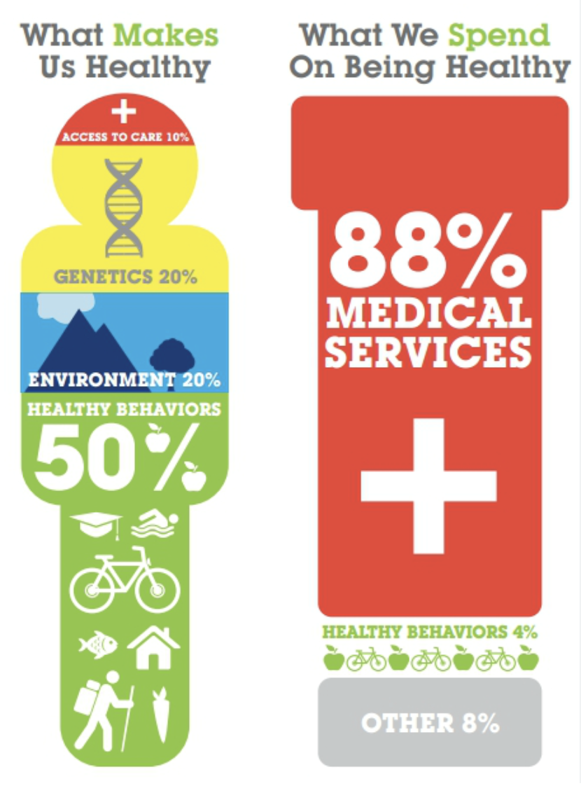
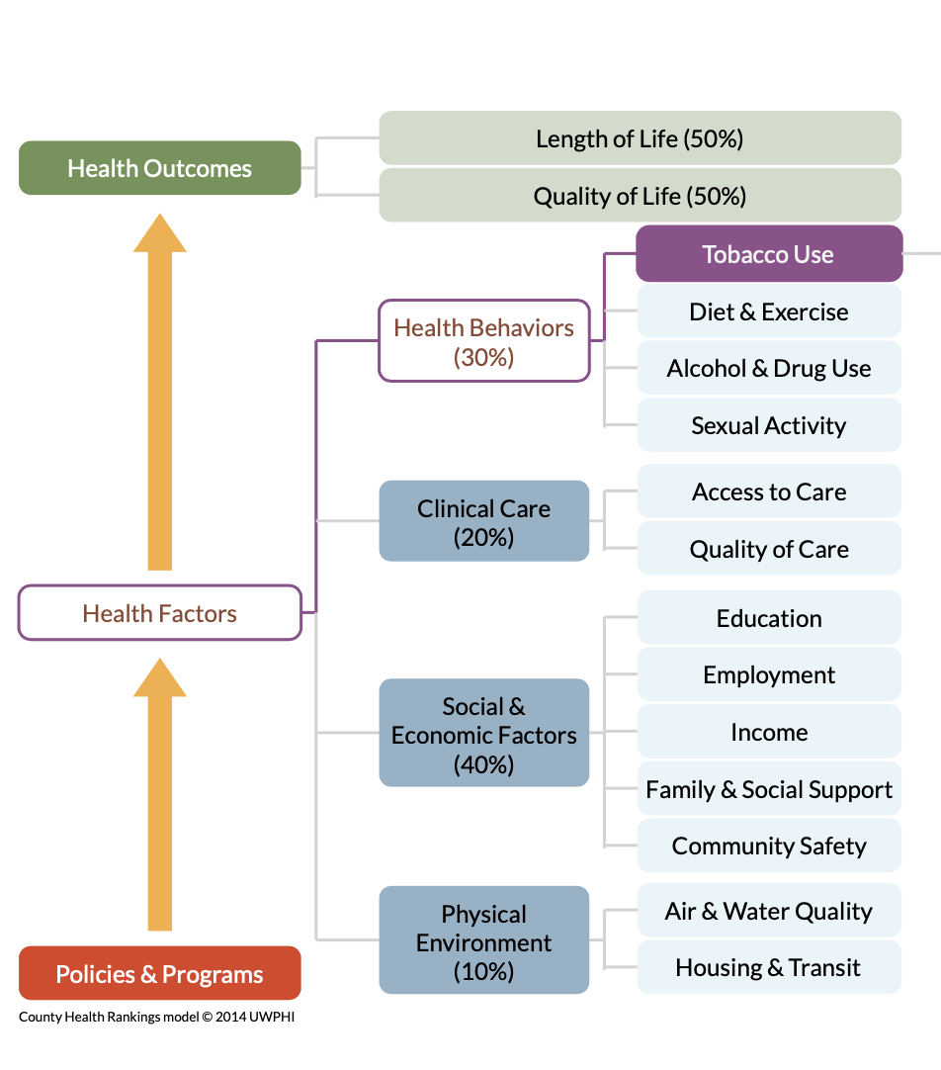
An approach to understanding
77% of the excess risk of death in England relative to Sweden is explained by distribution of birth characteristics.
A further 3% was explained by socioeconomic factors, over and above their effect on birth characteristics.
Zylbersztejn et al.
The Lancet 2018
Notes:
Are we asking the right question?
Either/or vs both/and
The widespread understanding of the importance of social determinants of health has led to a unhelpfully narrow even defeatist perspective
Considering how to improve?: Causality, sphere of influence, opportunity for intervention
impact, timing, and the political cycle

Slide 7
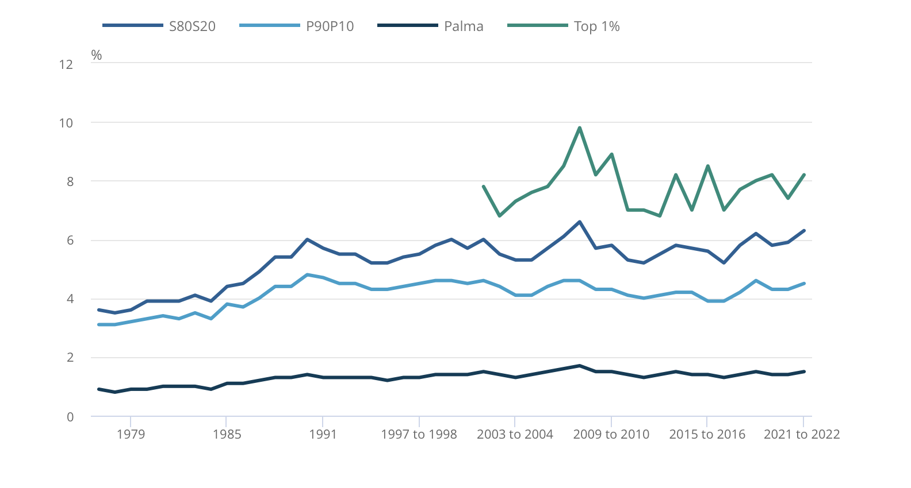
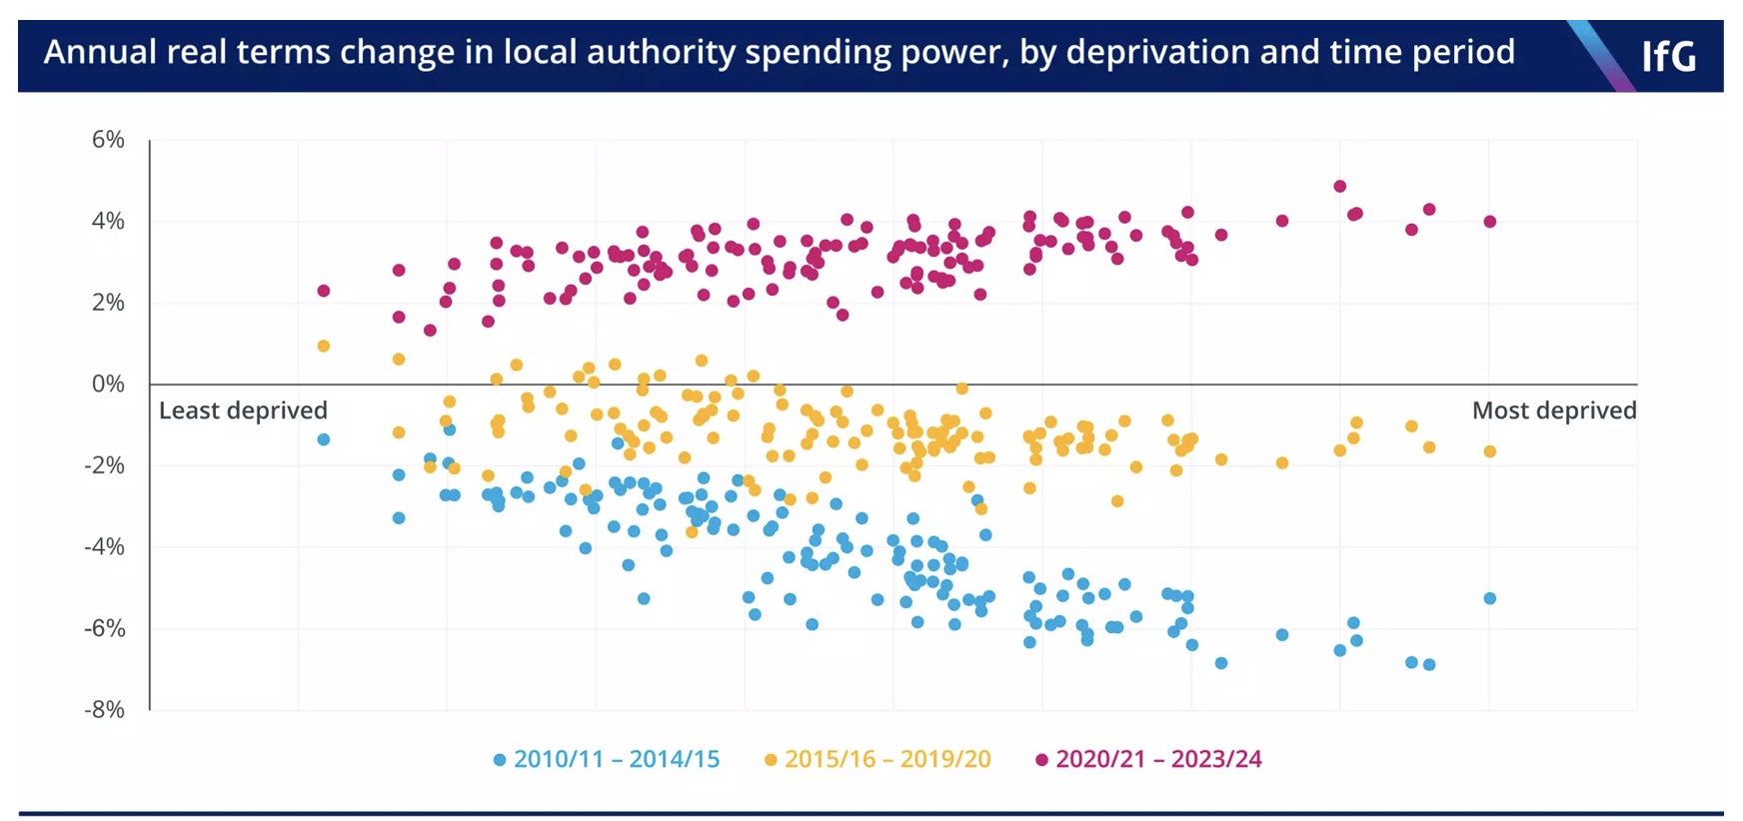
Opportunities for solving big problems
ONS statistical bulletin 25 2023
Household income inequality, UK: financial year ending 2022
More local authority bankruptcies
in 2023 than the 30 years before 2018
IfG 21.12.23
Public health funding down 27% per person, since 2015.
BMJ 17.2.24

Slide 8
A false dichotomy

Slide 9
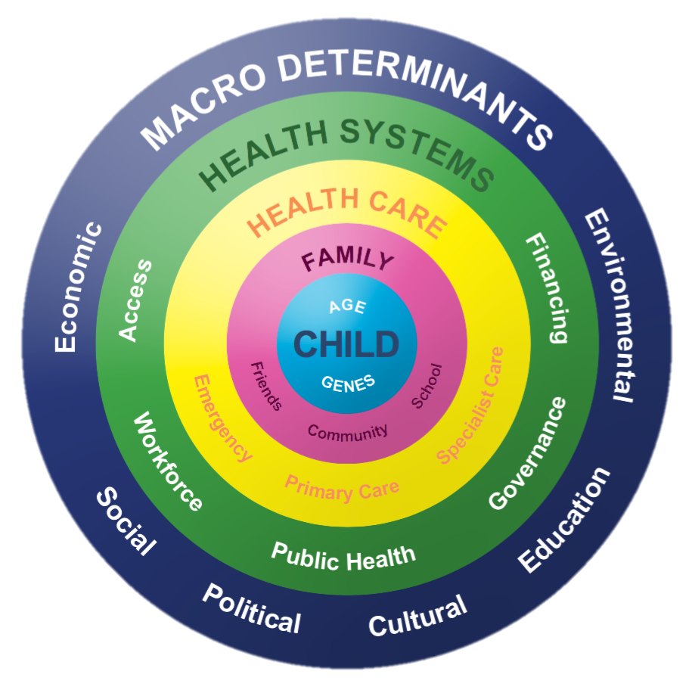
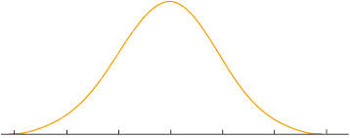
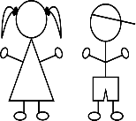
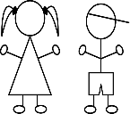
Causality and opportunity for intervention
Causality
poverty and inequalities manifests in increased risk and prevalence of disease, and reduced access to care.
Prevention paradox
Improving access to early intervention and care for large numbers of children with common problems
Notes:
Where is our sphere of influence?
How can we improve outcomes at scale?

Slide 10
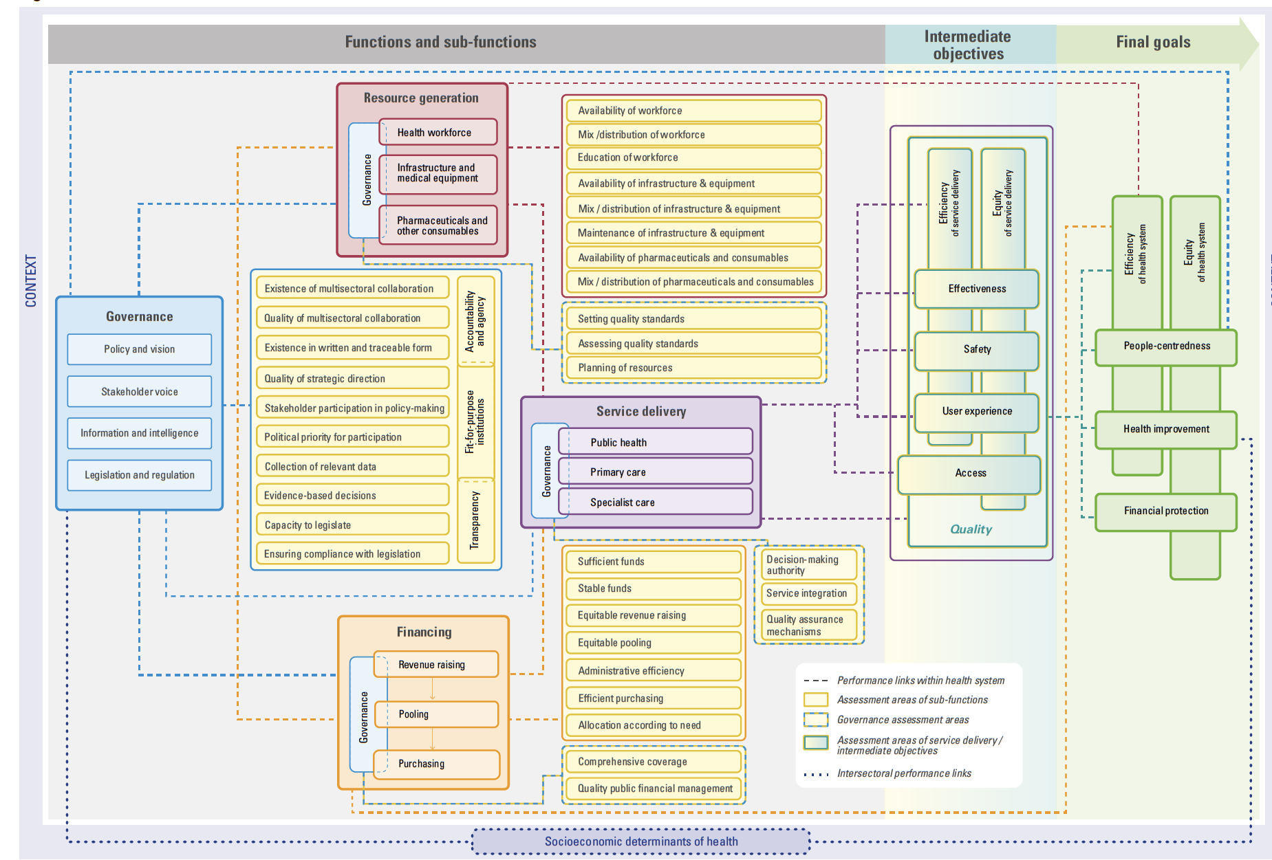
CHILDS applied research group
Health system strengthening as an opportunity
for improving outcomes, at scale.

Slide 11
CYPHP: the Children and Young People’s Health Partnership

Slide 12
A platform for local child health
Pragmatic cluster RCT
Purpose: to build the evidence base
Design: cRCT n=97,970 (<16y),
70 GP practices, 2 hospitals, 2 London boroughs, 2018-2021
Service Evaluation
Purpose: impact reporting and continuous improvement
Design: before-after, quasi-experimental

Slide 13
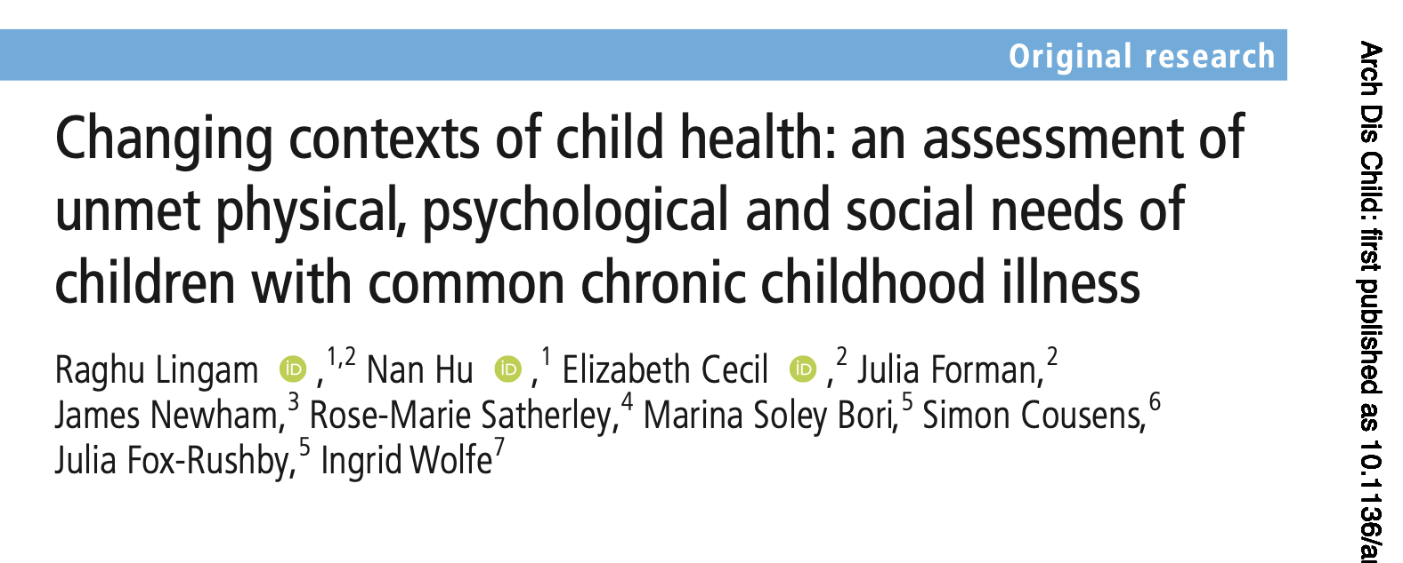
Cluster RCT and nested studies
RCT: 97,970 children in 70 practices, randomized to 11 intervention, 12 enhanced usual care clusters
1ry outcomes:
Non-elective admissions: no effect at population level.
IRR 1.00 (95%CI=0.91 to 1.10)
Paediatric quality of life at 6/12: no effect among children with tracer conditions
Adjusted mean difference= -0.33 (95%CI=-0.122 to 0.055)
2ry outcomes:
Eczema symptoms at 6/12=significantly increased adjusted mean difference=-1.37 (95%CI=-2.630 to -0.122)
Quality of asthma care significantly improved
Spacer prescription OR 1.53; 95% CI 1.03 - 2.25
Asthma action plan OR 3.67; 95% CI 2.44 - 5.51
Asthma control test OR 3.03; 95%CI 1.91-4.81)
Baseline assessment
56% of children with a LTC had unmet need for physical healthcare (n=7779)
78% had unmet bio/psycho/social needs (n=5554)
85% increased risk clinically important mental health needs among children with uncontrolled asthma
Identifying and delivering care for children with unmet needs is an important part of the potential for this model
Process evaluation:
26% coverage of local child health clinics and
3% coverage for targeted early intervention
likely too early for measuring impact
Satherley et al., under review
Health economics
Not cost effective at 6/12 (NHS/PSS perspectives)
Trends towards cost-effectiveness at longer time points
Soley-bori et al, Lancet Regional Health pending

Slide 14
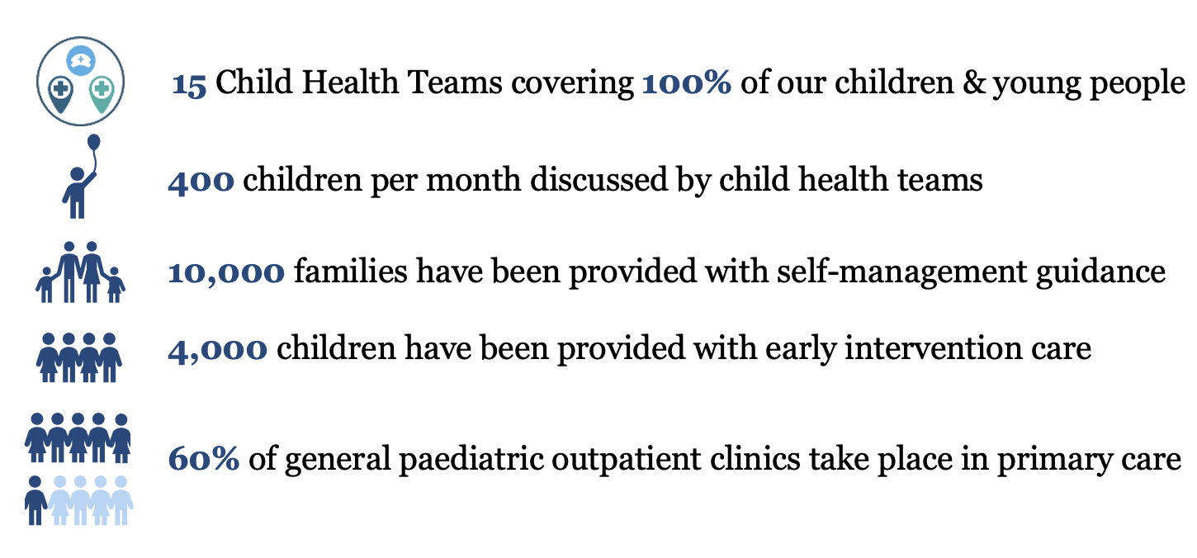
Service evaluation: embedding continues

Slide 15
CHILDS applied research platform
Key & project description
Key & project description
Finances
Finances
Finances
Finances
Housing
Local child health teams
Housing
Housing
Housing
Mental Health plus
Mental wellbeing
Early intervention care
Mental wellbeing
Mental wellbeing
Equipment
Mental wellbeing
Equipment
Equipment
Equipment
TEAMcare trial – technology enhanced asthma care
INSPIRE study (ARC) - identifying children at risk of low school readiness
Physical health
Physical health
Physical health
School/
nursery
Physical health
School/
nursery
School/
nursery
School/
nursery
INCLUDE study (ARC) – interventions for children with complex needs (incl family support worker)
ORACLE study – improving support for children with adverse childhood experiences (ACEs)
Social
Social
Social
Social

Slide 16
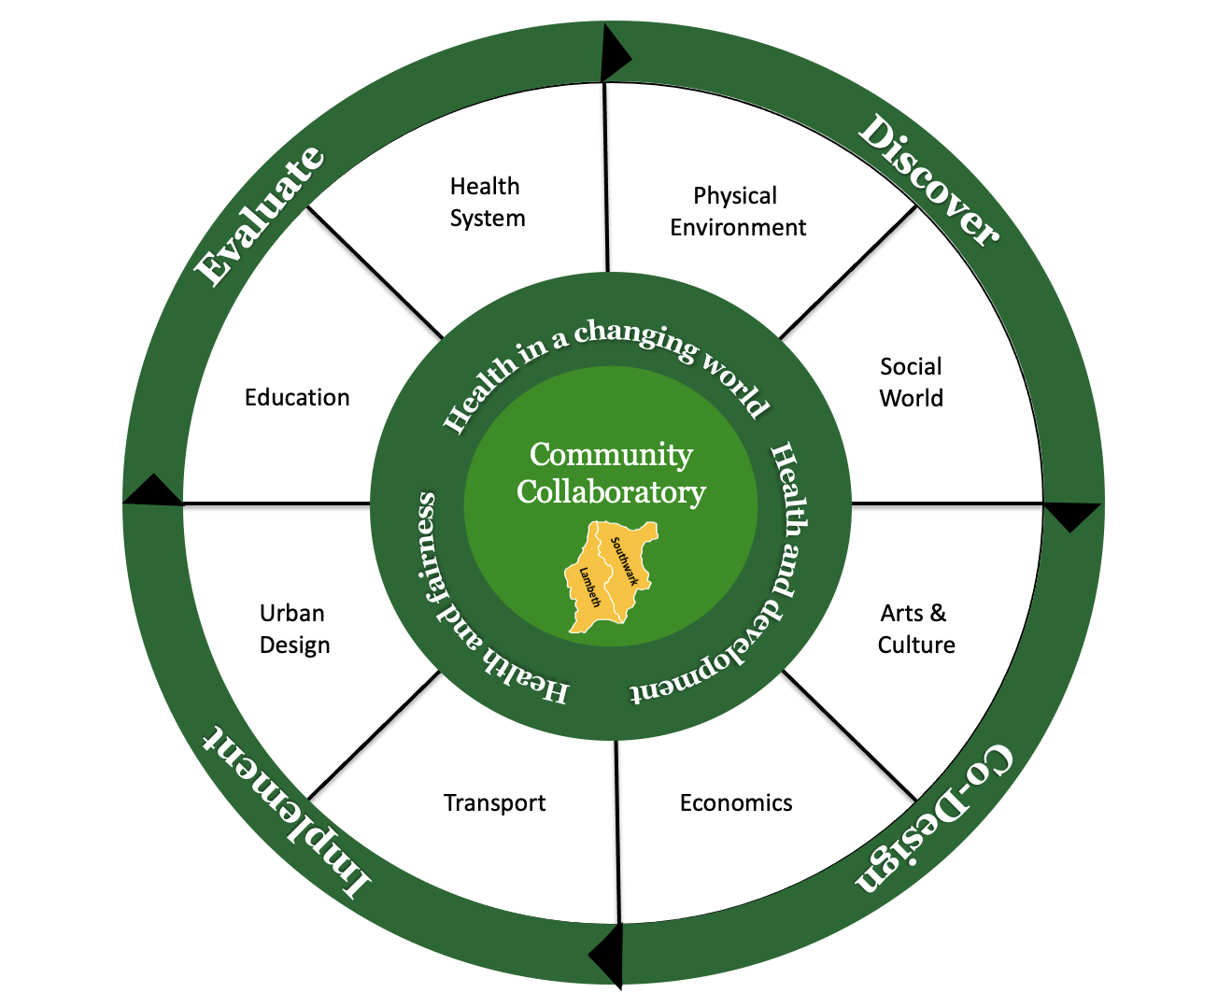
Act Early South London: research consortium
Co-production
Evaluation framework
Data tapestry
Knowledge exchange

Slide 17
Article 6: Right to life
Article 24: Right to the highest standard of healthcare
Article 27: Right to a standard of living adequate for physical, mental, spiritual, moral, and social development

Slide 18
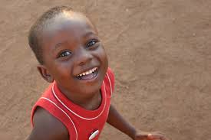
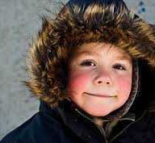
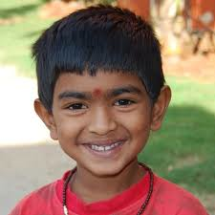
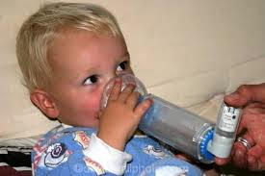
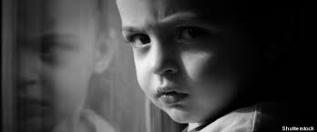
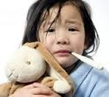
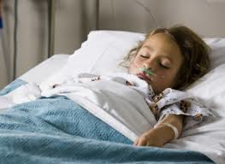
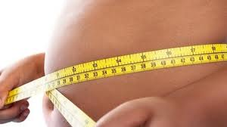
Thank you!

